Slide 1
OptiSystem-MATLAB data interchange model and features

Slide 2
Optical signal data format (1)
Signal type | Data elements | Comments
Sampled | InputPort1.Sampled.Signal | Represents the complex envelope of the optical signal (real/imag) – 1xn complex double If there are two polarization states, two rows will be created (2xn complex double)
 | InputPort1.Sampled.Time Inputport1.Sampled.Frequency | The time/frequency sampling points for the sampled optical signal (s or Hz) If the parameter Sampled signal domain = “Time”, use InputPort1.Sampled.Time If the parameter Sampled signal domain = “Frequency”, use InputPort1.Sampled.Frequency
 | InputPort1.Sampled.CentralFrequency | The center frequency (Hz) of the optical signal
Sampled (Channels) | InputPort1.Channels | List of wavelength channels entering specified port To access data for a sampled signal (Channel A), use InputPort1.Sampled(A).Signal, etc. To access data for a parameterized signal (Channel A), use InputPort1.Parameterized.Power(A), etc.
Sampled (Spatial) | InputPort1.Sampled.Spatial.ModeX.Amplitude | Real or complex amplitude of spatial mode(s) – nxn array Note 1: To access Y polarization data, use ModeY in lieu of ModeX Note 2: If more then one mode is present, separate sampled signals will be created for each mode and can be accessed as follows (for Mode A): InputPort1.Sampled(A).Spatial.ModeX.Amplitude
 | InputPort1.Sampled.Spatial.ModeX.Properties | String value (describes mode type and index)
 | InputPort1.Sampled.Spatial.ModeX.DeltaSpaceX InputPort1.Sampled.Spatial.ModeX.DeltaFrequencyX | X-polarization: Discretization in space (m) or discretization in frequency (1/m)
 | InputPort1.Sampled.Spatial.ModeX.DeltaSpaceY InputPort1.Sampled.Spatial.ModeX.DeltaFrequencyY | Y-polarization: Discretization in space (m) or discretization in frequency (1/m)
Parameterized | InputPort1.Parameterized.Power | Average power of parameterized optical signal (W)
 | InputPort1.Parameterized.Frequency | Central frequency of parameterized optical signal
 | InputPort1.Parameterized.SplittingRatio | Polarization splitting ratio of parameterized optical signal
 | InputPort1.Parameterized.Phase | Phase of parameterized optical signal

Slide 3
Optical signal data format (2)
Signal type | Data elements | Comments
Noise | InputPort1.Noise.Power | Average power of each noise bin (W)
 | InputPort1.Noise.LowerFrequency; | Lower frequency range of each noise bin (Hz)
 | InputPort1.Noise.UpperFrequency; | Upper frequency range of each noise bin (Hz)
 | InputPort1.Noise.Phase | Phase of each noise bin (Hz)
Individual sample | InputPort1.IndividualSample | Represents the complex amplitude of the optical signal for a single sampling point

Slide 4
Electrical & Binary/M-ary data formats
Electrical
Signal type | Data elements | Comments
Sampled | InputPort1.Sampled.Signal | Represents the electrical signal sampled waveform (real/imag) – 1xn complex double
 | InputPort1.Sampled.Time Inputport1.Sampled.Frequency | The time/frequency sampling points for the sampled electrical signal (s or Hz) If the parameter Sampled signal domain = “Time”, use InputPort1.Sampled.Time If the parameter Sampled signal domain = “Frequency”, use InputPort1.Sampled.Frequency
Noise | InputPort1.Noise.Signal | Represents the electrical noise sampled waveform (real/imag) – 1xn complex double Note: If the noise is combined with the sampled signal (before the MATLAB Component) these arrays will be empty (zero values)
 | InputPort1.Noise.Time Inputport1.Noise.Frequency | The time/frequency sampling points for the sampled electrical noise (s or Hz) If the parameter Sampled signal domain = “Time”, use InputPort1.Noise.Time If the parameter Sampled signal domain = “Frequency”, use InputPort1.Noise.Frequency
Individual sample | InputPort1.IndividualSample | Represents the amplitude of the electrical and noise signal for a single sampling point
Binary & M-ary
Signal type | Data elements | Comments
Binary | InputPort1.Sequence | Represents the sequence of binary bits (0’s and 1’s)
 | InputPort1.BitRate | Bit rate of binary sequence (1/s)
M-ary | InputPort1.Sequence | Represents the sequence of M-ary symbols – 1xn double
 | InputPort1.BitRate | Sample rate of M-ary sequence (1/s)

Slide 5
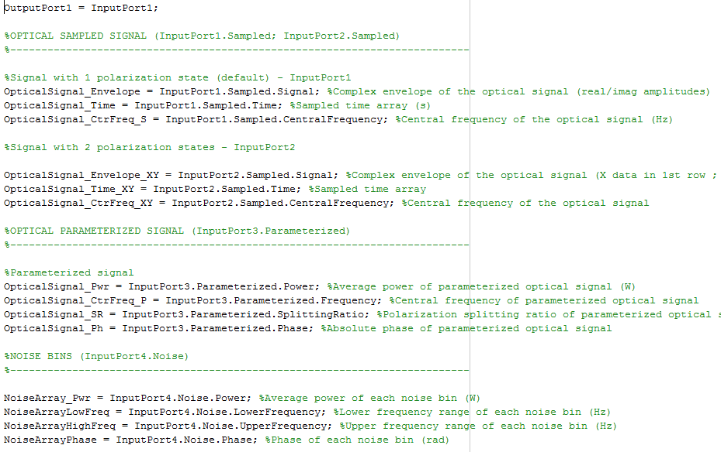
MATLAB m-file example (OpticalData.m)
The data structure of any input port can be equated to any output port as long as they are the same type (optical, electrical, m-ary, binary)
Ports are accessed using the nomenclature InputPort1, InputPort2, etc.
OpticalData.m
Variables on left are local to the MATLAB workspace.

Slide 6
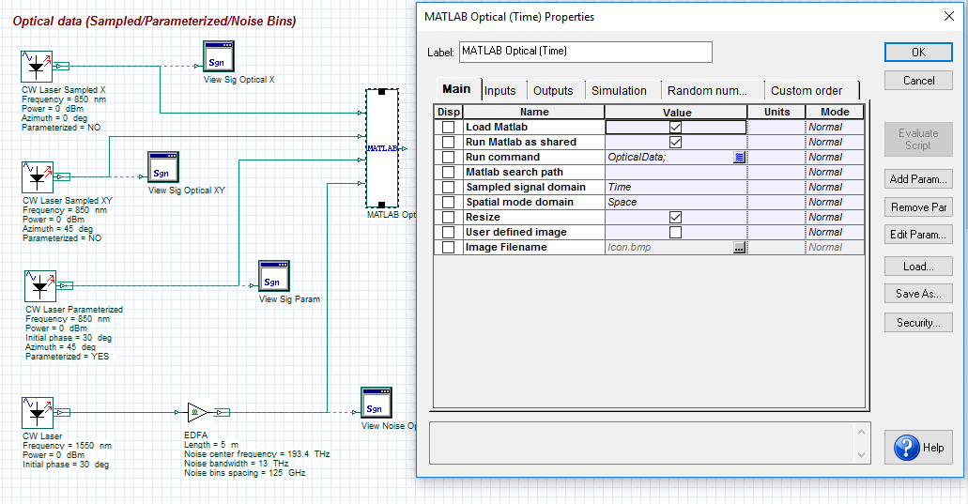
Accessing the MATLAB workspace
The data structure for all input and output ports and all variables declared within the MATLAB m-file can be viewed from the MATLAB workspace
To access the workspace, first select Load MATLAB from the MATLAB Component and select OK. This action pre-loads MATLAB (it will stay open unless it is manually closed)
After running a simulation, open the MATLAB Command Window and type “workspace”.
Load Matlab parameter
After completion of the simulation, type workspace + Enter to access the data structure for all signals and variables

Slide 7
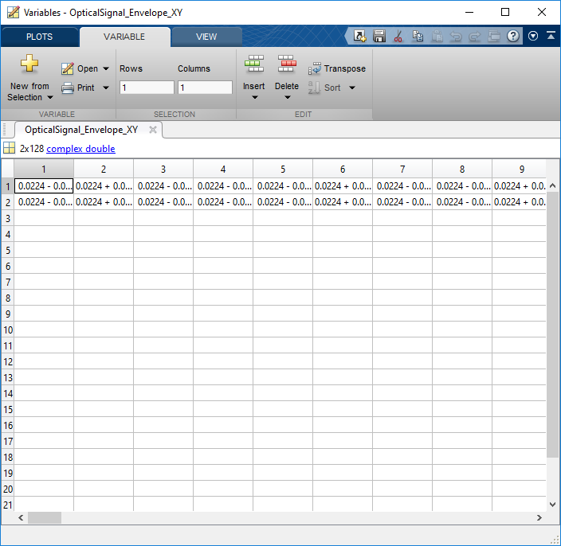
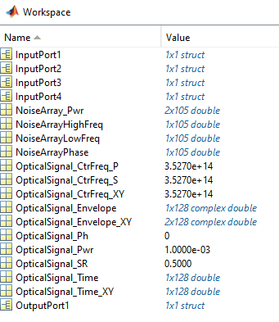
Example of workspace for Optical_Data.osd
To view further details on a data structure, double left click on any variable to open up the Variables window
Data structure for input ports
Size and type of data
The detailed data structure and contents for the variable OpticalSignal_Envelope_XY. This example shows the sampled complex amplitude of an optical signal envelope with X (first row) and Y (2nd row) polarization data
Data structure for output ports
Locally declared MATLAB variables

Slide 8
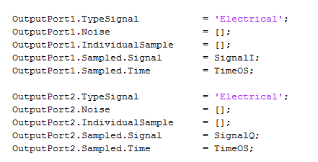
How to configure output ports
The data structure for all input ports is automatically created during the simulation, however output port data structures need to be configured from the MATLAB m-file
Two methods can be used:
Set an output port to be equal to an input port
Manually set the attributes of the data structure through declarations within the workspace
Method 1: Set output port equal to an input port
Method 2: Set output port(s) explicitly
When using this method the data type for the two linked ports must be the same
NOTE: Once the data structure is in place its contents can be modified within the MATLAB m-file (for example by performing math operations on the amplitude data). Also the size of the arrays can be changed but the size of the time/frequency and sampled signal arrays associated with the output port must match!.
In this example, Output Port 1 and Output Port 2 are fully defined from within the MATLAB workspace. Make sure that the defined signal type matches the port setting for the component

Slide 9
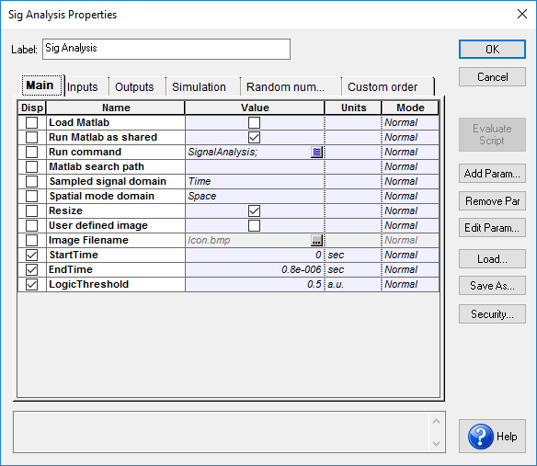
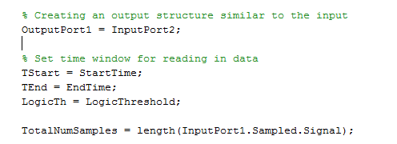
Linking parameters between OptiSystem & MATLAB
Custom parameters can be added to the MATLAB component and accessed within the MATLAB workspace during a simulation (the example project folder can be found under “MATLAB Signal Analysis”)
MATLAB m-file. The left variable is local to the MATLAB workspace whereas the right variable must match the OptiSystem parameter
Custom parameters

Slide 10
Linking MATLAB variables to Results (1)
Calculations performed in MATLAB can be displayed as a Component Result (the example project folder can be found under “MATLAB Signal Analysis”)
1) Custom results must first be defined in Component Results
2) Calculations performed in MATLAB are exported as a text file (to same folder where OptiSystem project is located)

Slide 11
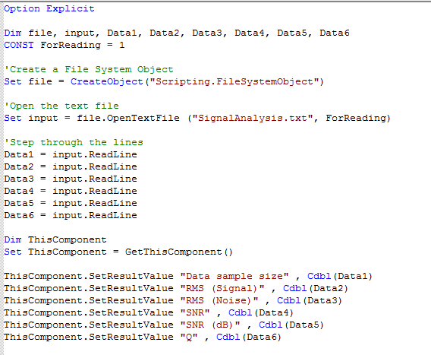
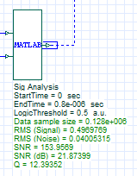
Linking MATLAB variables to Results (2)
3) The OptiSystem Component script feature is then used to access and display the results

