Slide 1
OptiSystem-MATLAB data formats (Version 1.0)

Slide 2
Optical signal data format (1)
Signal type | Data elements | Comments
Sampled | InputPort1.Sampled.Signal | Represents the complex envelope of the optical signal (real/imag) – 1xn complex double If there are two polarization states, two rows will be created (2xn complex double)
 | InputPort1.Sampled.Time Inputport1.Sampled.Frequency | The time/frequency sampling points for the sampled optical signal (s or Hz) If the parameter Sampled signal domain = “Time”, use InputPort1.Sampled.Time If the parameter Sampled signal domain = “Frequency”, use InputPort1.Sampled.Frequency
 | InputPort1.Sampled.CentralFrequency | The center frequency (Hz) of the optical signal
Sampled (Channels) | InputPort1.Channels | List of wavelength channels entering specified port To access data for a sampled signal (Channel A), use InputPort1.Sampled(A).Signal, etc. To access data for a parameterized signal (Channel A), use InputPort1.Parameterized.Power(A), etc.
Sampled (Spatial) | InputPort1.Sampled.Spatial.ModeX.Amplitude | Real or complex amplitude of spatial mode(s) – nxn array Note 1: To access Y polarization data, use ModeY in lieu of ModeX Note 2: If more then one mode is present, separate sampled signals will be created for each mode and can be accessed as follows (for Mode A): InputPort1.Sampled(A).Spatial.ModeX.Amplitude
 | InputPort1.Sampled.Spatial.ModeX.Properties | String value (describes mode type and index)
 | InputPort1.Sampled.Spatial.ModeX.DeltaSpaceX InputPort1.Sampled.Spatial.ModeX.DeltaFrequencyX | X-polarization: Discretization in space (m) or discretization in frequency (1/m)
 | InputPort1.Sampled.Spatial.ModeX.DeltaSpaceY InputPort1.Sampled.Spatial.ModeX.DeltaFrequencyY | Y-polarization: Discretization in space (m) or discretization in frequency (1/m)
Parameterized | InputPort1.Parameterized.Power | Average power of parameterized optical signal (W)
 | InputPort1.Parameterized.Frequency | Central frequency of parameterized optical signal
 | InputPort1.Parameterized.SplittingRatio | Polarization splitting ratio of parameterized optical signal
 | InputPort1.Parameterized.Phase | Phase of parameterized optical signal

Slide 3
Optical signal data format (2)
Signal type | Data elements | Comments
Noise | InputPort1.Noise.Power | Average power of each noise bin (W)
 | InputPort1.Noise.LowerFrequency; | Lower frequency range of each noise bin (Hz)
 | InputPort1.Noise.UpperFrequency; | Upper frequency range of each noise bin (Hz)
 | InputPort1.Noise.Phase | Phase of each noise bin (Hz)
Individual sample | InputPort1.IndividualSample | Represents the complex amplitude of the optical signal for a single sampling point

Slide 4
Electrical & Binary/M-ary data formats
Electrical
Signal type | Data elements | Comments
Sampled | InputPort1.Sampled.Signal | Represents the electrical signal sampled waveform (real/imag) – 1xn complex double
 | InputPort1.Sampled.Time Inputport1.Sampled.Frequency | The time/frequency sampling points for the sampled electrical signal (s or Hz) If the parameter Sampled signal domain = “Time”, use InputPort1.Sampled.Time If the parameter Sampled signal domain = “Frequency”, use InputPort1.Sampled.Frequency
Noise | InputPort1.Noise.Signal | Represents the electrical noise sampled waveform (real/imag) – 1xn complex double Note: If the noise is combined with the sampled signal (before the MATLAB Component) these arrays will be empty (zero values)
 | InputPort1.Noise.Time Inputport1.Noise.Frequency | The time/frequency sampling points for the sampled electrical noise (s or Hz) If the parameter Sampled signal domain = “Time”, use InputPort1.Noise.Time If the parameter Sampled signal domain = “Frequency”, use InputPort1.Noise.Frequency
Individual sample | InputPort1.IndividualSample | Represents the amplitude of the electrical and noise signal for a single sampling point
Binary & M-ary
Signal type | Data elements | Comments
Binary | InputPort1.Sequence | Represents the sequence of binary bits (0’s and 1’s)
 | InputPort1.BitRate | Bit rate of binary sequence (1/s)
M-ary | InputPort1.Sequence | Represents the sequence of M-ary symbols – 1xn double
 | InputPort1.BitRate | Sample rate of M-ary sequence (1/s)

Slide 5
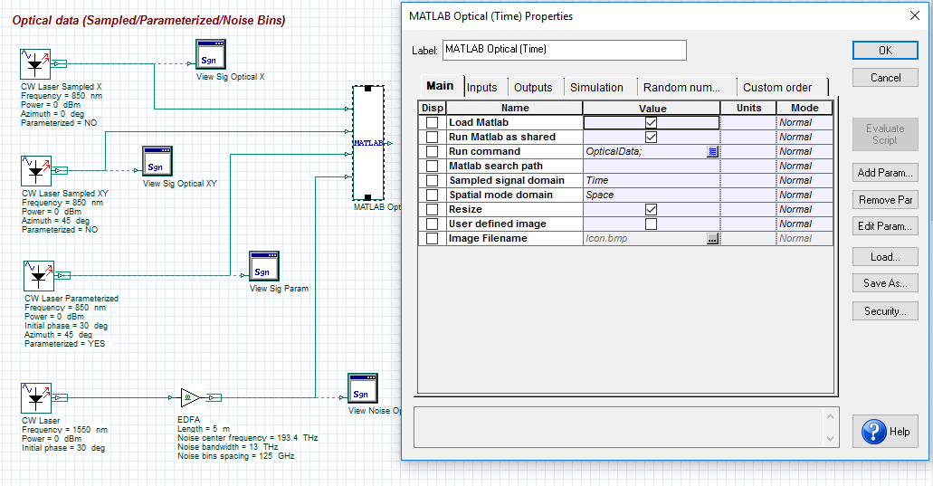
Accessing the MATLAB workspace
The data structure for all input and output ports and all variables declared within the MATLAB m-file can be viewed from the MATLAB workspace
To access the workspace, first select Load MATLAB from the MATLAB Component and select OK. This action pre-loads MATLAB (it will stay open unless it is manually closed)
After running a simulation, open the MATLAB Command Window and type “workspace”.
Load Matlab parameter
After completion of the simulation, type workspace + Enter to access the data structure for all signals and variables

Slide 6
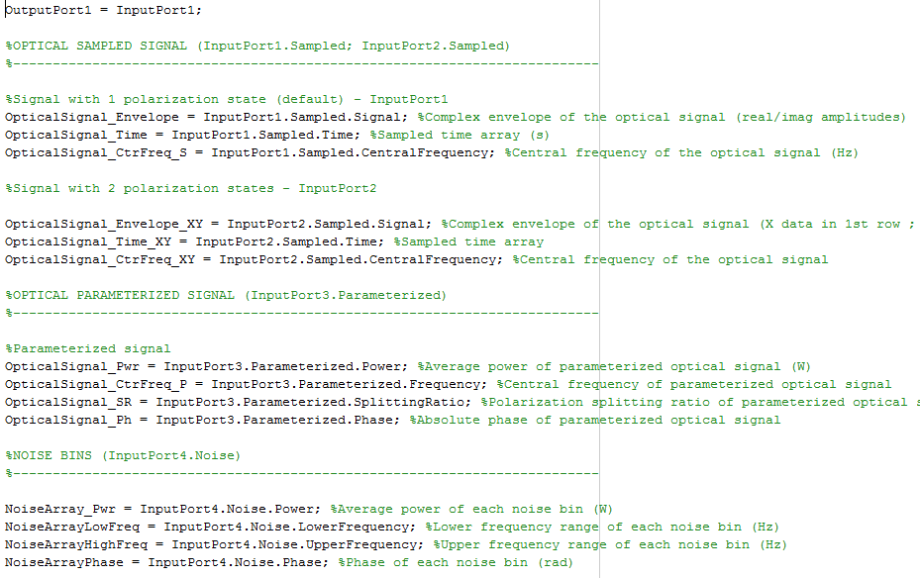
MATLAB m-file associated with Optical_Data.osd
The data structure of any input port can be equated to any output port as long as they are the same type (optical, electrical, m-ary, binary)
Ports are accessed using the nomenclature InputPort1, InputPort2, etc.
OpticalData.m
Variables on left are local to the MATLAB workspace.

Slide 7
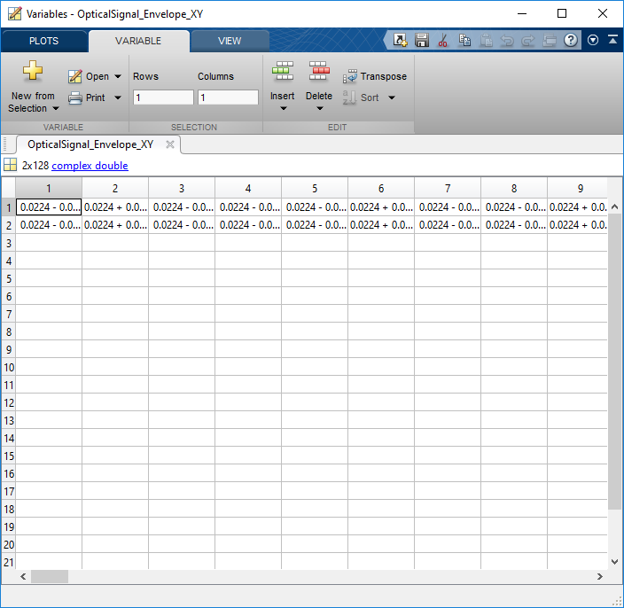
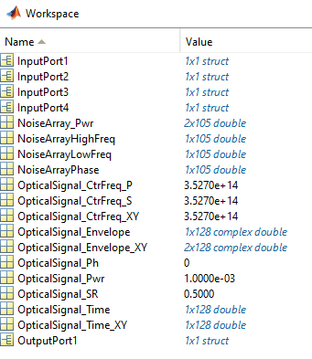
Example of workspace for Optical_Data.osd
To view further details on a data structure, double left click on any variable to open up the Variables window
Data structure for input ports
Size and type of data
The detailed data structure and contents for the variable OpticalSignal_Envelope_XY. This example shows the sampled complex amplitude of an optical signal envelope with X (first row) and Y (2nd row) polarization data
Data structure for output ports
Locally declared MATLAB variables

