Slide 1

OptiSystem applications:
Optical receiver analysis (PIN-TIA-LA)

Slide 2



Introduction
PIN-TIA-LA modelling
The overall performance of a point-to-point optical communication link is normally defined based on the minimum average optical power, measured at the input to the optical receiver, that is required to achieve a given BER. Known as optical receiver sensitivity, this key parameter can be used to compare different receiver configurations in order to determine the right design components for an application.
For direct detection intensity modulated (IMDD) systems the optical receiver will usually consist of a PIN photodetector (to convert the optical field to current), followed by a transimpedance amplifier (TIA) which amplifies and converts the current to a voltage, and then a limiting amplifier which conditions (limits) the voltage waveform for processing by a decision circuit (using a voltage decision threshold).
In this application note we will present an optical receiver sensitivity calculation model for an optical receiver system that includes a PIN-TIA and PIN-TIA-LA configuration. The noise models for these configurations are based on application notes from Maxim Integrated ™ [1, 2]
The reference file for this application note is: PIN_TIA_LA_Analysis Version 1_0.osd
REF 1: "Accurately Estimating Optical Receiver Sensitivity", Application Note HFAN-3.0.0 (Rev. 1; 04/08), Maxim Integrated, www.maximintegrated.com
REF 2: "Optical receiver performance evaluation", Application Note 1938 HFAN-03.0.2, Maxim Integrated, www.maximintegrated.com

Slide 3
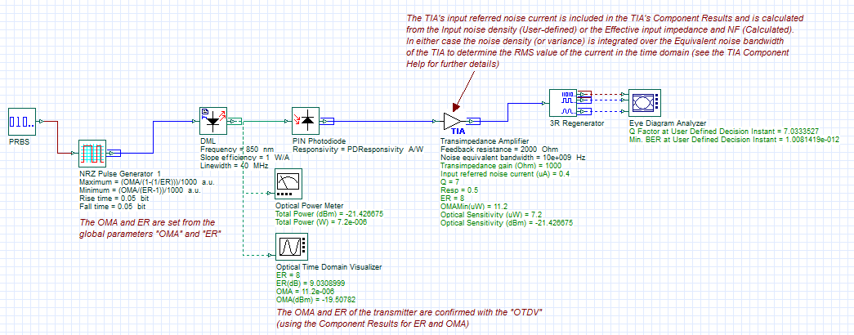
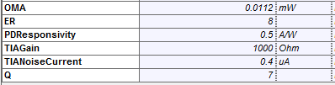
PIN-TIA configuration (1)
This example demonstrates a directly modulated 10 Gb/s system with a PIN-TIA receiver configuration. It is assumed that the total noise impact on the system performance results from the input referred noise current of the TIA (thus the thermal noise current of the PIN is assumed to be zero). It is also assumed that the shot noise from the PIN is negligible for this analysis.
For this design the noise current is assumed to be 0.4 uA RMS, Responsivity = 0.5, Tx ER = 9 dB, and the target BER is 1e-12 (Ref 1)
Based on these settings the minimum required Optical Modulation Amplitude is set to 11.2 uWpp (Q=7) and the associated Receiver sensitivity = 7.25 uW. The formulas (based on Ref 2) can be found in the Component Script of the TIA component (see next slide)
REF 1: "Accurately Estimating Optical Receiver Sensitivity", Application Note HFAN-3.0.0 (Rev. 1; 04/08), Maxim Integrated, www.maximintegrated.com
REF 2: "Optical receiver performance evaluation", Application Note 1938 HFAN-03.0.2, Maxim Integrated, www.maximintegrated.com
Layout: PIN-TIA Rx Analysis
An Eye Diagram Analyzer is used to estimate the Q factor based on statistical noise analysis of Logic 1 and 0 signals.
Global parameter settings for direct modulation link with PIN-TIA receiver

Slide 4
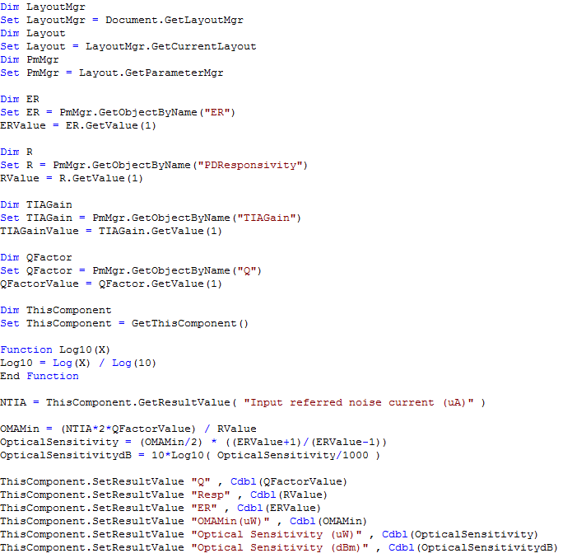
PIN-TIA configuration (2)
The VBScript below is associated with the TIA Component (Layout: PIN-TIA Rx Analysis)
This part of the TIA component script is used to access the global parameter settings
Calculations are performed here to determine:
OMA Minimum = I_{rms}*2*Q/Responsivity
where I_{rms} is the input referred noise current of the TIA
Optical Sensitivity = (OMA/2) x (ER+1)/(ER-1)
where ER is the extinction ratio setting of transmitted optical waveform
The calculation results are exported to the TIA Component Results panel using the SetResultValue operation. These values are displayed after completion of the simulation.

Slide 5
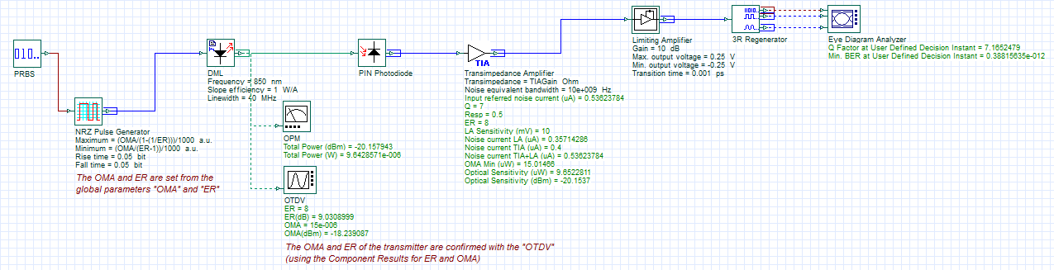
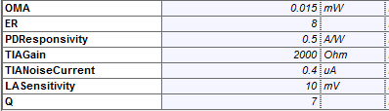
PIN-TIA-LA configuration (1)
This example demonstrates a directly modulated 10 Gb/s system with a PIN-TIA-LA receiver configuration. It is assumed that the total noise impact on the system performance is based on the input referred noise current of the TIA (thus the thermal noise current of the PIN is assumed to be zero) and the input sensitivity of the LA (which is converted to an equivalent input referred noise).
For this design the TIA gain and noise current is assumed to be 2000 ohm and 0.4 uA RMS, the LA input sensitivity = 10 mV (peak-to-peak), Responsivity = 0.5, Tx ER = 9 dB, and the target BER is 1e-12 (Q=7)
Based on these settings the minimum required Optical Modulation Amplitude is set to 15 uWpp (Q=7) and the associated Receiver sensitivity = 9.65 uW.
The formulas (based on Ref 2) can be found in the Component Script of the TIA component (see next slide)
The TIA component script is used to calculate the receiver sensitivity (for a given Q) based on the noise characteristics of the TIA and LA. The input referred noise of the TIA is set based on the combined noises of the TIA and the LA.
Layout: PIN-TIA-LA Rx Analysis
Global parameter settings for direct modulation link with PIN-TIA-LA receiver

Slide 6
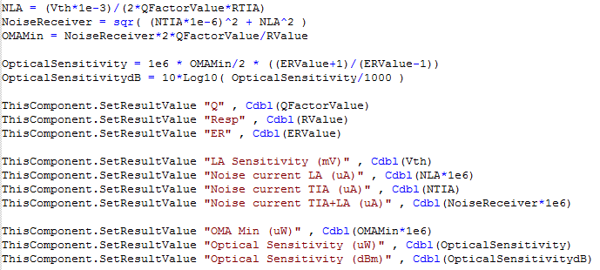
PIN-TIA-LA configuration (2)
The VBScript below is associated with the TIA Component (Layout: PIN-TIA-LA Rx Analysis)
Calculations are performed here to determine:
Noise current LA (NLA) = (LASensitvity)/(2*Q*TIAGain)
where TIAGain is the gain setting of the TIA and LASensitivity is the input voltage sensitivity of the TIA (normally included in the vendor specification sheet)
Total noise current (NoiseReceiver) = I_{total} = sqrt(I_{rms}² + I_{LA}²)
OMA Minimum = I_{total}*2*Q/Responsivity
Optical Sensitivity = (OMA/2) x (ER+1)/(ER-1)
where ER is the extinction ratio setting of transmitted optical waveform

