Slide 1

OptiSystem applications:
Digital modulation analysis (PSK)

Slide 2



Introduction
PSK modulation
Digital modulation systems are used to transmit digital (quantized) information over a medium such as air or optical fiber. Transmission is achieved by mapping the information (baseband) channel onto an analog carrier channel, propagating over the medium, and then recovering the baseband channel at the receiver¹. Several techniques can be used to carry the information channel and involve changing the characteristics of its analog carrier (periodic) signal. These include²:
  Amplitude shift keying (ASK), also called pulse amplitude modulation (PAM), where different amplitudes of the carrier are used to represent the digital signal
  Phase shift keying (PSK), where different phase settings of the carrier are used to represent the digital signal
  Quadrature amplitude modulation (QAM) – a combination of PAM and PSK
  Frequency shift keying (FSK), where different relative frequency settings (relative to the carrier frequency) are used to represent the digital signal
This application note reviews common implementations for PSK modulation and includes the following models:
  Binary phase shift keying (Layout: BPSK)
  Differential binary phase shift keying (Layout: D-BPSK)
  Quadrature phase shift keying (Layout: QPSK)
  Offset quadrature phase shift keying (Layout: O-QPSK)
  Pi/4 quadrature phase shift keying (Layout: Pi/4-QPSK)
  Differential quadrature phase shift keying (Layout: D-BPSK)
  BPSK over analog carrier (Layout: BPSK (with Carrier))
  QPSK over analog carrier (Layout: QPSK (with Carrier))
REF 1: All About Modulation Part 1, Intuitive Guide to Principles of Communications, Charan Langton (2002, revised Dec 2005). Retrieved 16 Mar 17 from http://complextoreal.com/tutorials/tutorial-8-all-about-modulation-part-1/#.WMrlRn_nLTY
REF 2: Link budget analysis: Digital Modulation Part 1, Atlanta RF (Bob Garvey, Chief Engineer), July. Retrieved (16 Mar 17) from http://www.atlantarf.com/Downloads.php

Slide 3
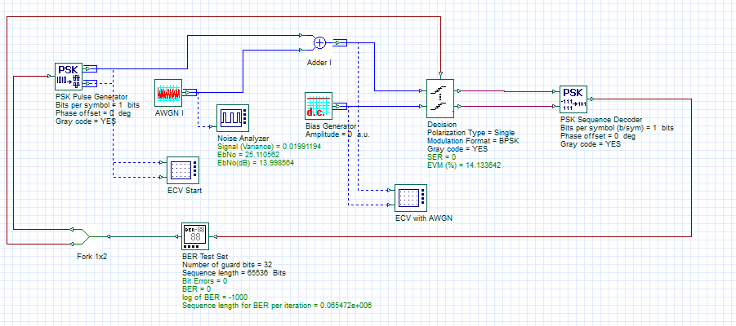
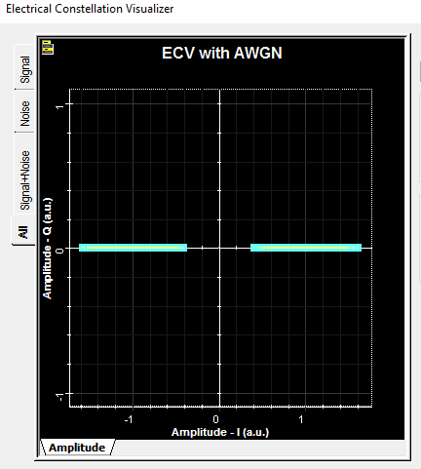
Binary phase shift keying (BPSK)
This example demonstrates binary phase shift keying (BPSK) using the PSK Pulse Generator, Decision and PSK Sequence Decoder components. It is a two-level modulation technique where the antipodal signals are represented by phases of 0 and 180 degrees (binary “0” and binary “1”, respectively). As only phase is being changed, the amplitude of the modulation envelope is constant.
Layout: D-BPSK
180 phase (binary 1) subject to zero-mean Gaussian noise
180 phase (binary 1) subject to zero-mean Gaussian noise

Slide 4
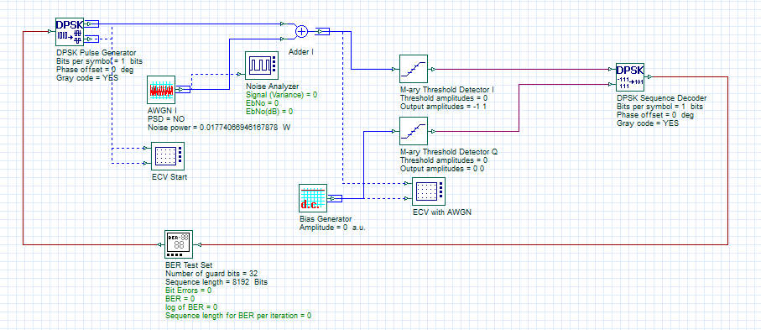
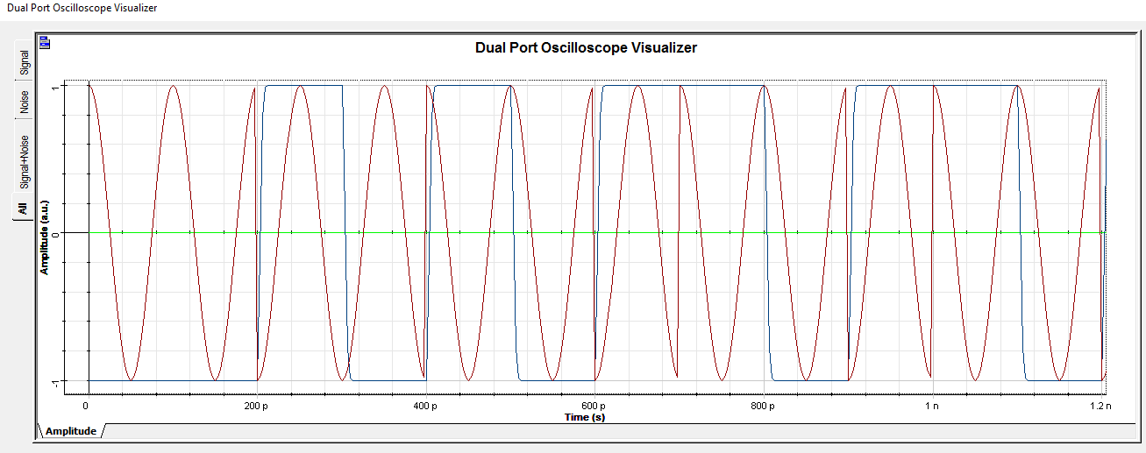
Differential binary phase shift keying (D-BPSK)
This example demonstrates differential binary phase shift keying (D-BPSK) using the DPSK Pulse Generator, M-ary Threshold and DPSK Sequence Decoder (with no analog carrier). When differential encoding is used, the phase transitions change by 180 deg compared to the previous bit if a binary 1 is transmitted and does not change if a binary 0 is transmitted
REF: Phase-shift keying. (2017, January 26). In Wikipedia, The Free Encyclopedia. Retrieved 17:53, March 16, 2017, from https://en.wikipedia.org/w/index.php?title=Phase-shift_keying&oldid=762095019
Layout: D-BPSK
1-1 bit transition: 180 deg change in phase
0
0
1
0
1
0
1
1
0
1
1
0
0-0 bit transition: No change in phase
0-1 bit transition: 180 deg change in phase
1-0 bit transition: No change in phase

Slide 5
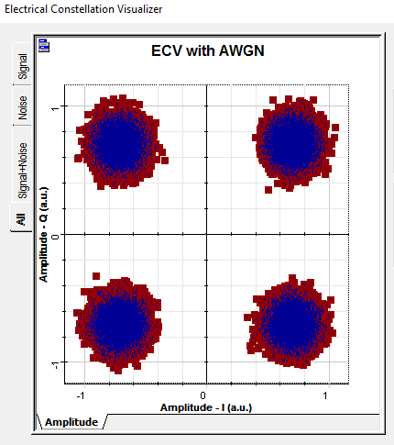
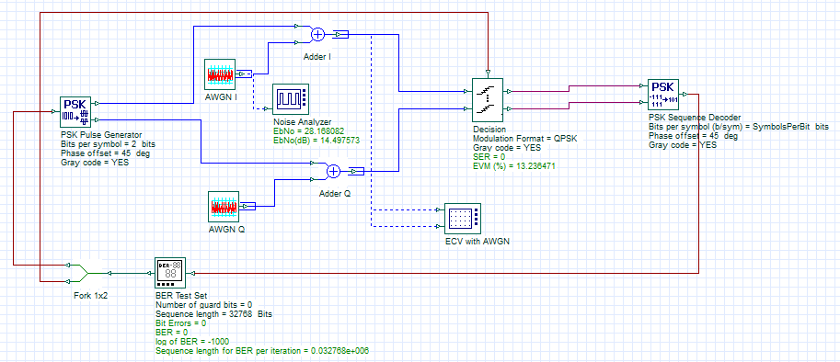
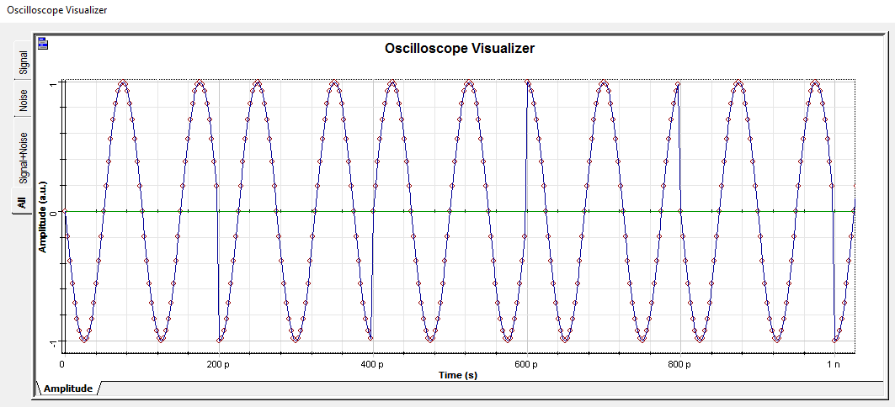
Quadrature phase shift keying (QPSK)
This example demonstrates quadrature phase shift keying (QPSK) using the PSK Pulse Generator, Decision and PSK Sequence Decoder (with no analog carrier). See layout "QPSK (with carrier)" for an example with includes an analog transmission channel.
REF: L. Kazovsky, S. Benedetto, A. Willner, Optical Fiber Communication Systems, Artech House (1996), pp. 199-200
Layout: QPSK
Symbol: 01 (Phase: 135 deg)
Symbol: 00 (Phase: 45 deg)
Symbol: 10 (Phase: 225 deg)
Symbol: 11 (Phase: 315 deg)
Example sequence of symbols 00, 01, 10 and 11 modulated onto a periodic carrier channel

Slide 6
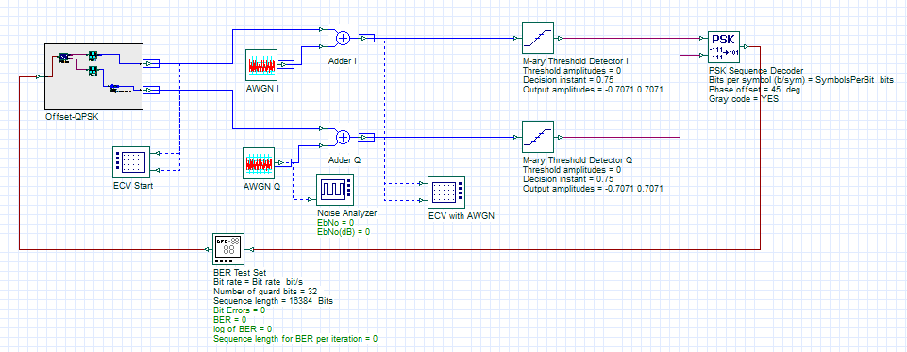
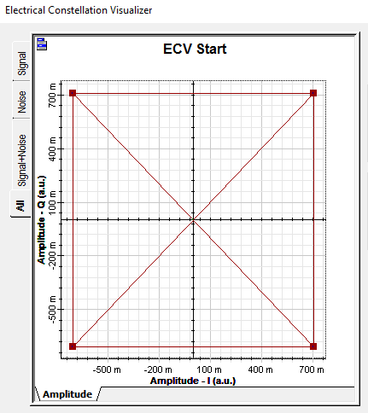
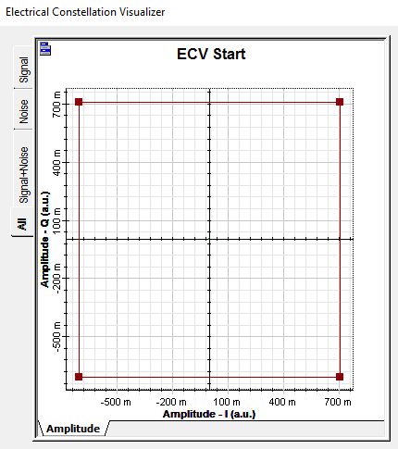
Offset quadrature phase shift keying (O-QPSK)
This example demonstrates off-set quadrature phase shift keying (O-QPSK) using the PSK Pulse Generator, Threshold and PSK Sequence Decoder components. The O-QPSK modulator applies a one bit (half-symbol) period time delay to the Q channel thus creating a staggered constellation (this ensures that the maximum phase shift between symbol transitions is 90 deg – compared to 180 deg for QPSK)
REF 1: Phase-shift keying. (2017, January 26). In Wikipedia, The Free Encyclopedia. Retrieved 17:53, March 16, 2017, from https://en.wikipedia.org/w/index.php?title=Phase-shift_keying&oldid=762095019
REF 2: Link budget analysis: Digital Modulation Part 3, Atlanta RF (Bob Garvey, Chief Engineer), July. Retrieved (16 Mar 17) from http://www.atlantarf.com/Downloads.php
Layout: O-QPSK
QPSK transitions
O-QPSK transitions
Max phase transition of 90 deg
Max phase transition of 180 deg

Slide 7
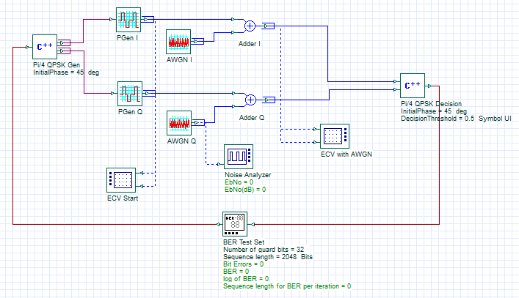
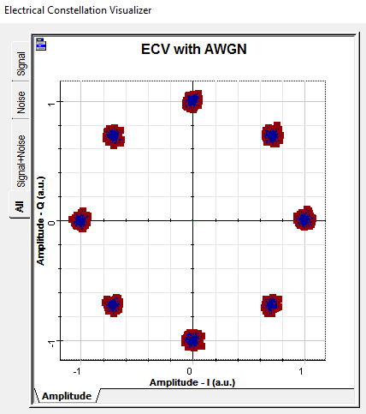
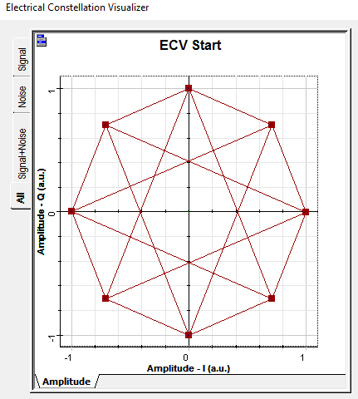
Pi/4 quadrature phase shift keying (Pi/4-QPSK)
This example demonstrates Pi/4 quadrature phase shift keying (Pi/4 QPSK) using the Cpp Component. The Pi/4-QPSK modulator uses two separate QPSK constellations. For even numbered symbols the standard QPSK constellation is used; for odd numbered constellations a 45 deg rotated version of the QPSK constellation is used.
REF 1: Phase-shift keying. (2017, January 26). In Wikipedia, The Free Encyclopedia. Retrieved 17:53, March 16, 2017, from https://en.wikipedia.org/w/index.php?title=Phase-shift_keying&oldid=762095019
REF 2: Link budget analysis: Digital Modulation Part 3, Atlanta RF (Bob Garvey, Chief Engineer), July. Retrieved (16 Mar 17) from http://www.atlantarf.com/Downloads.php
Layout: Pi/4-QPSK
QPSK transitions
Pi/4-QPSK transitions
Max phase transitions of 135 deg
Max phase transitions of 180 deg

Slide 8
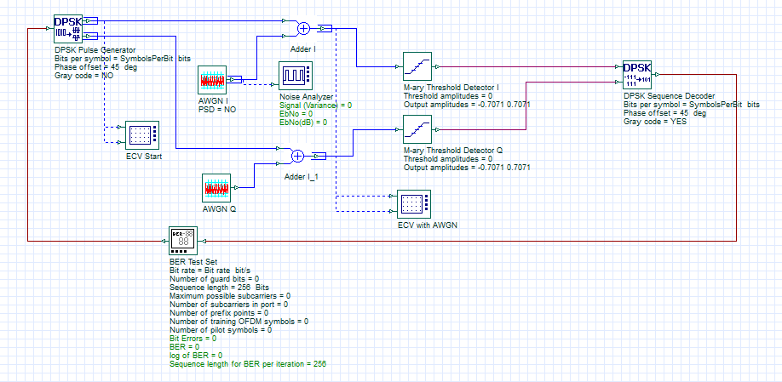
Differential quadrature phase shift keying (D-QPSK)
This example demonstrates differential quadrature phase shift keying (D-BPSK) using the DPSK Pulse Generator, M-ary Threshold and DPSK Sequence Decoder (with no analog carrier). Similar to BPSK differential encoding, the phase transitions change by a defined value compared to the previous symbol based on the transmitted symbol (00, 01, 10, 11).
REF: Phase-shift keying. (2017, January 26). In Wikipedia, The Free Encyclopedia. Retrieved 17:53, March 16, 2017, from https://en.wikipedia.org/w/index.php?title=Phase-shift_keying&oldid=762095019
Layout: D-QPSK

Slide 9
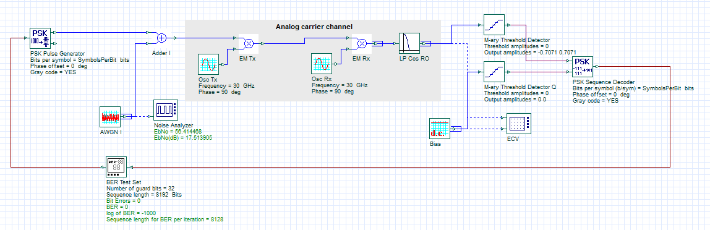
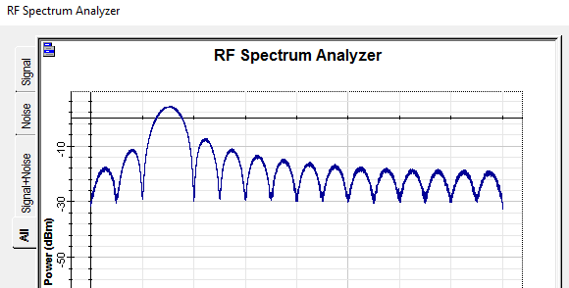
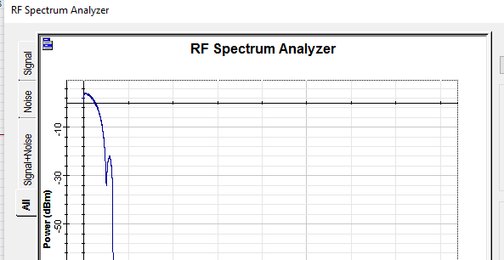
BPSK with carrier channel
This example demonstrates binary phase shift keying (BPSK) using the PSK Pulse Generator, Decision and PSK Sequence Decoder with transmission over an analog carrier. Modulation is achieved by mixing the information (baseband) channel with an RF oscillator (30 GHz). At the receiver, the transmitted channel is mixed with a local oscillator at the same carrier frequency and low pass filtered (10 GHz) to remove the double frequency component
Layout: BPSK (with carrier)
Recovered baseband information channel after demodulation and filtering
Information channel modulated at 30 GHz

Slide 10
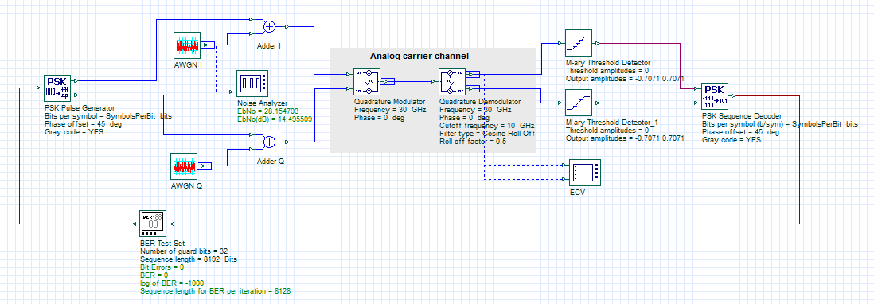
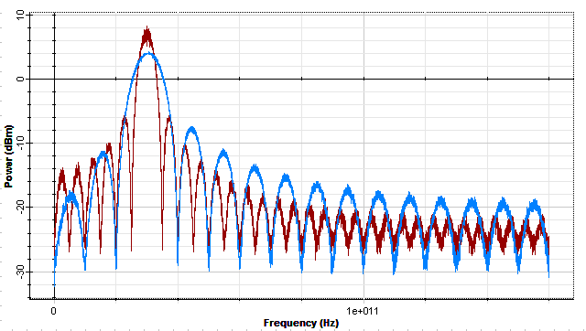
QPSK with carrier channel
This example demonstrates quadrature phase shift keying (QPSK) using the PSK Pulse Generator, Threshold and PSK Sequence Decoder with transmission over an analog carrier. Modulation is achieved by mixing the information (baseband) channel with an RF quadrature modulator (30 GHz). At the receiver, the transmitted channel is demodulated with a Quadrature demodulator with a local oscillator at the same carrier frequency and low pass filtered (10 GHz) to remove the double frequency component
REF: Link budget analysis: Digital Modulation Part 3, Atlanta RF (Bob Garvey, Chief Engineer), July. Retrieved (16 Mar 17) from http://www.atlantarf.com/Downloads.php
Layout: QPSK (with carrier)
The QPSK channel (red) has twice the bandwidth efficiency compared to BPSK (blue)

