Slide 1

OptiSystem applications:
Digital modulation analysis (FSK)

Slide 2



Introduction
FSK modulation
Digital modulation systems are used to transmit digital (quantized) information over a medium such as air or optical fiber. Transmission is achieved by mapping the information (baseband) channel onto an analog carrier channel, propagating over the medium, and then recovering the baseband channel at the receiver¹. Several techniques can be used to carry the information channel and involve changing the characteristics of its analog carrier (periodic) signal. These include²:
  Amplitude shift keying (ASK), also called pulse amplitude modulation (PAM), where different amplitudes of the carrier are used to represent the digital signal
  Phase shift keying (PSK), where different phase settings of the carrier are used to represent the digital signal
  Quadrature amplitude modulation (QAM) – a combination of PAM and PSK
  Frequency shift keying (FSK), where different frequency settings (relative to the carrier frequency) are used to represent the digital signal
This application note reviews common implementations for FSK modulation and includes the following models:
  Binary frequency shift keying with coherent detection (Layout: BFSK (Coherent))
  Binary frequency shift keying with envelope detection(Layout: BFSK (Non-coherent))
  Continuous phase frequency shift keying (Layout: CPFSK)
  Minimum shift keying (Layout: MSK)
  Gaussian minimum shift keying (Layout: GMSK)
REF 1: All About Modulation Part 1, Intuitive Guide to Principles of Communications, Charan Langton (2002, revised Dec 2005). Retrieved 16 Mar 17 from http://complextoreal.com/tutorials/tutorial-8-all-about-modulation-part-1/#.WMrlRn_nLTY
REF 2: Link budget analysis: Digital Modulation Part 1, Atlanta RF (Bob Garvey, Chief Engineer), July. Retrieved (16 Mar 17) from http://www.atlantarf.com/Downloads.php

Slide 3
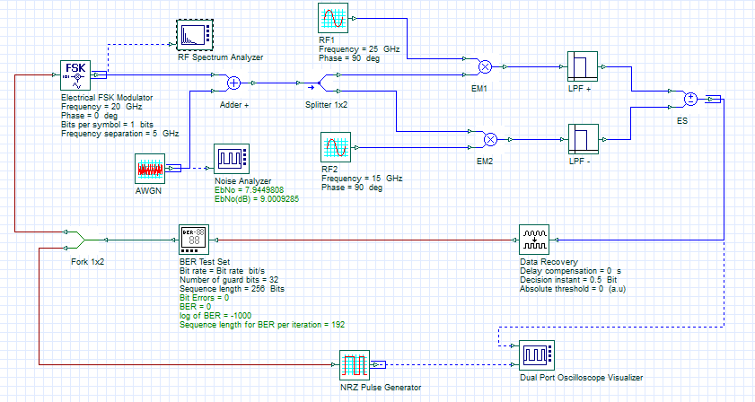
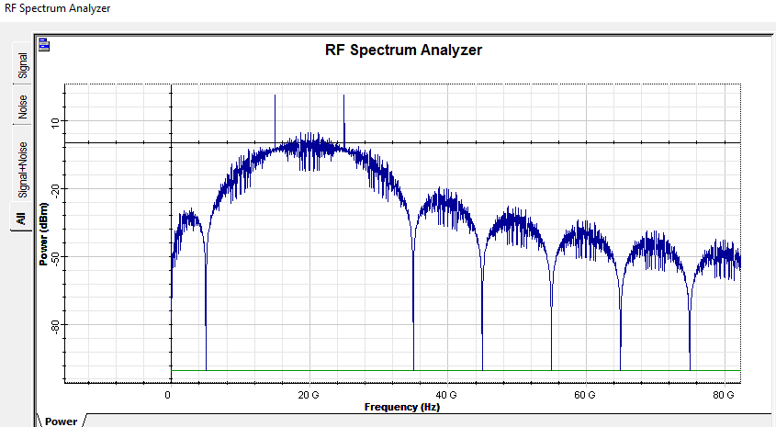
Binary frequency shift keying (BFSK Coherent)
This example demonstrates binary frequency shift keying (BFSK) with coherent detection. Binary FSK works by representing 1 and 0 states with two different frequencies. In this example the frequency difference is 10 GHz (20+5 GHz = 25 GHz and 20-5 GHz = 15 GHz).
REF: Link budget analysis: Digital Modulation Part 2, Atlanta RF (Bob Garvey, Chief Engineer), June 2013. Retrieved (16 Mar 17) from http://www.atlantarf.com/Downloads.php
Layout: BFSK (Coherent)
BFSK spectrum with two overlapping (orthogonal) waveforms (Delta Freq = 5 GHz)

Slide 4
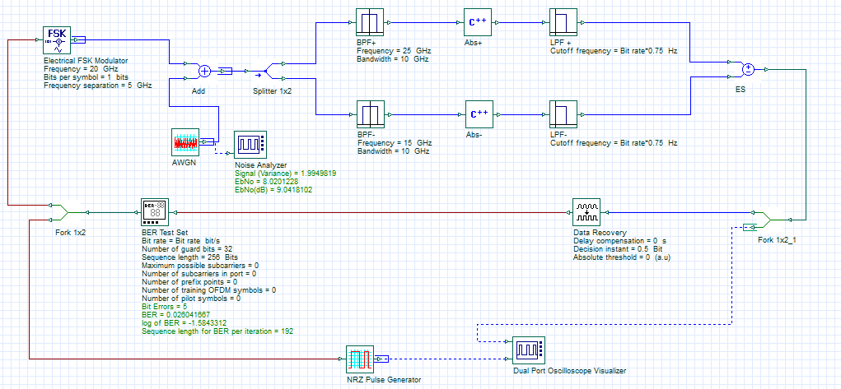
Binary frequency shift keying (BFSK Non-coherent)
This example demonstrates binary frequency shift keying (BFSK) with non-coherent (envelope) detection. Binary FSK works by representing 1 and 0 states with two different frequencies. In this example the frequency difference is 10 GHz (20+5 GHz = 25 GHz and 20-5 GHz = 15 GHz) where Δf = 1/(2*Bit Period) = 5 GHz (Modulation index = 1)
REF: Link budget analysis: Digital Modulation Part 2, Atlanta RF (Bob Garvey, Chief Engineer), June 2013. Retrieved (16 Mar 17) from http://www.atlantarf.com/Downloads.php
Layout: BFSK (Non-coherent)
Envelope detectors

Slide 5
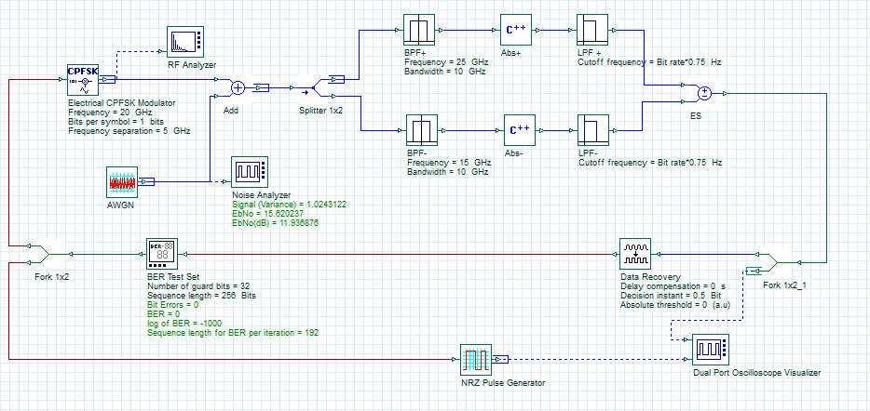
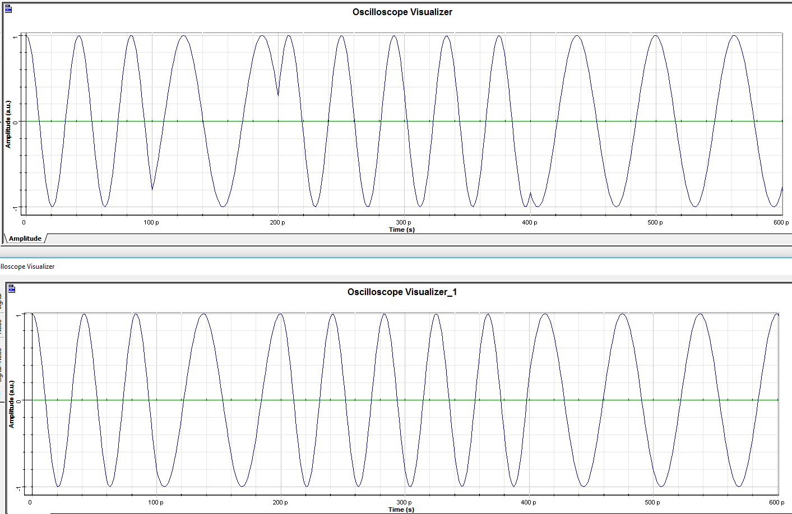
Continuous phase frequency shift keying (CPFSK)
This example demonstrates continuous phase frequency shift keying (CPFSK) using the Electrical CPFSK Modulator. The CPFSK technique is used to avoid phase discontinuities between oscillator switch transitions through the application of an integration method.
In the example below, the top FSK waveform represents the output from the Electrical FSK Modulator set to Δf = 4 GHz (with resulting abrupt phase changes between frequency states); whereas the lower FSK waveform represents the output from the Electrical CPFSK Modulator (with resulting smoother phase transitions between frequency states)
REF: Continuous phase modulation. (2015, December 18). In Wikipedia, The Free Encyclopedia. Retrieved 18:23, March 24, 2017, from https://en.wikipedia.org/w/index.php?title=Continuous_phase_modulation&oldid=695807066
Layout: CPFSK
BFSK waveform
CPFSK waveform

Slide 6
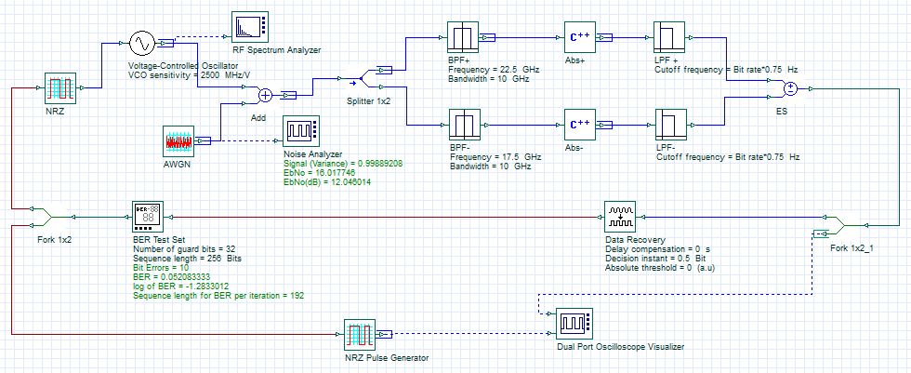
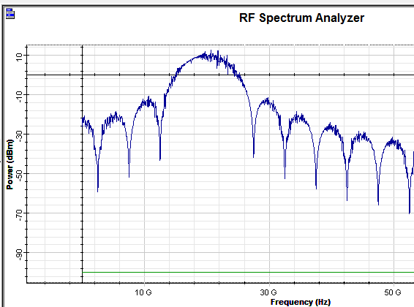
Minimum shift keying (MSK)
This example demonstrates minimum shift keying (MSK) with non-coherent (envelope) detection. MSK works by representing 1 and 0 states with two frequencies that are spaced apart at half of the information channel bit rate, which in this case is 10/2 = 5 GHz or 20+2.5 GHz = 22.5 GHz and 20-2.5 GHz = 17.5 GHz; where Δf = 1/(4*Bit Period) = 2.5 GHz (Modulation index = 0.5). This implementation provides a compact frequency spectrum.
REF: Link budget analysis: Digital Modulation Part 2, Atlanta RF (Bob Garvey, Chief Engineer), June 2013. Retrieved (16 Mar 17) from http://www.atlantarf.com/Downloads.php
Layout: MSK
MSK spectrum with two overlapping (orthogonal) waveforms (Delta Freq = 2.5 GHz)

Slide 7
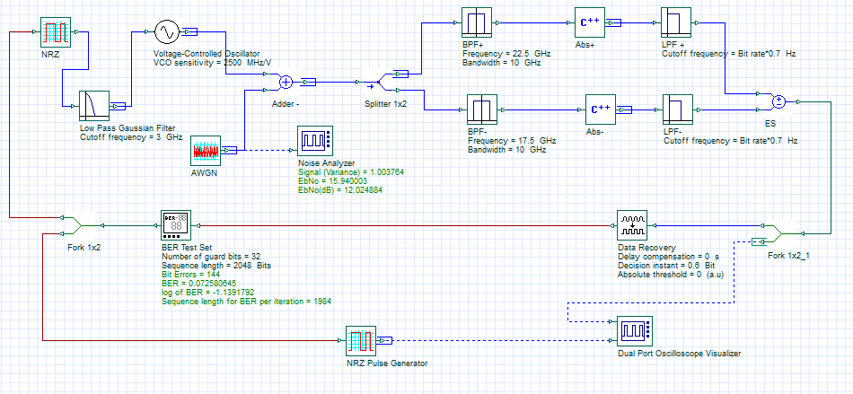
Gaussian minimum shift keying (GMSK)
This example demonstrates minimum shift keying (MSK) with pulse pre-shaping (Gaussian filtered). This helps to further smooth the phase transitions (and hence further reduces sideband power). However the BER performance is impacted by inter-symbol interference (ISI) resulting from the pulse filtering.
REF: Link budget analysis: Digital Modulation Part 2, Atlanta RF (Bob Garvey, Chief Engineer), June 2013. Retrieved (16 Mar 17) from http://www.atlantarf.com/Downloads.php
Layout: GMSK
Pulse pre-shaping (BW = 3 GHz) 3dBW x SymPeriod = 0.3

