Slide 1

Optical Coherent Receiver Analysis

Slide 2



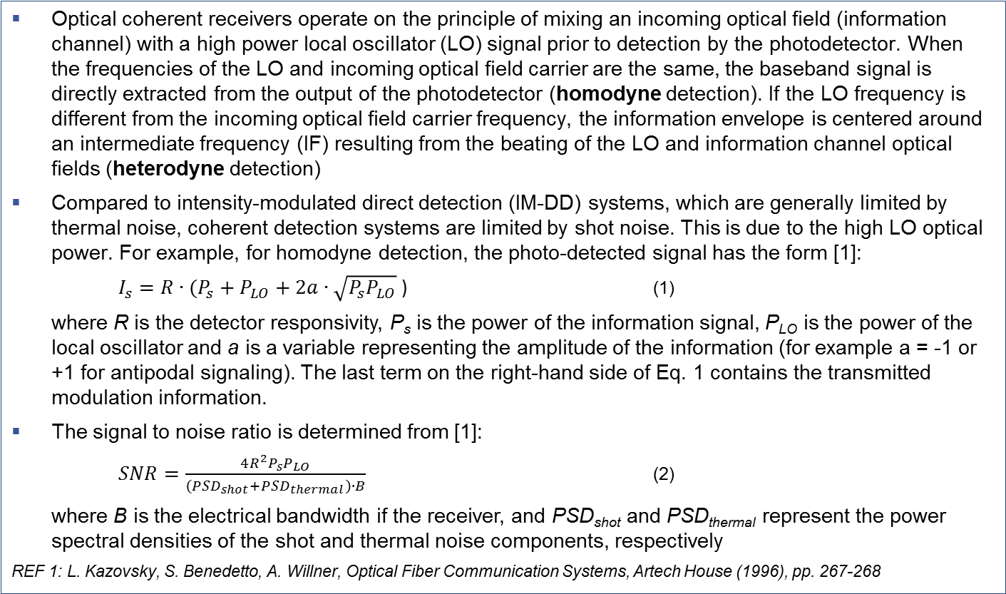
Introduction (1)
Coherent receiver analysis
Optical coherent receivers operate on the principle of mixing an incoming optical field (information channel) with a high power local oscillator (LO) signal prior to detection by the photodetector. When the frequencies of the LO and incoming optical field carrier are the same, the baseband signal is directly extracted from the output of the photodetector (homodyne detection). If the LO frequency is different from the incoming optical field carrier frequency, the information envelope is centered around an intermediate frequency (IF) resulting from the beating of the LO and information channel optical fields (heterodyne detection)
Compared to intensity-modulated direct detection (IM-DD) systems, which are generally limited by thermal noise, coherent detection systems are limited by shot noise. This is due to the high LO optical power. For example, for homodyne detection, the photo-detected signal has the form [1]:
  $I_{s}=R∙(P_{s}+P_{LO}+2a∙\sqrt{P_{s}P_{LO}}$ ) (1)
where R is the detector responsivity, P_{s} is the power of the information signal, P_{LO} is the power of the local oscillator and a is a variable representing the amplitude of the information (for example a = -1 or +1 for antipodal signaling). The last term on the right-hand side of Eq. 1 contains the transmitted modulation information.
The signal to noise ratio is determined from [1]:
  $SNR=\frac{4R^{2}P_{s}P_{LO}}{\left({PSD}_{shot}+{PSD}_{thermal}\right)∙B}$ (2)
where B is the electrical bandwidth if the receiver, and PSD_{shot} and PSD_{thermal} represent the power spectral densities of the shot and thermal noise components, respectively
REF 1: L. Kazovsky, S. Benedetto, A. Willner, Optical Fiber Communication Systems, Artech House (1996), pp. 267-268

Slide 3
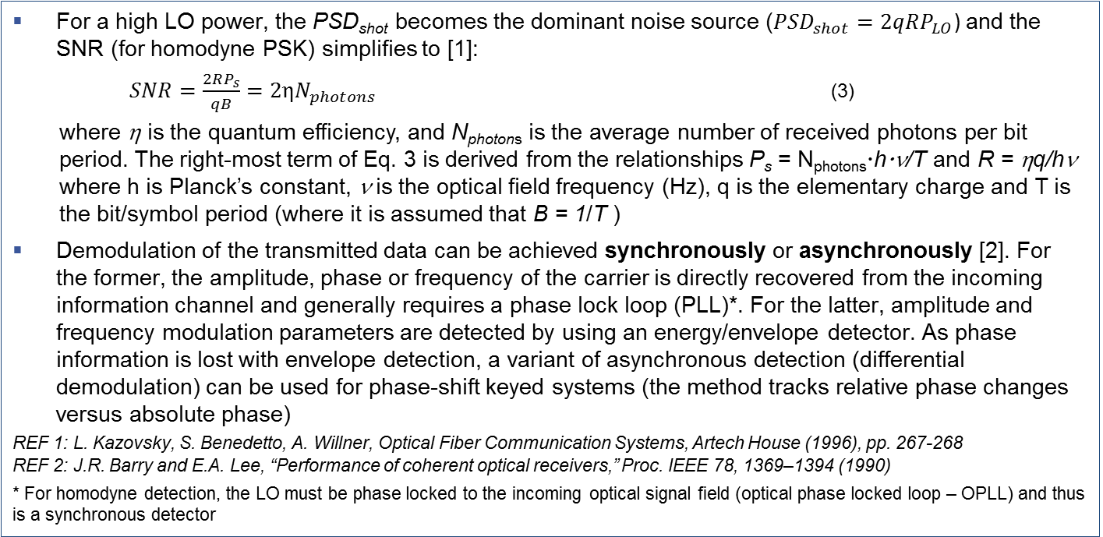
Introduction (2)
Coherent receiver analysis
For a high LO power, the PSD_{shot} becomes the dominant noise source (${PSD}_{shot}=2qRP_{LO}$) and the SNR (for homodyne PSK) simplifies to [1]:
  $SNR=\frac{2RP_{s}}{qB}=2ηN_{photons}$ (3)
  where η is the quantum efficiency, and N_{photons} is the average number of received photons per bit period. The right-most term of Eq. 3 is derived from the relationships P_{s} = N_{photons}hν/T and R = ηq/hν where h is Planck’s constant, ν is the optical field frequency (Hz), q is the elementary charge and T is the bit/symbol period (where it is assumed that B = 1/T )
Demodulation of the transmitted data can be achieved synchronously or asynchronously [2]. For the former, the amplitude, phase or frequency of the carrier is directly recovered from the incoming information channel and generally requires a phase lock loop (PLL)*. For the latter, amplitude and frequency modulation parameters are detected by using an energy/envelope detector. As phase information is lost with envelope detection, a variant of asynchronous detection (differential demodulation) can be used for phase-shift keyed systems (the method tracks relative phase changes versus absolute phase)
REF 1: L. Kazovsky, S. Benedetto, A. Willner, Optical Fiber Communication Systems, Artech House (1996), pp. 267-268
REF 2: J.R. Barry and E.A. Lee, “Performance of coherent optical receivers,” Proc. IEEE 78, 1369–1394 (1990)
* For homodyne detection, the LO must be phase locked to the incoming optical signal field (optical phase locked loop – OPLL) and thus is a synchronous detector

Slide 4
Introduction (3)
Coherent receiver analysis
For this application note the following examples will be reviewed :
  Two level amplitude shift keying (OOK) with direct detection
  Homodyne balanced receiver (using binary PSK antipodal modulation)
  Homodyne balanced receiver (using quadrature PSK modulation)
  Homodyne balanced receiver (using binary ASK modulation)
  Synchronous heterodyne balanced receiver (using binary PSK modulation)
  Asynchronous heterodyne balanced receiver (using differential binary PSK modulation)
  Synchronous heterodyne balanced receiver (using quadrature PSK modulation)
  Asynchronous heterodyne FSK balanced receiver (dual filter)
These examples are located in the OptiSystem file Sensitivity Analysis Coherent Receivers Version 1_0.osd. BER analysis results can be found in BER Analysis Coherent Receivers Version 1_0.xlsx

Slide 5
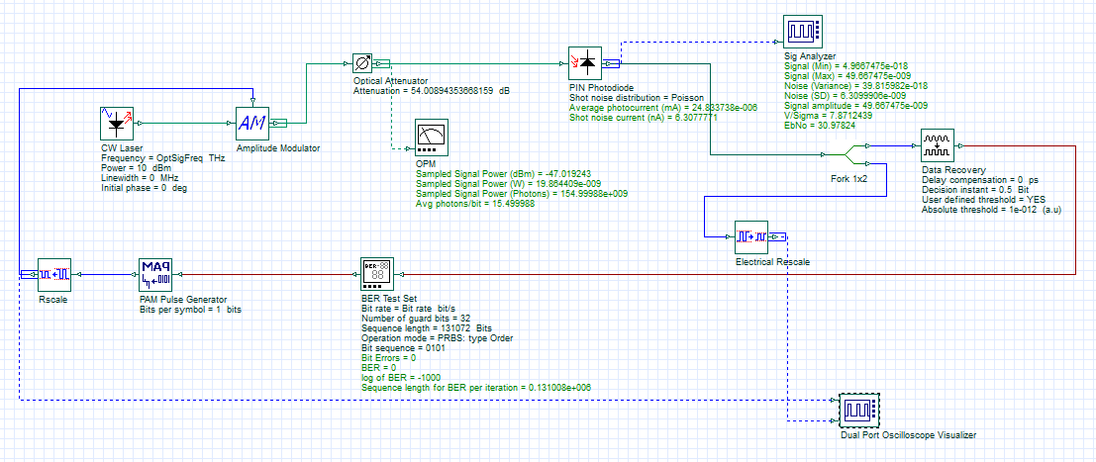
Two-level ASK with direct detection
In this example the quantum (shot) noise limit of an ideal PIN receiver (using binary ASK modulation) is analyzed. The test configuration is as follows : Bit rate: 10 Gb/s; Wavelength (OptSigFreq) = 193.414 THz; PIN responsivity ~ 1.25 A/W (QE*q/h*freq where QE=1); Dark current = 0 nA
The probability of error is calculated as follows: P(E) = 0.5*exp(-2*Nphotons), where Nphotons is the average number of photons received per bit period
REF: L. Kazovsky, S. Benedetto, A. Willner, Optical Fiber Communication Systems, Artech House (1996), pp. 199-200
To model quantum-limited performance the Shot Noise Distribution has been set to the Poisson statistical noise model
Layout: 2ASK DD
A Component script has been set up to calculate the average photons arriving per bit interval (=Sampled Signal Power (Photons)/Bandwidth)
The BER Test Set is the best tool to model quantum-limited performance as we need to count (over a very long sequence) the number of times that no photons are received over a specified bit interval (but expecting a Logic 1 ON state)

Slide 6
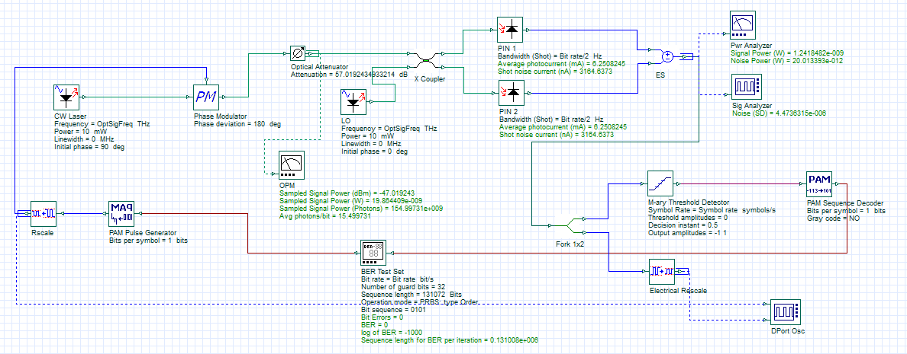
Homodyne balanced receiver (BPSK)
In this example the quantum (shot) noise limit of an ideal homodyne balanced receiver (using binary PSK antipodal modulation) is analyzed. The test configuration is as follows: Bit rate: 10 Gb/s; Wavelength (OptSigFreq) = 193.414 THz; Power LO = 0.01 W; PIN responsivity ~ 1.25 A/W (QE*q/h*freq, where QE=1); Dark current = 0 nA
The shot noise of the balanced detector is dominated by the local oscillator power and is calculated as follows:
  Variance = q*R*Pwr_{LO}*BW = 1.6E-19*1.25*0.01*10e9 = 2.0e-11 A²
  Standard deviation (RMS current) = SQRT(Variance) = 4475e-6 A
The probability of error is calculated as follows: 1/2*erfc(SQRT(SNR)) = 1/2*erfc(SQRT(2*Nphotons)) . To obtain a BER = 10⁻⁹, 9 photons per bit is required.
REF: L. Kazovsky, S. Benedetto, A. Willner, Optical Fiber Communication Systems, Artech House (1996), pp. 267-271
Layout: Homodyne (BPSK)
All the models assume idealized signal and LO optical sources (Linewidth = 0 MHz, or zero phase noise)
The measured noise power is 20e-12 W (after balanced detection) thus confirming that the shot noise calculation matches the theoretical setting.

Slide 7
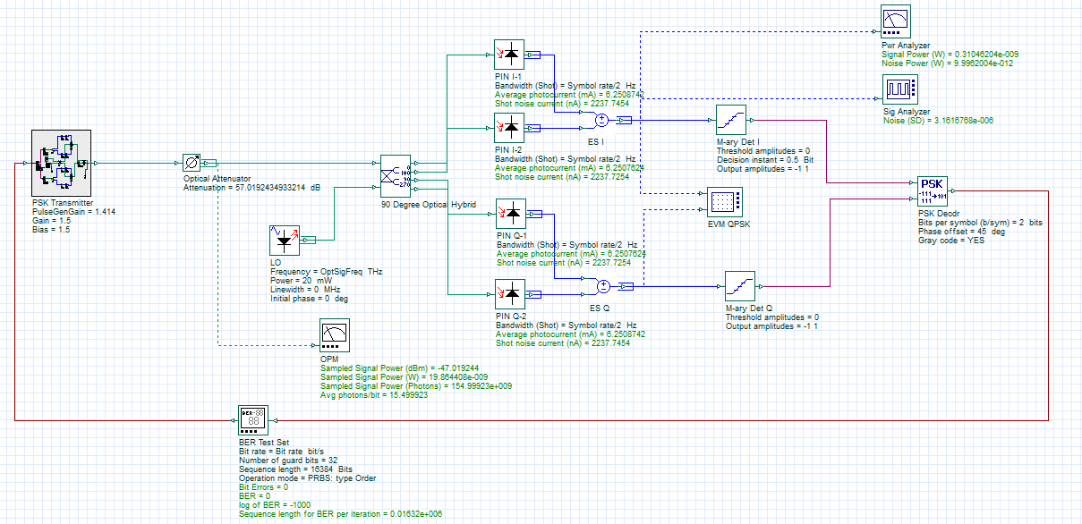
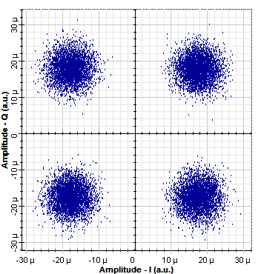
Homodyne balanced receiver (QPSK)
In this example the quantum (shot) noise limit of an ideal homodyne balanced receiver (using quadrature PSK modulation) is analyzed. The test configuration is as follows: Bit rate: 10 Gb/s; Symbol rate: 5 Gb/s; Wavelength (OptSigFreq) = 193.414 THz; Power LO = 0.02 W; PIN responsivity ~ 1.25 A/W (QE*q/h*freq, where QE=1); Dark current = 0 nA
The shot noise of the balanced detector (for each arm) is dominated by the local oscillator power and is calculated as follows:
  Variance = q*R*Pwr_{LO}*BW = 1.6E-19*1.25*0.01*5e9 = 1.0e-11 A²
  Standard deviation (RMS current) = SQRT(Variance) = 3164e-9 A (per I and Q channel)
The signal to noise performance is halved compared to the BPSK homodyne case (due to the 90 deg hybrid which results in a 3 dB drop to the input optical signal) . Thus to achieve the same SER/BER of 10⁻⁹, the input number of photons/bits must be doubled, or equal to 18 (from 1/2*erfc(SQRT(Nphotons)).
REF: K. Kikuchi, "Fundamentals of Coherent Optical Fiber Communications," in Journal of Lightwave Technology, vol. 34, no. 1, pp. 157-179, Jan.1, 1 2016.
Layout: Homodyne (QPSK)
To ensure that SER ≅ BER, Gray coding is used

Slide 8
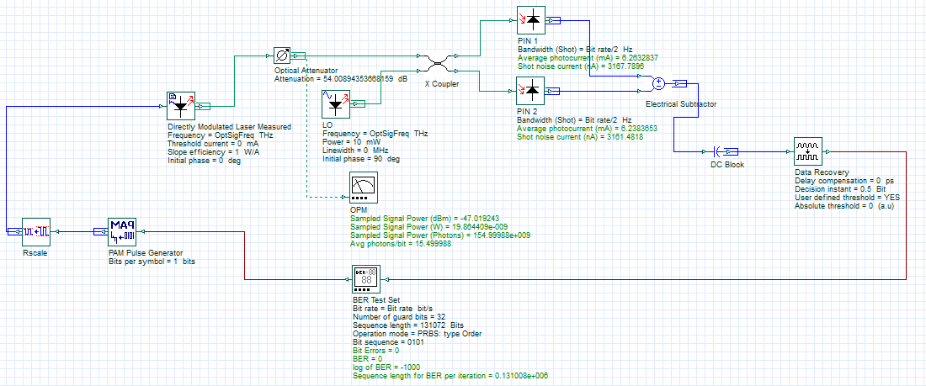
Homodyne balanced receiver (ASK)
In this example the quantum (shot) noise limit of an ideal homodyne balanced receiver (using binary ASK modulation) is analyzed. The test configuration is as follows : Bit rate: 10 Gb/s; Wavelength (OptSigFreq) = 193.414 THz; Power LO = 0.01 W; PIN responsivity ~ 1.25 A/W (QE*q/h*freq where QE=1); Dark current = 0 nA
Due to the on-off nature of the modulation (compared to the constant power of PSK) there is 3 dB loss in performance compared to BPSK Homodyne. Thus for a BER = 10⁻⁹, the number of photons per bit must equal 18 (from 1/2*erfc(SQRT(Nphotons)).
REF: L. Kazovsky, S. Benedetto, A. Willner, Optical Fiber Communication Systems, Artech House (1996), pp. 271-272
Layout: Homodyne (ASK)

Slide 9
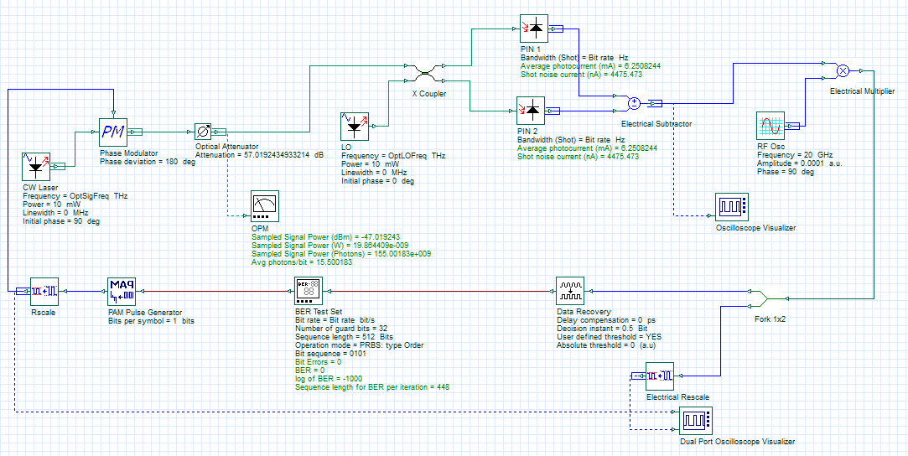
Synchronous heterodyne receiver (BPSK)
In this example the quantum (shot) noise limit of an ideal heterodyne balanced receiver (using binary PSK modulation) is analyzed. The test configuration is as follows : Bit rate: 10 Gb/s; Wavelength (OptSigFreq) = 193.414 THz; Wavelength LO = 193.434 THz; Power LO = 0.01 W; PIN responsivity ~ 1.25 A/W (QE*q/h*freq , where QE=1); Dark current = 0 nA
Due to the beating of the local oscillator with the input signal an intermediate signal will be created . This signal (and associated band) will be contained in both the positive (real) and negative (image) frequency bands (phase diversity receiver). Though the latter is not a real signal, the noise (quantum) fluctuations will be folded into the real band resulting in a doubling of the noise energy (and thus a 3 dB penalty in performance compared to BPSK Homodyne) [2] . For this example the noise energy has been doubled by increasing the receiver noise bandwidth setting (Total RMS current = 6328 nA).
For a BER = 10⁻⁹, the number of photons per bit must equal 18 (from 1/2*erfc(SQRT(Nphotons)) [1].
REF 1: L. Kazovsky, S. Benedetto, A. Willner, Optical Fiber Communication Systems, Artech House (1996), pp. 271-272
REF 2: K. Kikuchi, "Fundamentals of Coherent Optical Fiber Communications," in Journal of Lightwave Technology, vol. 34, no. 1, pp. 157-179, Jan.1, 1 2016.
Layout: Sync Het Rcvr (BPSK)
Synchronous detection is performed by mixing the received IF signal with an RF oscillator with the same frequency and phase

Slide 10
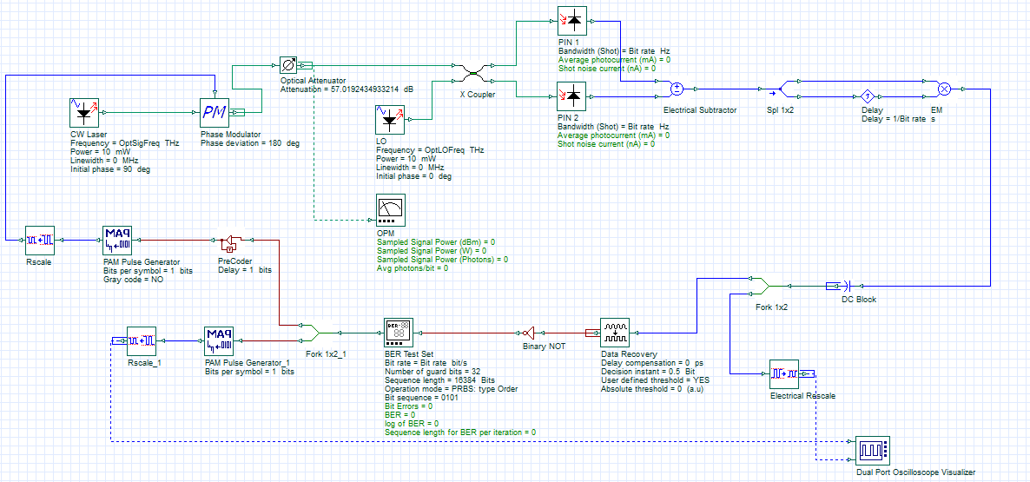
Asynchronous heterodyne receiver (Diff BPSK)
In this example the quantum (shot) noise limit of an asynchronous heterodyne balanced receiver (using differential binary PSK modulation) is analyzed. The test configuration is as follows: Bit rate: 10 Gb/s; Wavelength (OptSigFreq) = 193.414 THz; Wavelength LO = 193.434 THz; Power LO = 0.01 W; PIN responsivity ~ 1.25 A/W (QE*q/h*freq where QE=1); Dark current = 0 nA
For a BER = 10⁻⁹, the number of photons per bit must equal 20 (from 1/2*exp(-Nphotons)), approximately a 0.5 dB penalty compared to synchronous heterodyne detection.
REF: L. Kazovsky, S. Benedetto, A. Willner, Optical Fiber Communication Systems, Artech House (1996), pp. 288-291
Layout: ASync Het Rcvr (D-BPSK)
One bit delay demodulator (detects the phase change between received bit intervals)
Differential encoding is used to improve bit error performance

Slide 11
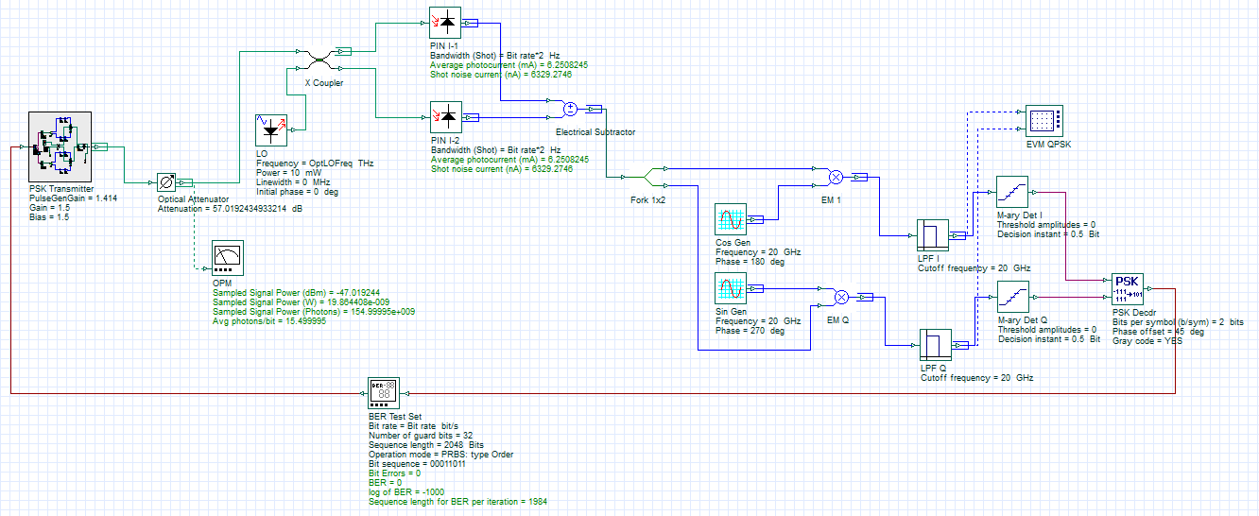
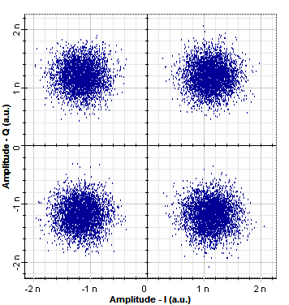
Synchronous heterodyne receiver (QPSK)
In this example the quantum (shot) noise limit of an synchronous heterodyne QPSK balanced receiver is analyzed. The test configuration is as follows: Bit rate: 10 Gb/s; Wavelength (OptSigFreq) = 193.414 THz; Wavelength LO = 193.434 THz; Power LO = 0.01 W; PIN responsivity ~ 1.25 A/W (QE*q/h*freq where QE=1); Dark current = 0 nA
For a BER = 10⁻⁹, the number of photons per bit must equal 18 (from 1/2*exp(-Nphotons)) which is equal to the QPSK homodyne and BPSK heterodyne receiver models. For the former, the noise penalty is 3 dB less but the requirement to use a 90 deg hybrid results in a 3 dB signal penalty thus resulting in the same level of performance compared to QPSK heterodyne. For the latter, the QPSK performance is equal to the BPSK as the QPSK symbol occupies two bit intervals (and thus has the same photons/bit).
REF: K. Kikuchi, "Fundamentals of Coherent Optical Fiber Communications," in Journal of Lightwave Technology, vol. 34, no. 1, pp. 157-179, Jan.1, 1 2016.
Layout: Sync Het Rcvr (QPSK)
I-channel (Real)
Q-channel (Imag)

Slide 12
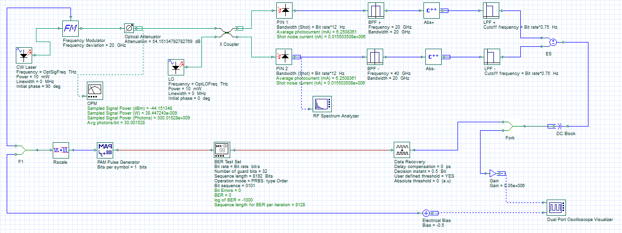
Asynchronous FSK (Dual filter)
In this example the quantum (shot) noise limited performance of an asynchronous heterodyne FSK balanced receiver (dual filter) is analyzed. The test configuration is as follows: Bit rate: 10 Gb/s; Freq deviation (FSK) = 20 Gb/s; Wavelength (OptSigFreq) = 193.414 THz; Wavelength LO = 193.444 THz; Power LO = 0.01 W; PIN responsivity ~ 1.25 A/W (QE*q/h*freq where QE=1); Dark current = 0 nA
Band pass filters are used to isolate each frequency, followed by envelope detection - accomplished by performing wave rectification (absolute value of the incoming signal waveform) followed by detection of the waveform enveloped with a low pass filter.
For a BER = 10⁻⁹, the number of photons per bit must equal 40 (from 1/2*exp(-Nphotons/2))
REF: L. Kazovsky, S. Benedetto, A. Willner, Optical Fiber Communication Systems, Artech House (1996), pp. 280-288.
Layout: ASync FSK (Dual Filter)

Slide 13
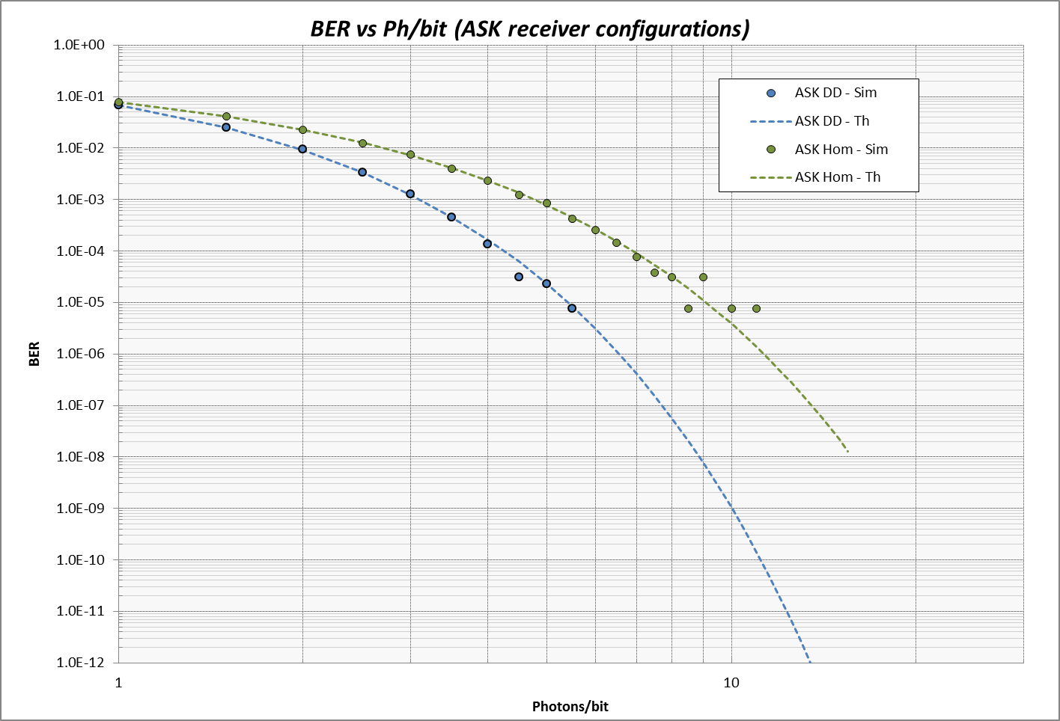
BER waterfall curves (ASK)
Results for BER versus Average photons per bit received are shown below for ASK Direct Detection and ASK Homodyne
Though the ASK DD shows better theoretical quantum-limited performance compared to ASK Homodyne, the practical performance limit of direct detection systems is much higher due to the presence of thermal noise resulting from the load resistance (only shot noise is modeled here)

Slide 14
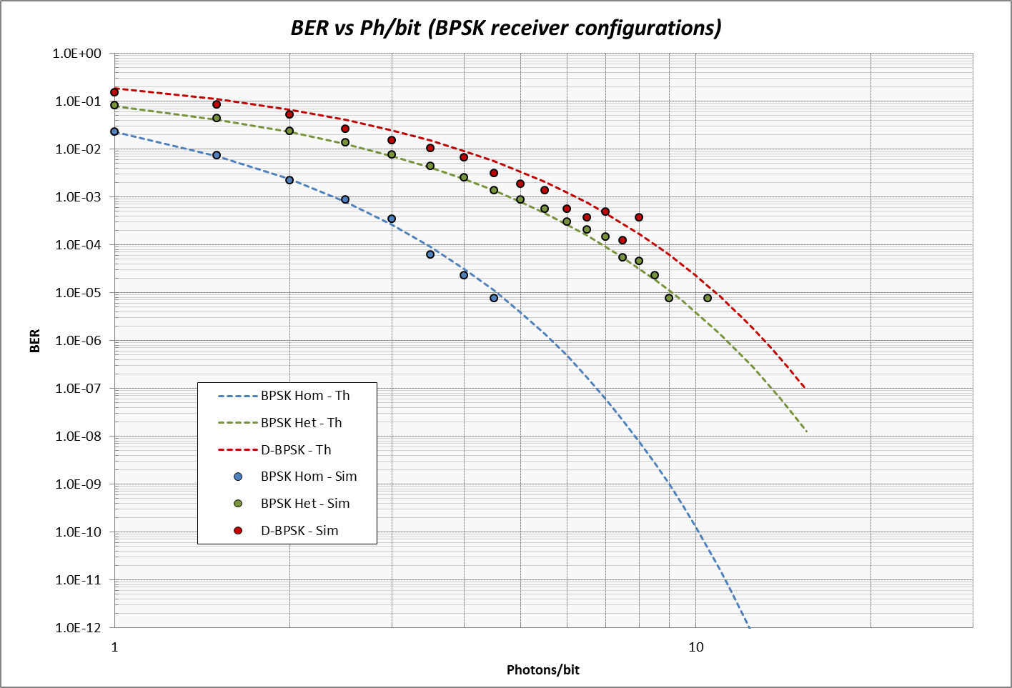
BER waterfall curves (BPSK)
Results for BER versus Average photons per bit received are shown below for BPSK Homodyne, BPSK Heterodyne and Differential BPSK
BPSK Homodyne provides the best shot-noise limited performance (but requires freq/phase synchronization between the signal and LO) , followed by BPSK Heterodyne (with a 3 dB penalty resulting from a doubling of the noise density) and Diff BPSK (with an additional 0.5 dB resulting from the use of a differential detection method that however doesn’t require an electrical PLL)

Slide 15
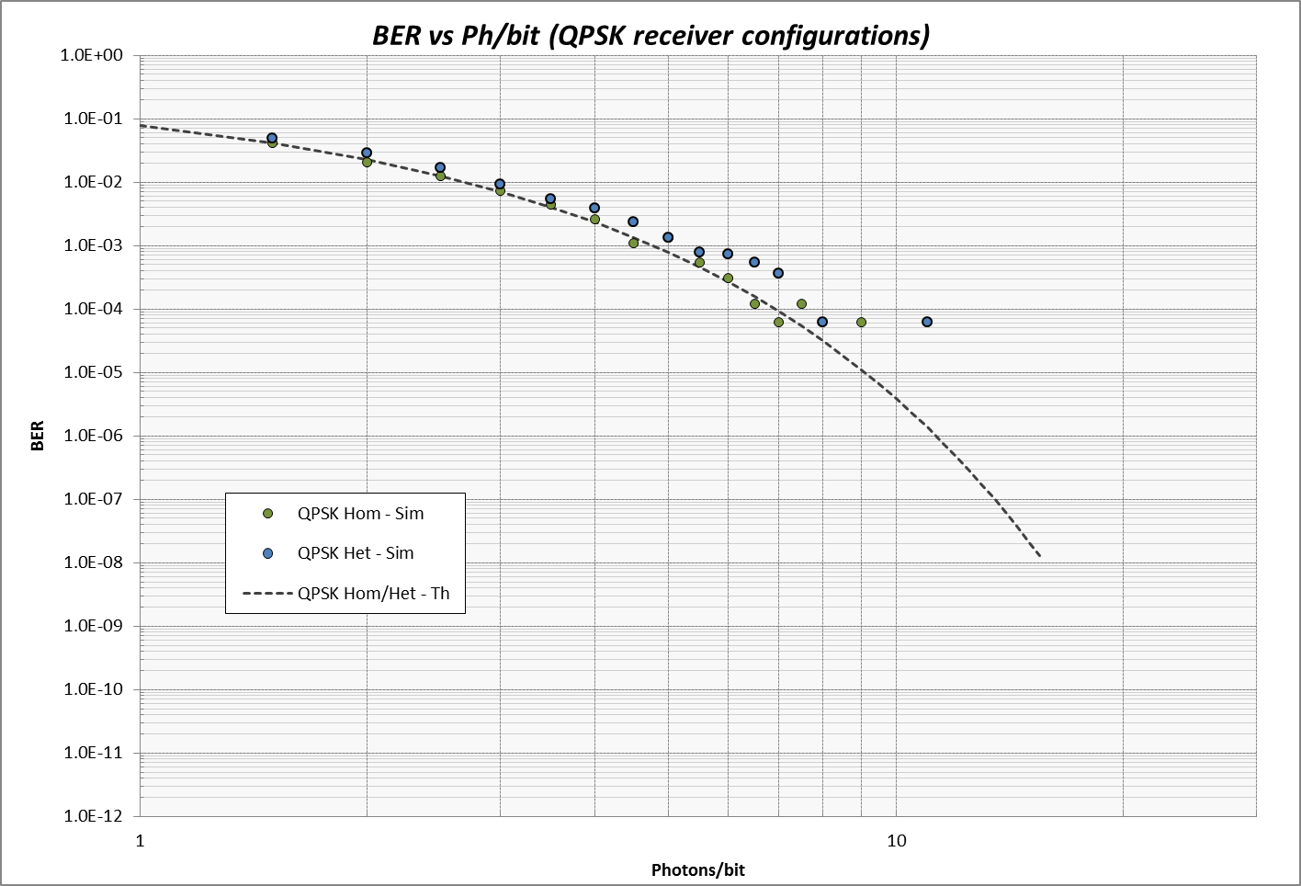
BER waterfall curves (QPSK)
Results for BER versus Average photons per bit received are shown below for QPSK Homodyne and QPSK Heterodyne
Both receiver models provide the same performance as the noise penalty is 3 dB less for QPSK Homodyne but this benefit is offset from the requirement to use a 90 deg hybrid (which re-introduces a 3 dB signal penalty)

Slide 16
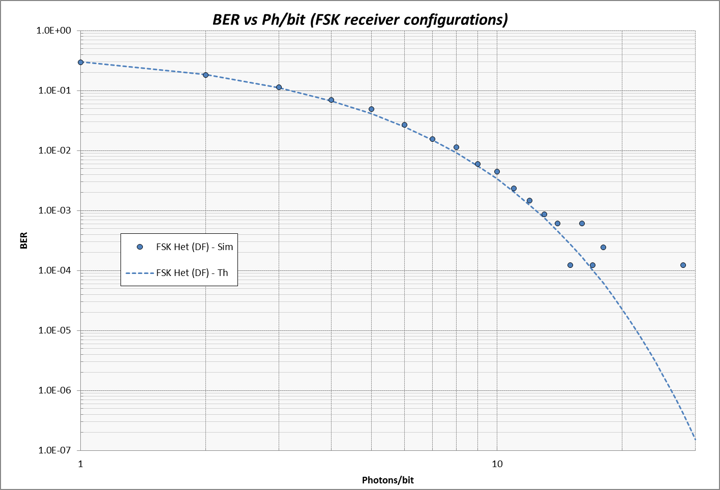
BER waterfall curve (FSK)
Results for BER versus Average photons per bit received are shown below for FSK Het (Dual Filter)

