Slide 1
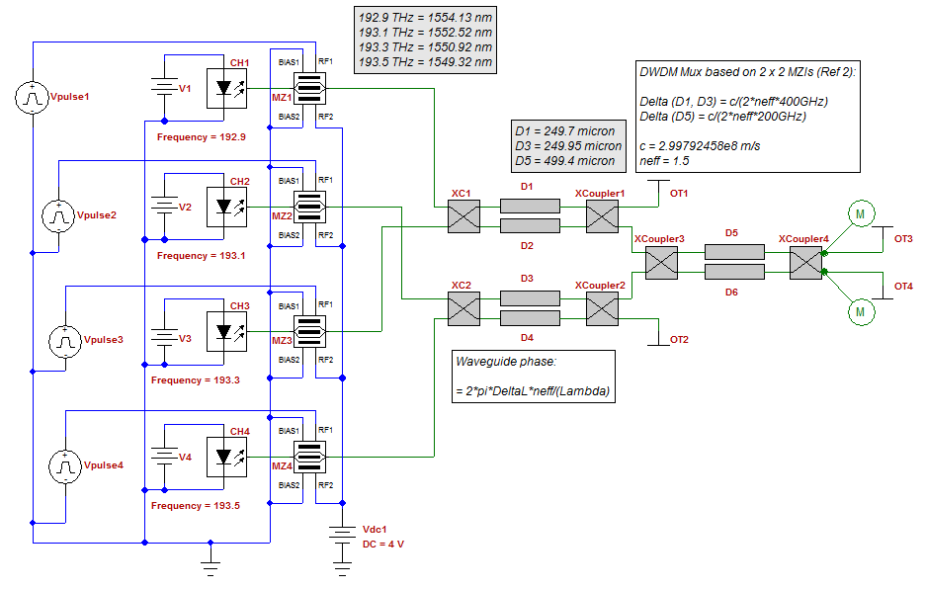
Ring Resonator Gyroscope

Slide 2
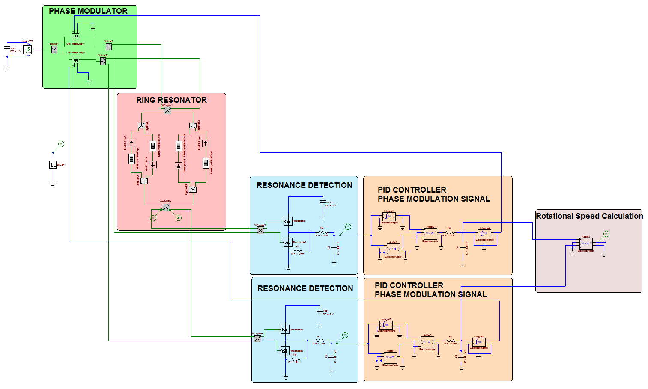
Fiber Optic Gyroscope Building Blocks

Slide 3
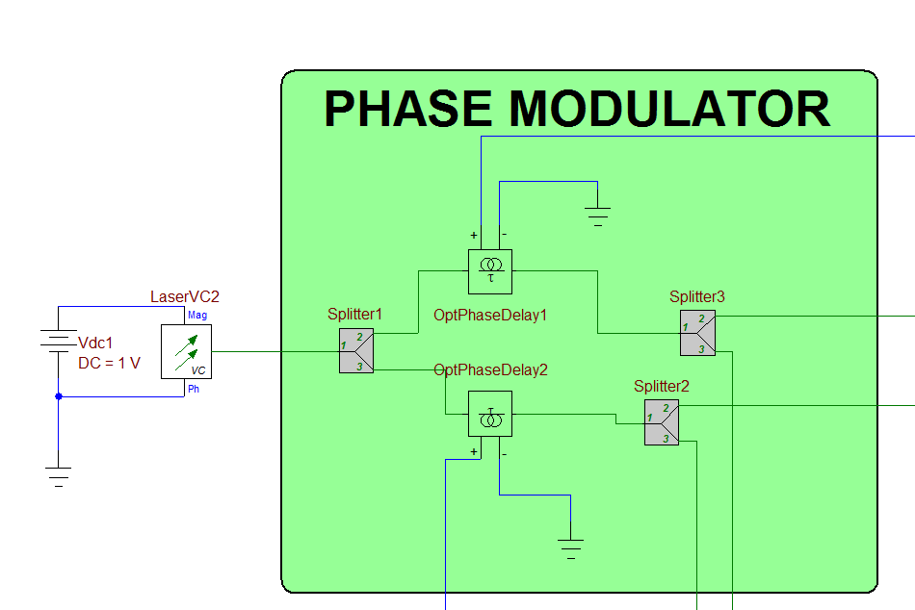
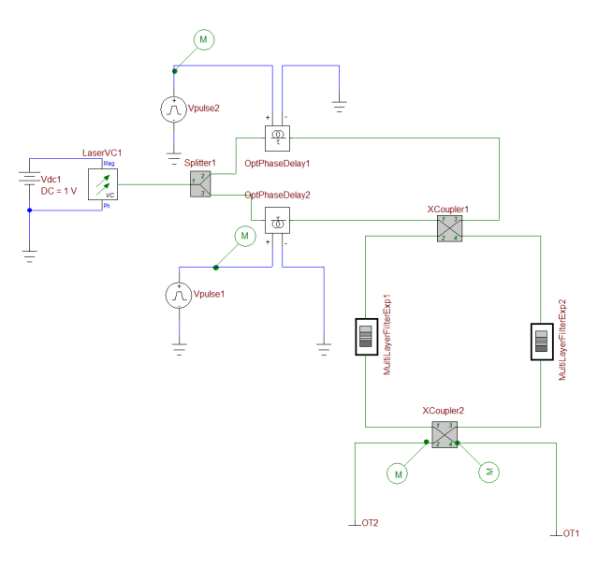
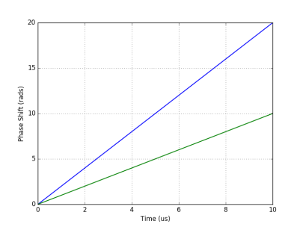
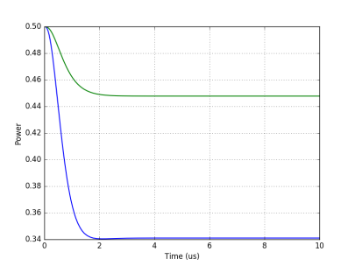
Phase Modulator
Phase Modulation
The first splitter is used to create clockwise (CW) and counter clockwise (CCW) propagating waves in the ring resonator using a single laser source
In OptiSPICE phase delay elements can be used to change the phase of an optical signal using a voltage node
In this Ring Resonator Gyroscope design, phase delay elements are used to introduce a linear increase in phase over time to shift the carrier frequency of the CW and CCW propagating waves
This frequency shift is used to keep the carrier frequency of the CW and CCW propagating waves at resonance
Linear Phase Increase
The simulation results show the effect of the linear increase in phase
At time=0 the carrier frequency is equal to the resonant frequency of the ring resonator
The introduction of the linear increase in phase over time shifts the carrier frequency of the waves travelling inside the ring resonator
Over time, because the carrier frequencies shift towards off-resonance, the output at the drop port decreases and reaches a new steady state

Slide 4
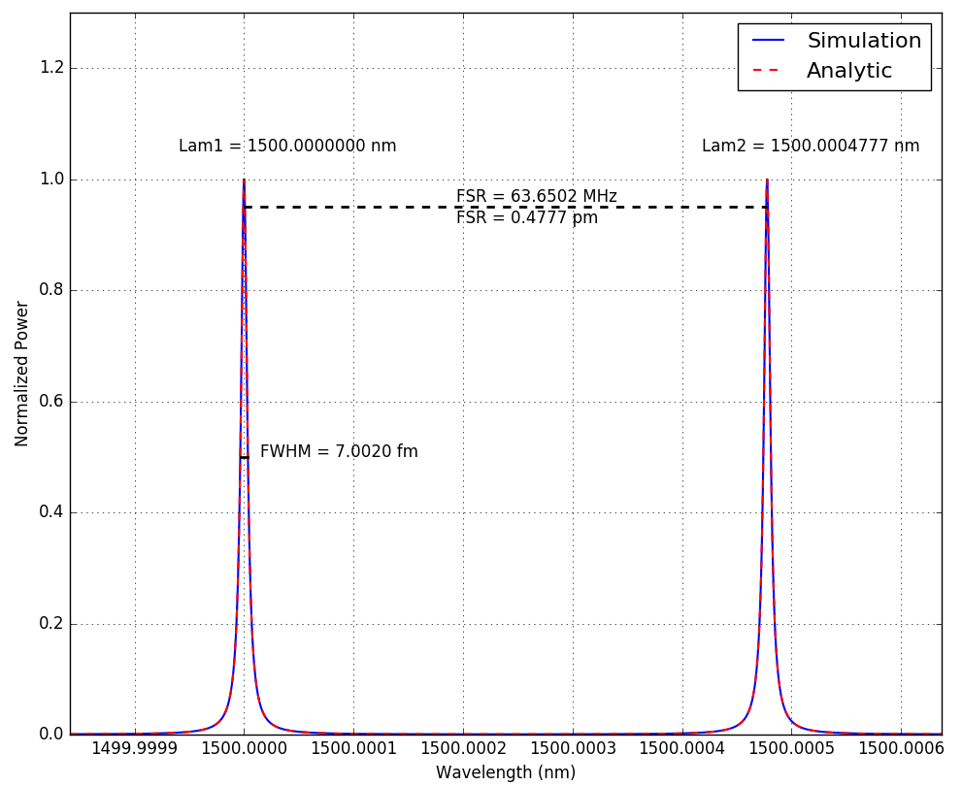
OptiSPICE Ring Resonator Model
Ring Resonator parameters
Circumference of the ring, L = 3.14 m
Refractive index of the waveguide, n = 1.5
Propagation loss, a = 1
Coupling coefficients, r1 = 0.045, r2 = 0.045
Change in length (L1 = L + alphaL*V) , alphaL = 1
Basic Equations*
, m = 1,2 3 ...
*Bogaerts, Wim, et al. "Silicon microring resonators." Laser & Photonics Reviews 6.1 (2012): 47-73.

Slide 5
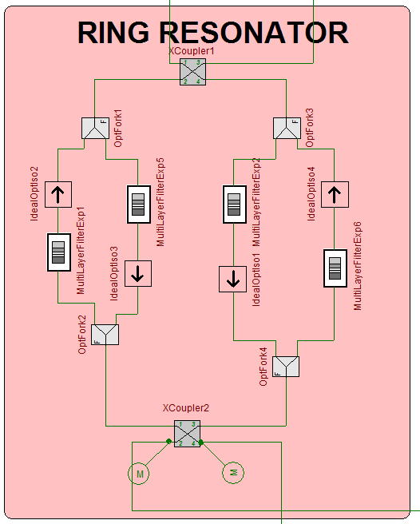
Ring Resonator/Sagnac Effect
Building blocks
2 Cross Couplers
4 Waveguides
4 Optical Isolators
4 Waveguides
OptiSPICE Model
Explicit multilayer filter model is set up with a single layer
The length change in the waveguide can be controlled by a voltage source
The relationship between the length change in the waveguide and the voltage can be made linear or non-linear
Optical Forks and Isolators are used to separate clockwise (CW) and counter clockwise (CCW) traveling signals so a different length change (due to Sagnac effect) can be applied to each signal
Sagnac Effect*
Number of turns, N
Speed of light, c
Speed of light in dielectric medium,
Area of the ring resonator, A
Rotational Speed,
The change in distance seen by CW and CCW signals,
The relationship between rotational speed and change in resonant frequency is given by,
CW
CCW
CCW Drop Port
CW Drop Port
*VAWTER, GREGORY A., et al. Developments in pursuit of a micro-optic gyroscope. No. SAND2003-0665. Sandia National Labs., Albuquerque, NM (US); Sandia National Labs., Livermore, CA (US), 2003.

Slide 6
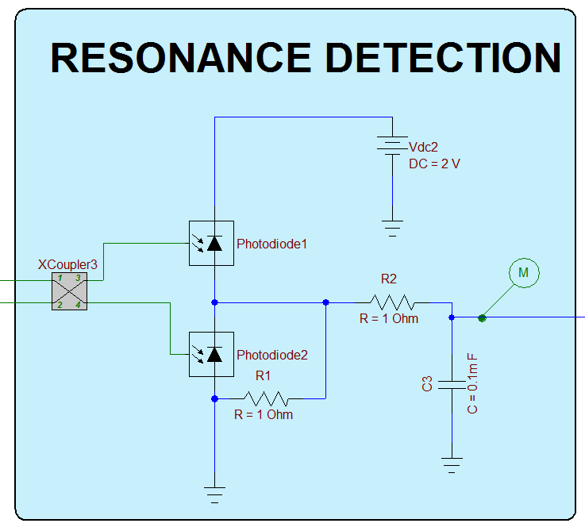
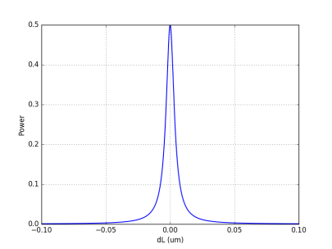
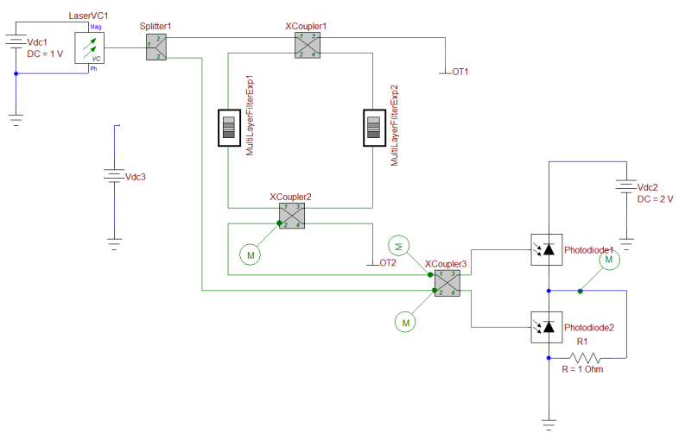
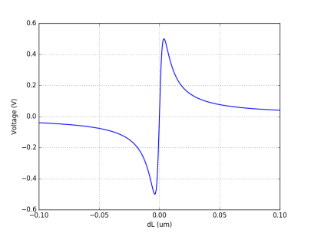
Resonance Detection
Keeping the carrier at resonant frequency
2 separate resonance detectors are used for CW and CCW propagating optical signals
The output of the balanced detectors are used to drive the controller that generates the signal for phase modulation
The RC filter following the output of the balanced detectors is used to filter out sudden changes at the output which may destabilize the circuit and cause divergence during simulation
Balanced Detectors
Drop Port Output
Laser Output
RC Filter
Length vs. Detector Output
The simulation results show the balanced detector output vs. the change in the circumference of the ring resonator
The carrier frequency is equal to the resonant frequency of the ring resonator when dL = 0, the drop port output is at its peak and the balanced detectors are at 0 V
The output of the balanced detectors increase/decrease as the circumference of the ring resonator increases/decreases
The output at the drop port also decreases as the size of the circumference changes

Slide 7
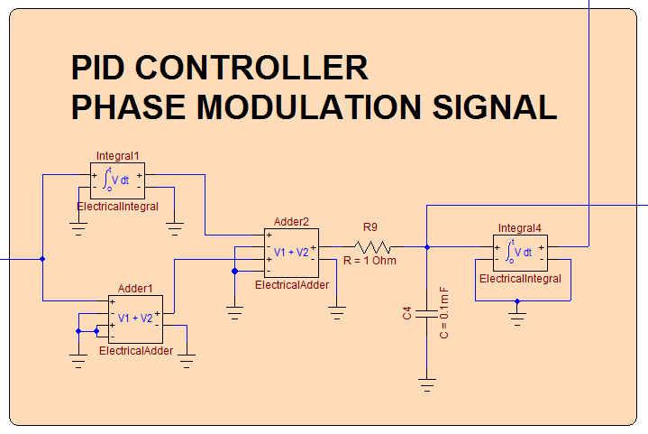
PID CONTROLLER
Phase Modulator Control Signal
Generating Phase Modulation Signal
When there is a shift in resonant frequency the output of the balanced detectors shift away from 0 V
The proportional-integral (PI) controller calculates a shift in frequency proportional the balanced detector output
The integrator following the PI controller generates the phase modulator signal that shifts the carrier frequency going into the ring resonator
The RC filter following the output of the PI controller is used to filter out sudden changes at the output which may destabilize the circuit and cause divergence during simulation
PI CONTROLLER
Balanced Detector Output
RC Filter
Integrator

Slide 8
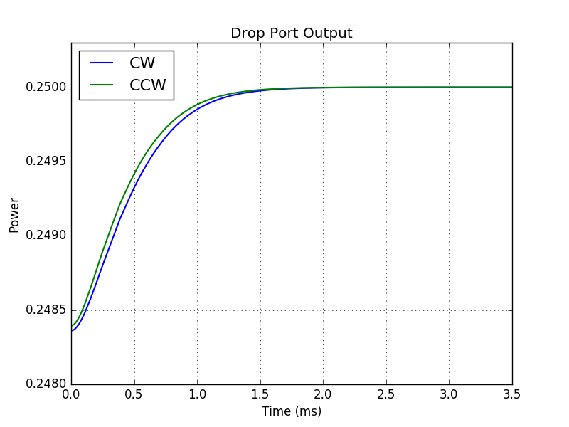
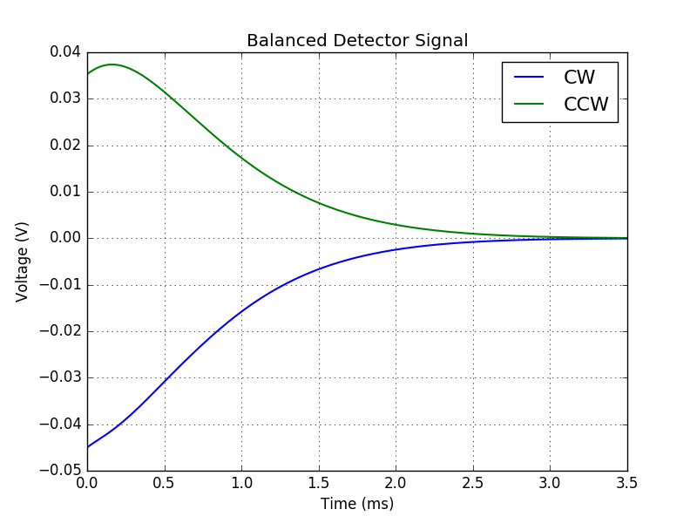
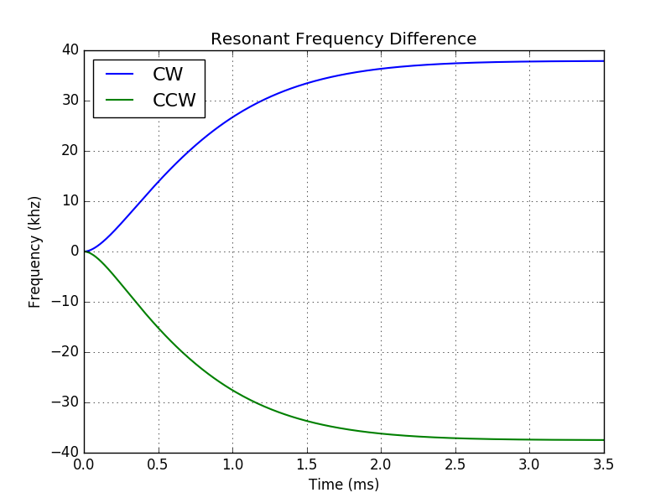
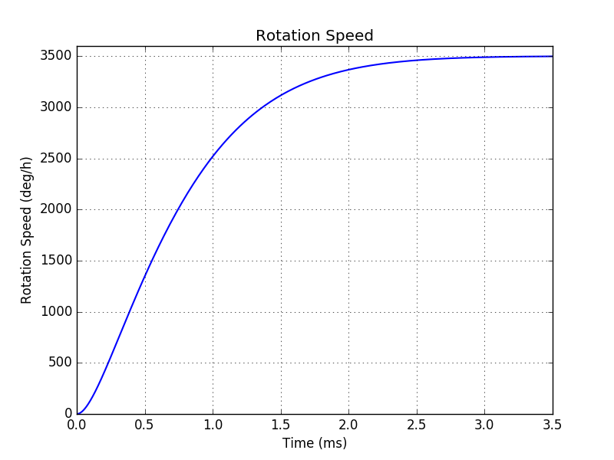
Simulation Results
Calculating the rotation speed
In this example rotation speed of 3500 deg/h (0.01697 rad/s) was applied to the ring resonator by varying its circumference using the following equation,
The simulation results from OptiSPICE shows the output of the drop port moving back to resonance (max output) over time
As the output of the drop port approaches resonance the balanced detector output reaches 0 due to the application of the linear phase increase by the phase modulator
Finally the rotation speed can be calculated from the difference in resonant frequencies of CW and CCW signals using the following equation,

