Slide 1

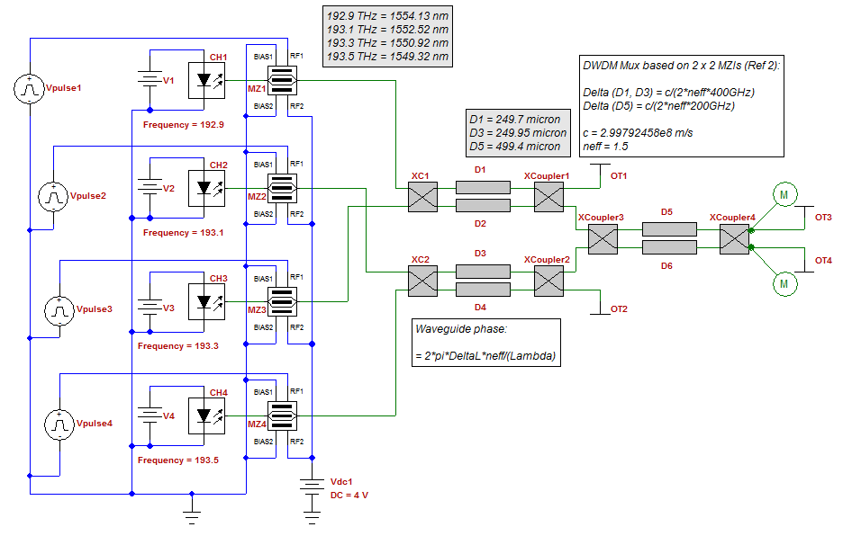


Optical PLL for homodyne detection

Slide 2

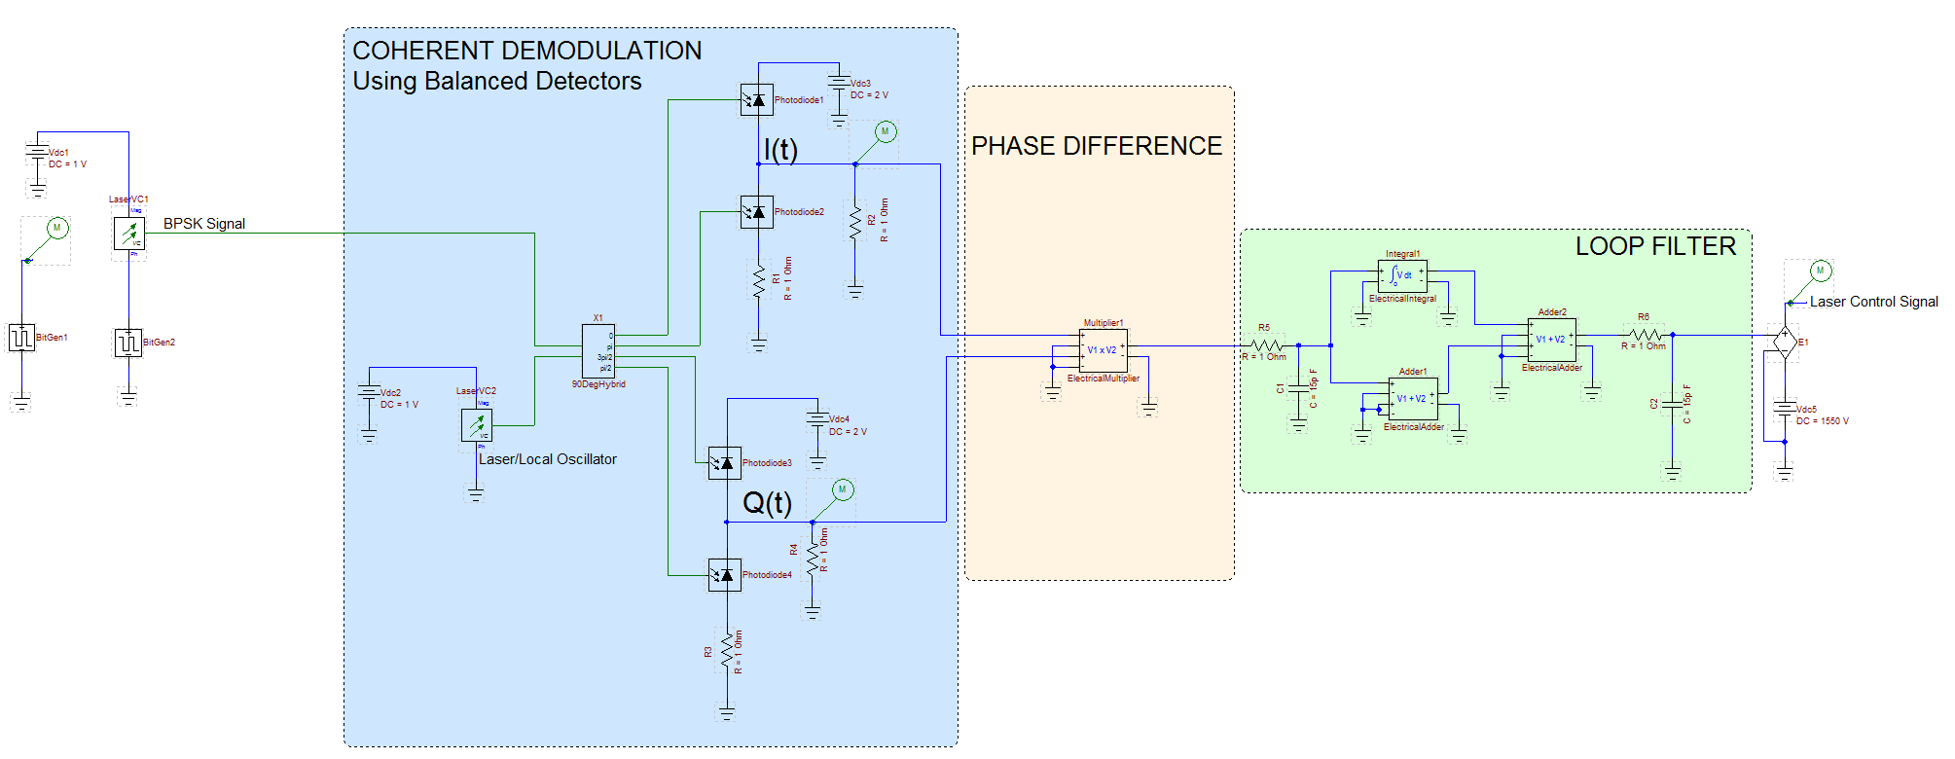


Optical BPSK PLL building blocks
Signal Generation and Detection
  BPSK Signal Generator
  Local Oscillator
  90 degree hybrid
  Balanced detectors
Phase Difference Calculation
  Electrical multiplier
Feedback: Generating the control signal
  Loop Filter
  DC Offset

Slide 3


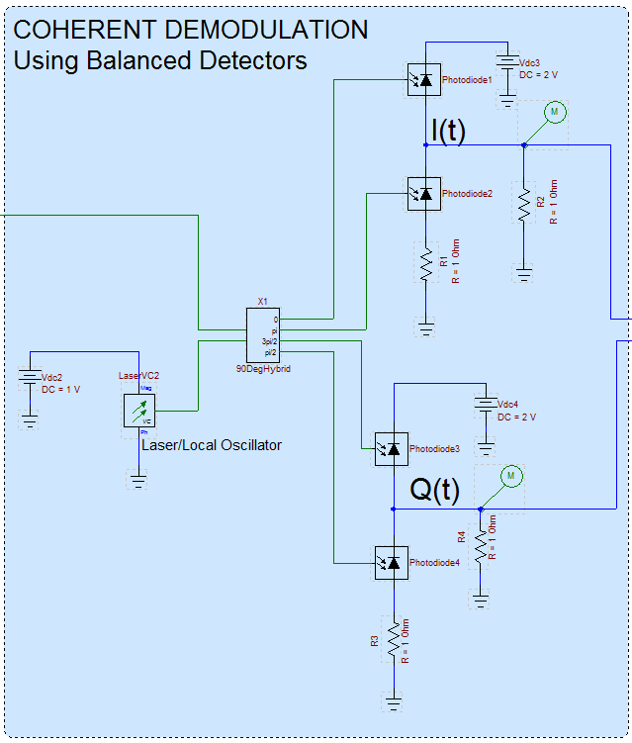
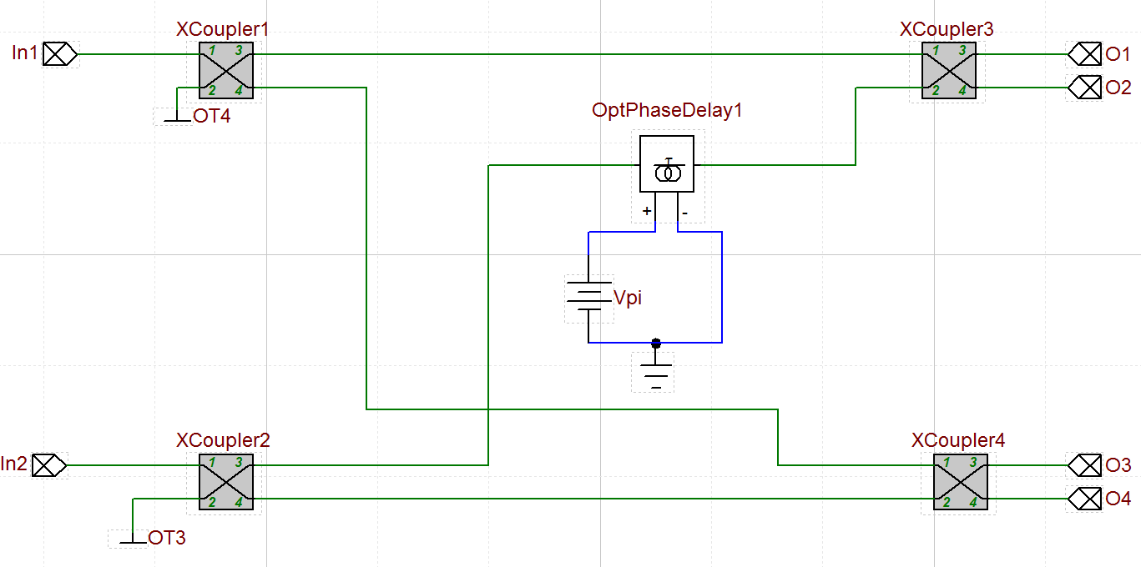

90 Degree Hybrid
The 90 Degree Hybrid mixes the incoming optical field with the local oscillator (LO) optical field and produces four outgoing signals with phase differences of 0, π, 3π/2 and π/2
The electric field amplitudes of the PSK and LO signals are represented by A and B, respectively
PSK signal
Local oscillator

Slide 4


Coherent detection with balanced detectors
The instantaneous power incident on each photodiode can be calculated as follows
Therefore the instantaneous field intensity (power) in each arm is equal to,
LO field squared (DC term)
Sum and difference frequency terms (mixing)
Signal field squared (DC term)

Slide 5

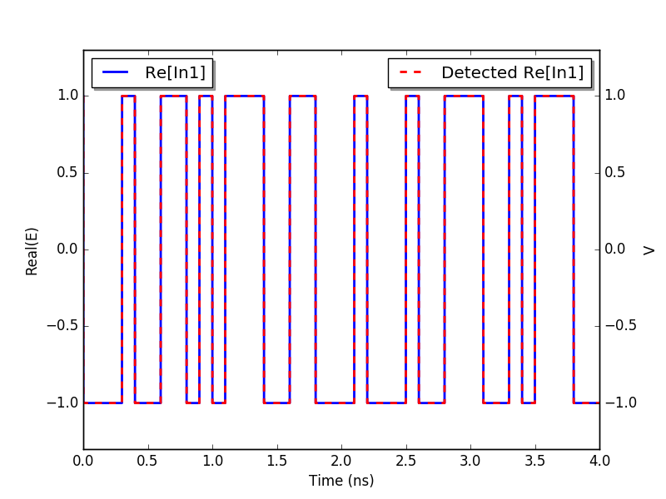
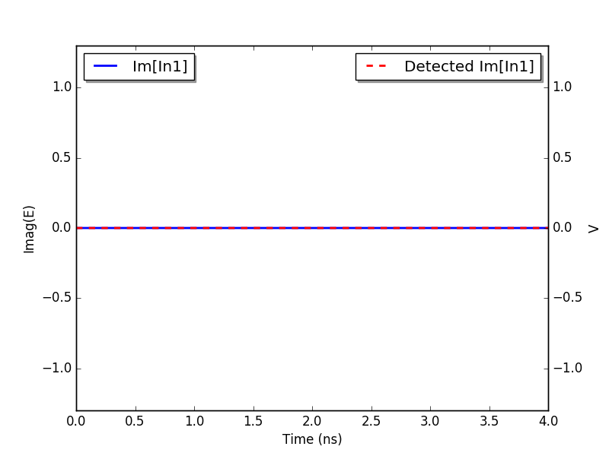
Homodyne balanced detection (ideal)
Perfect recovery in ideal conditions assuming
ideal photodiode with Responsivity = 1
and
Represents the real part of the detected BPSK signal (Real(In1)) – measured from the upper branch of the balanced detector (I(t))
Represents the imaginary part of the detected BPSK signal (Imag(In1)) – measured from the lower branch of the balanced detector (Q(t)). Under ideal conditions, this signal should be zero (the phase modulation occurs only along the I axis)

Slide 6
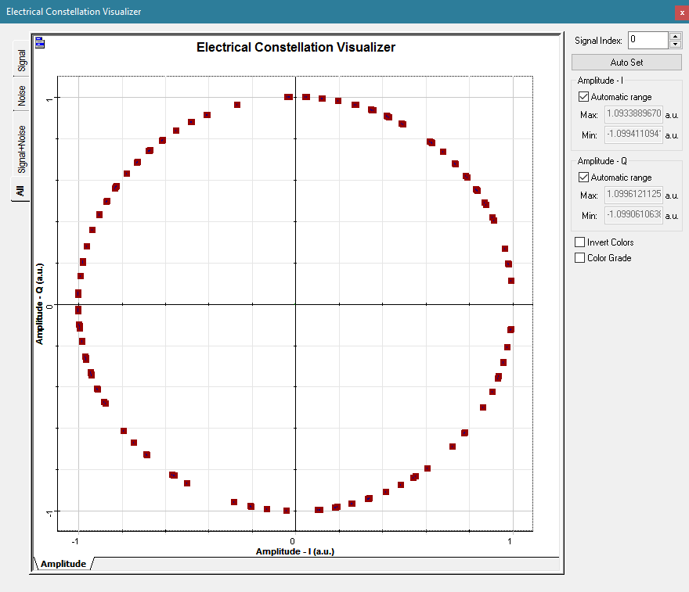


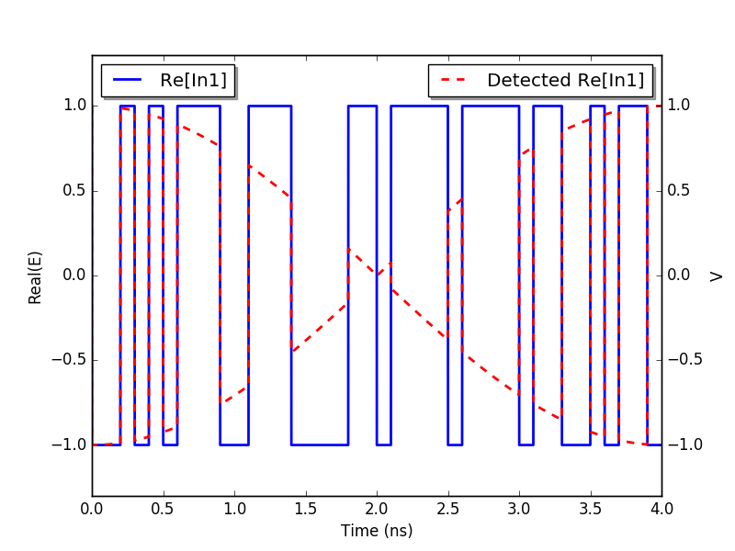
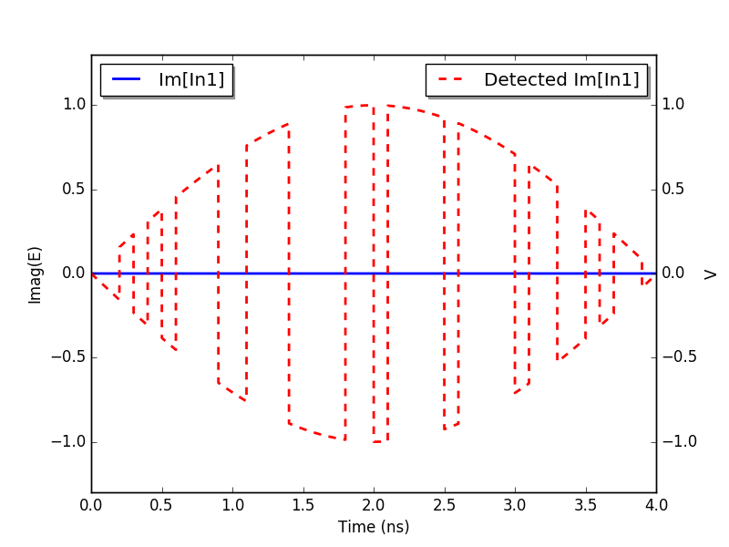
Homodyne balanced detection (non-ideal)
In non-ideal conditions phase correction is needed
and/or
Rotation in the constellation diagram
Due to a frequency difference between the signal and LO, the detected BPSK signal constellation will have terms in both the I (real) and Q (imaginary) axes. This results in a rotation of the I-Q constellation

Slide 7
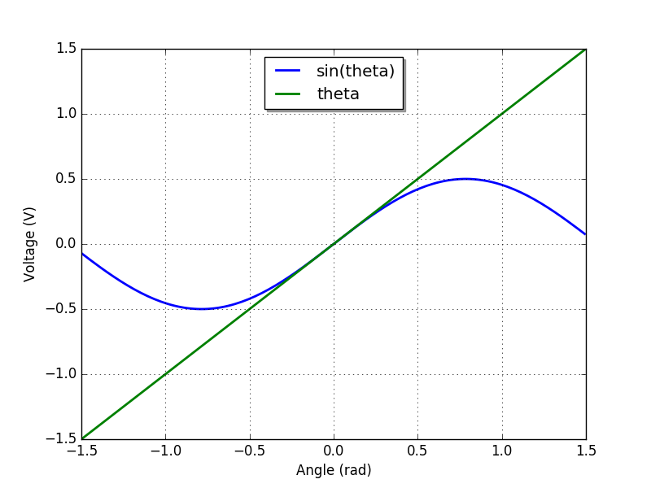



Phase difference (Electrical multiplier) 1
Electrical multiplier estimates the phase
by multiplying I and Q
Using small angle approximation
The plot shows the sweep of the phase where

Slide 8
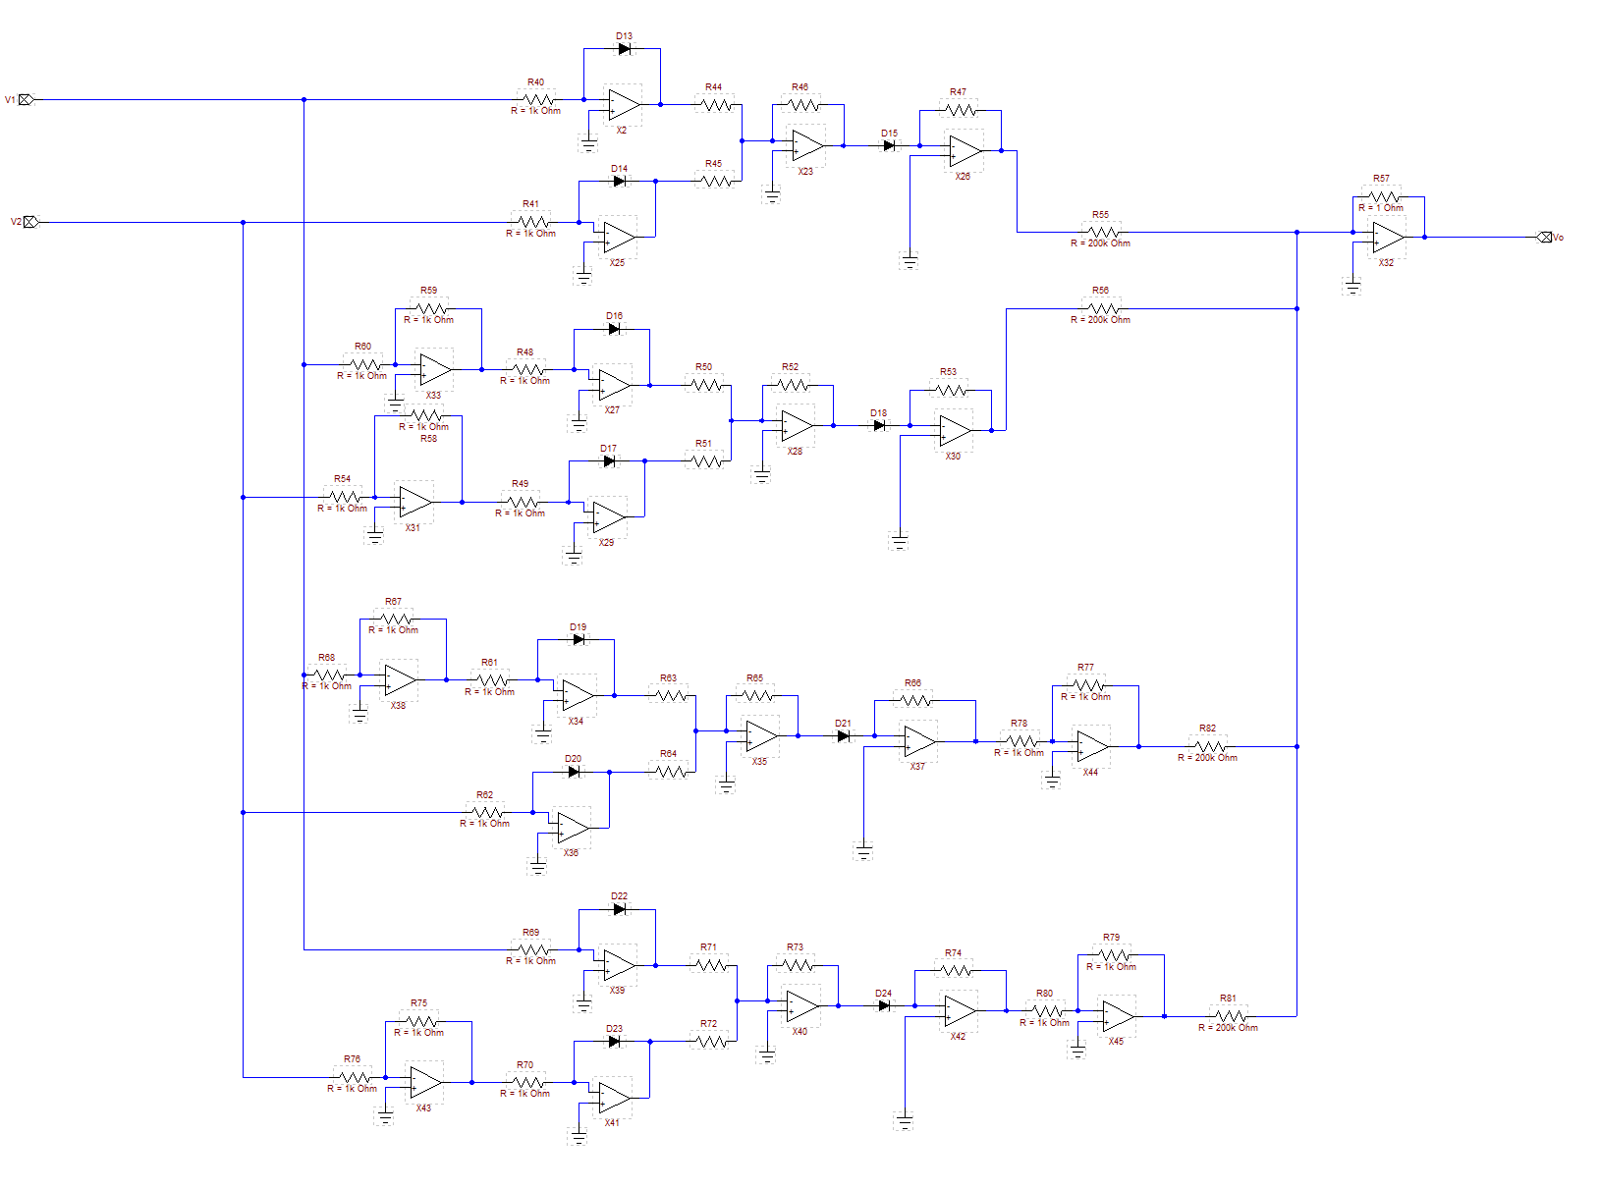
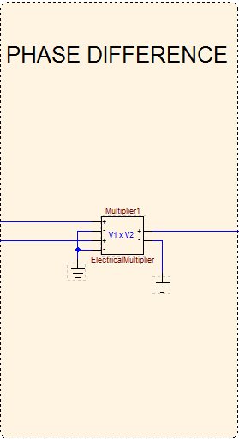
Phase difference (Electrical multiplier) 2
There is no straightforward circuit for analog multiplication (normally achieved by using log and inverse log)
This can be realized using operational amplifiers or transistors (see left diagram below). OptiSPICE also has an electrical multiplier element (see right diagram below) which can perform this operation mathematically.

Slide 9
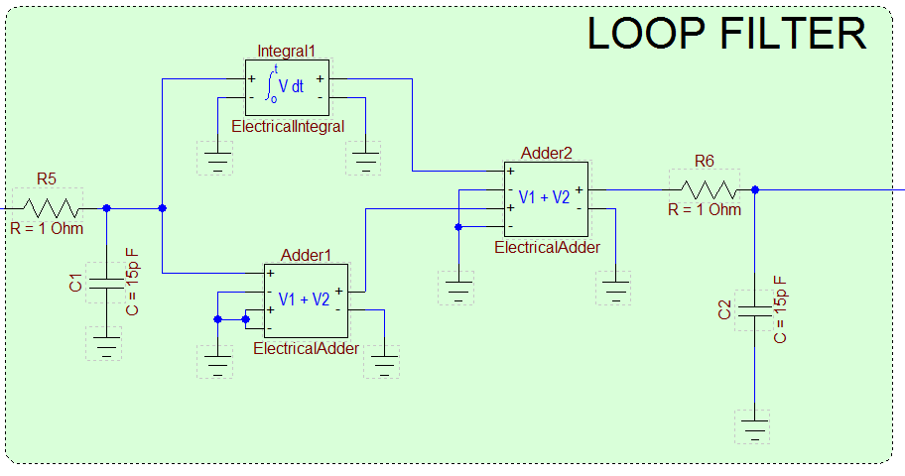


Loop Filter-PI Controller
A loop filter is used to generate the control
signal for the tunable laser from the detected phase difference. It consists of a proportional
integral controller and a low pass filter
are scaling factors
is the output of the electrical multiplier which
is the detected phase difference (error signal)
Adder and Integrator circuits can be created using operational amplifiers
OptiSPICE has built-in voltage adder and integrator elements that can be used directly to perform these operations
The controller works as long as the phase or frequency difference is not too large
There is not any straight forward way to figure out the values for the scaling factors
They can be adjusted manually or through an optimization routine to obtain a desired PLL response

Slide 10
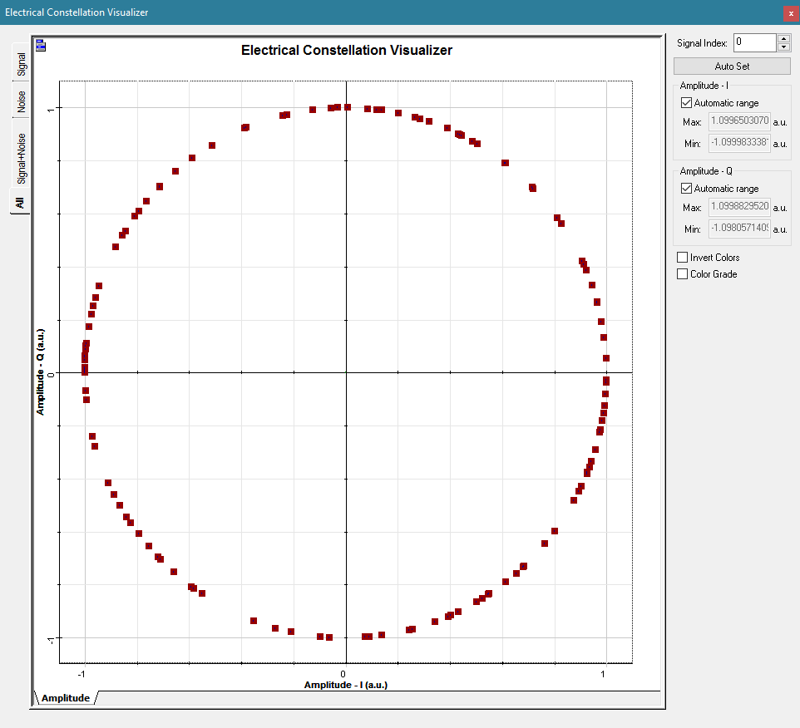
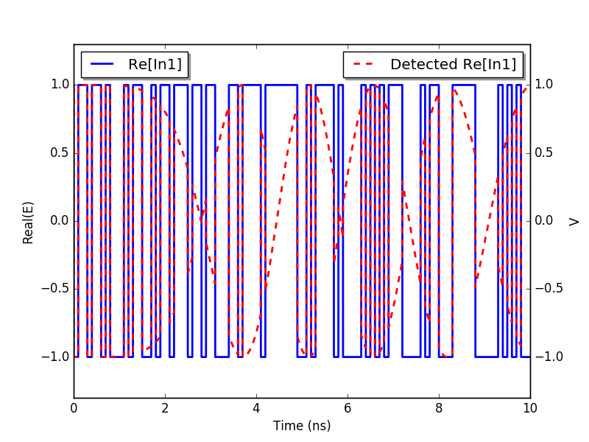
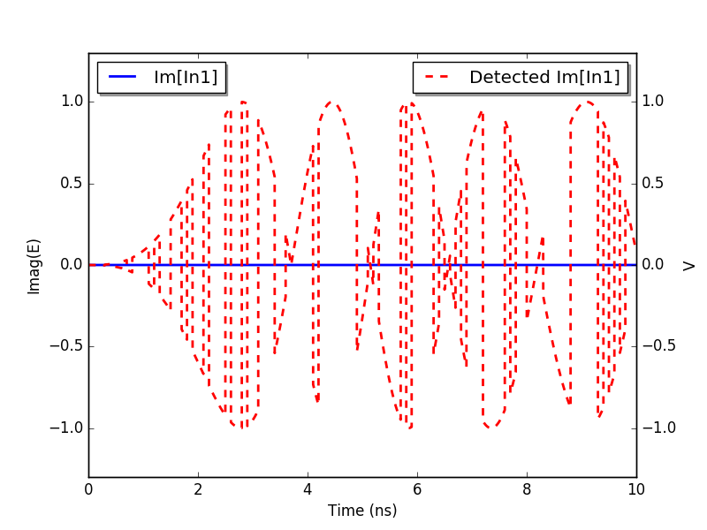
Simulation results – no PLL
Without the active phase correction of the PLL
a constant frequency difference between the local
oscillator and the carrier signal detected I and Q
do not have the correct phase (pi or –pi for BPSK).
The constant frequency difference results in the
rotation of the constellation diagram
Phase Locked Loop OFF

Slide 11
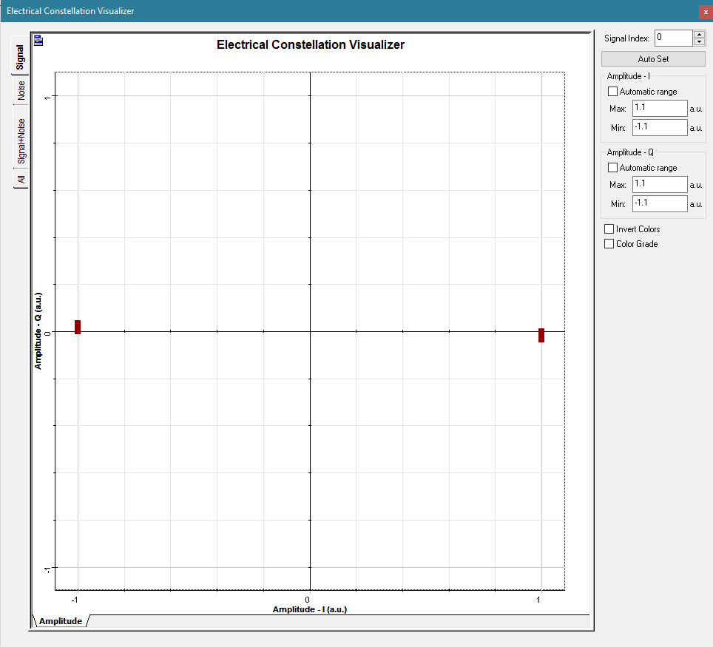
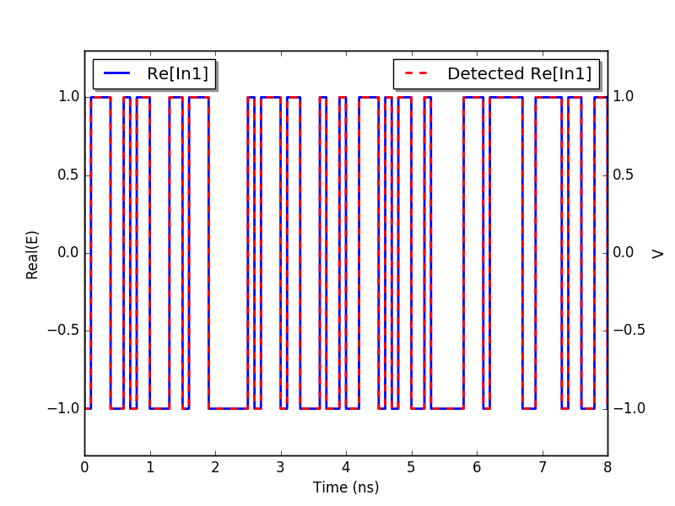
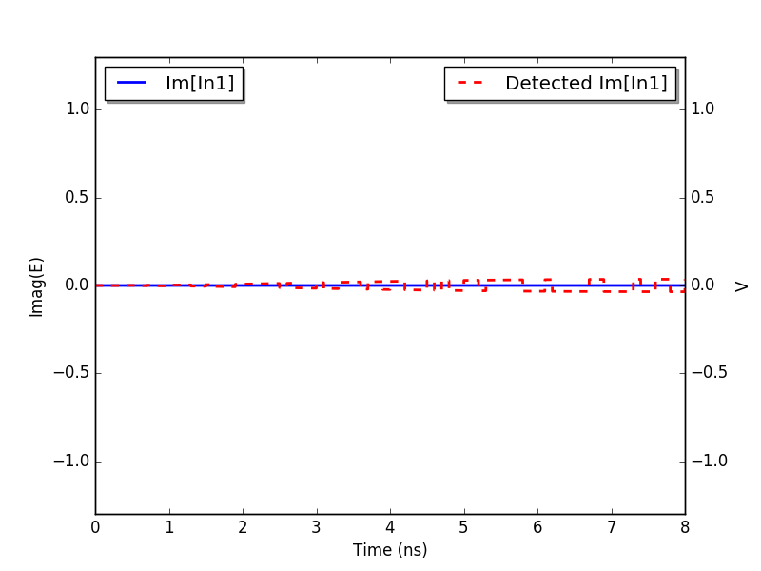
Simulation results – PLL on
When the PLL is activated the frequency/phase of
the local oscillator tracks the frequency/phase of the
carrier signal. Therefore the detected I and Q have the right phase and the constellation diagram does not rotate
Phase Locked Loop ON

