Slide 1
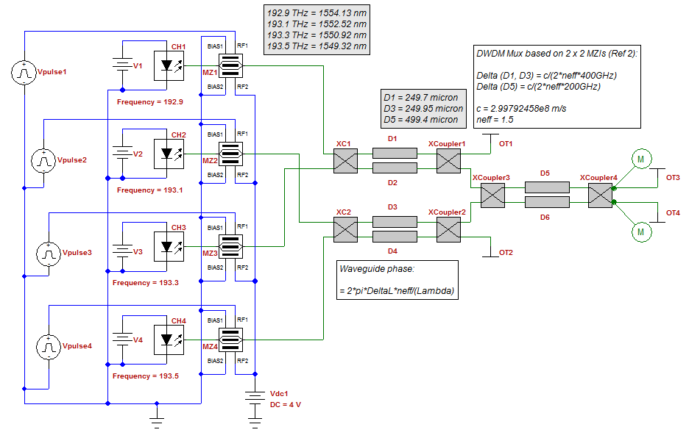
Silicon Depletion-Mode TW Modulator

Slide 2
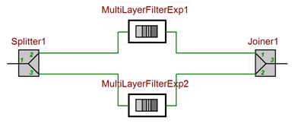
Introduction (MZM)
Mach Zehnder Modulator (MZM)
Phase shift is achieved from using Pockels Effect, Kerr, or carrier injection/depletion
Short and compact but requires higher voltage/power
Limited modulation speed (10-40 Gb/s)
Building blocks
1 Splitter
1 Joiner
2 Waveguides
OptiSPICE Model
Explicit multilayer filter model is set up with a single layer
The change in the refractive index can be controlled by a voltage source
Can be configured as push-pull or asymmetric

Slide 3
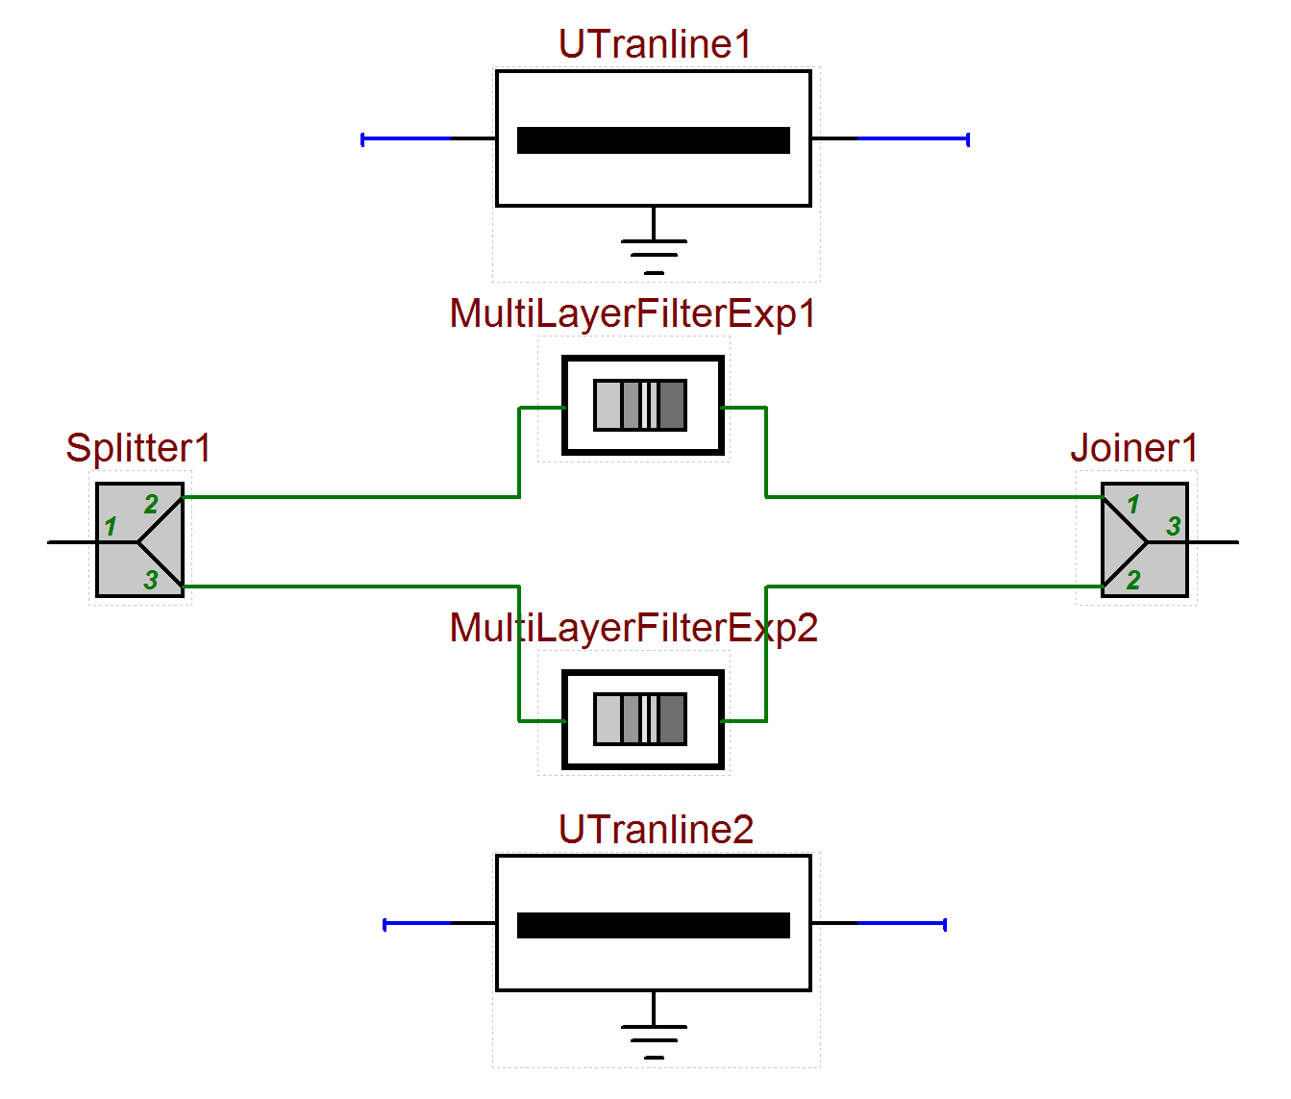
Introduction (TW Modulator)
Traveling Wave MZM
Modulation occurs the same way as MZM
Phase shift is achieved from using Pockels Effect, Kerr, or carrier injection/depletion
Longer device but uses lower voltage/power compared to regular MZM
Can achieve higher modulation speeds (~70 Gbit/s)
Building blocks
1 Splitter
1 Joiner
2 Transmission line electrodes
2 Waveguides
OptiSPICE Model
The waveguide consists of many layers with controllable refractive indexes
Each transmission line corresponds to a different metal contact connected to one of the waveguides
The waveguides and the transmission line models have the same length and the same number of sections
The refractive index of each layer is a function of the voltage in the corresponding section of the transmission line

Slide 4
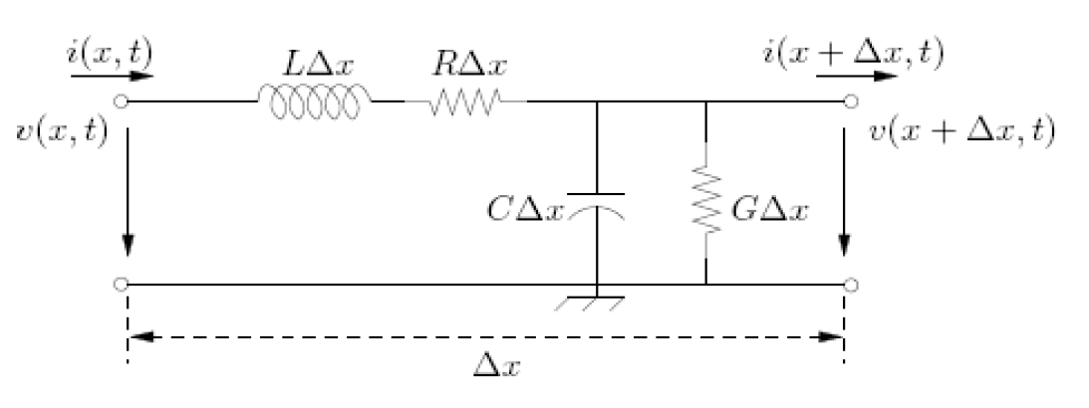
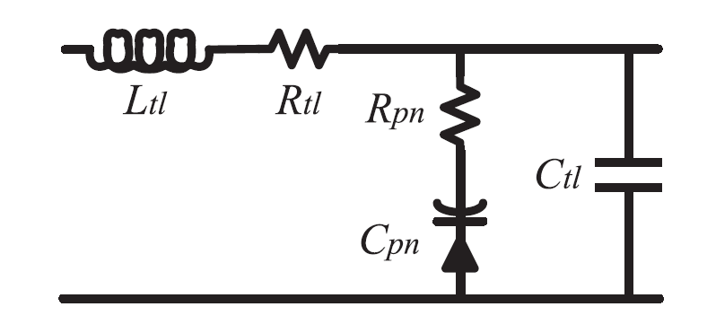
Si-TWM Model Overview
Modified transmission line model for PN Junction
Sectionalized modulator arms (MLF + TL)
Δn α E in each section (can be nonlinear)
Transmission line model
Modified Transmission Line Model*
Single sections connected to a single layer of a multilayer filter
*K. Zhu, V. Saxena and W. Kuang, "Compact Verilog-A modeling of silicon traveling-wave modulator for hybrid CMOS photonic circuit design," 2014 IEEE 57th International Midwest Symposium on Circuits and Systems (MWSCAS), College Station, TX, 2014, pp. 615-618.

Slide 5
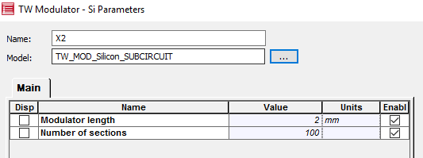
Parameters
Transmission line (model parameters)
100 Sections (Number of sections)
Rtl = 2kohm/m
Ctl = 120 pf/m
Ltl = 500 nH/m
RS = 13e-3 ohm*m
CJ = 186 pf/m @(-3V Reverse Bias)
d = 2 mm (Modulator length)
Transmission line (calculated parameters)
R0 = re(Z0) = 43 ohm @ 40 Ghz
neff = 3.4@ 40 Ghz
v = 8.8174e+07 m/s @ 40 Ghz
Multilayer filter (model parameters)
n = 3.4 (Refractive index)
d = 2 mm (Modulator length)
100 ML filter layers (Number of sections)
Multilayer filter (calculated parameters)
v = c/n = 8.8174e+07 m/s
Vpi =1.3 V

Slide 6
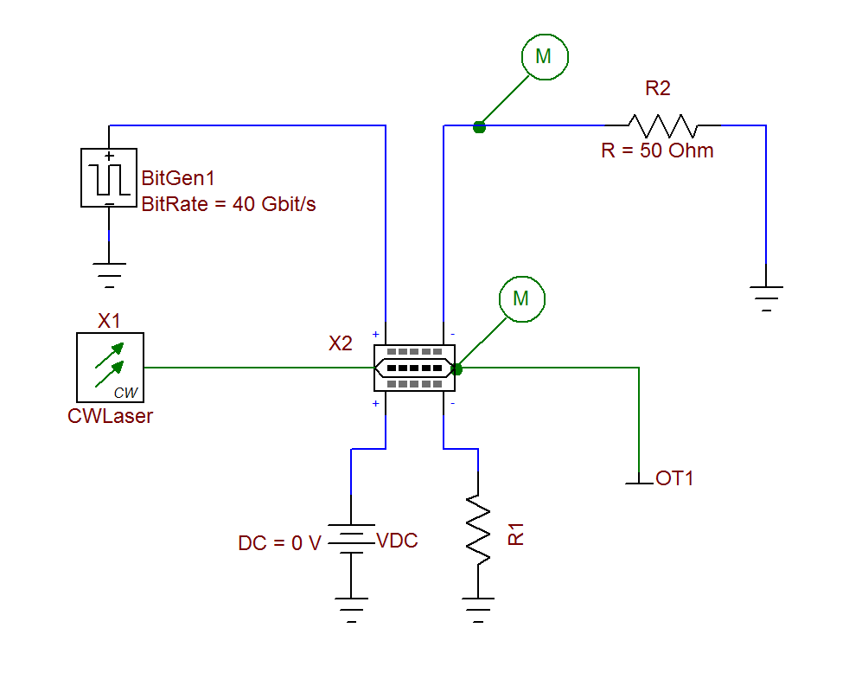
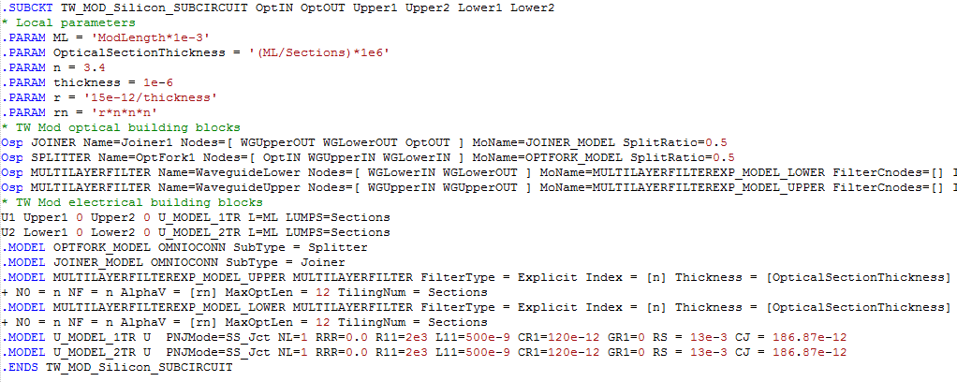
OptiSPICE TWM circuit
Load at the end of the metal contact
Sub-circuit combining all the elements

Slide 7
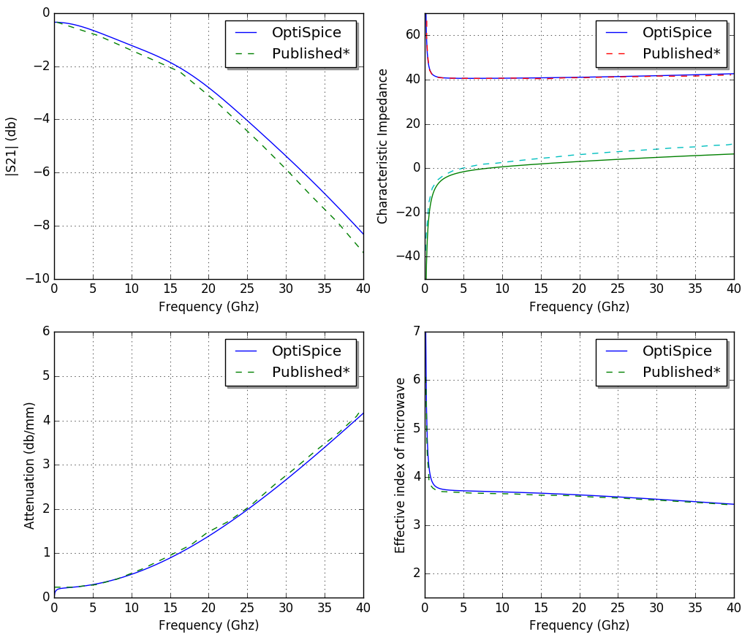
Transmission line characteristics
* Hao Xu, Xianyao Li, Xi Xiao, Zhiyong Li, Yude Yu and Jinzhong Yu, "Demonstration and Characterization of High-Speed Silicon
Depletion-Mode Mach–Zehnder Modulators," in IEEE Journal of Selected Topics in Quantum Electronics, vol. 20, no. 4, pp. 23-32,
July-Aug. 2014.

Slide 8
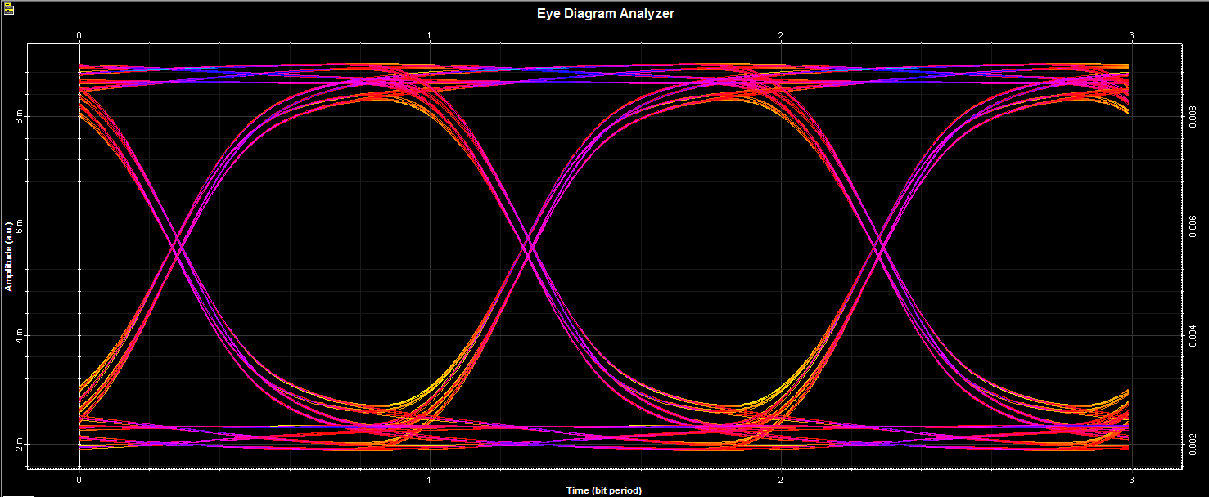
Optical eye results
Eye diagram results for traveling wave modulator simulation (Ref design: TWMZM_Silicon.osch)

Slide 9
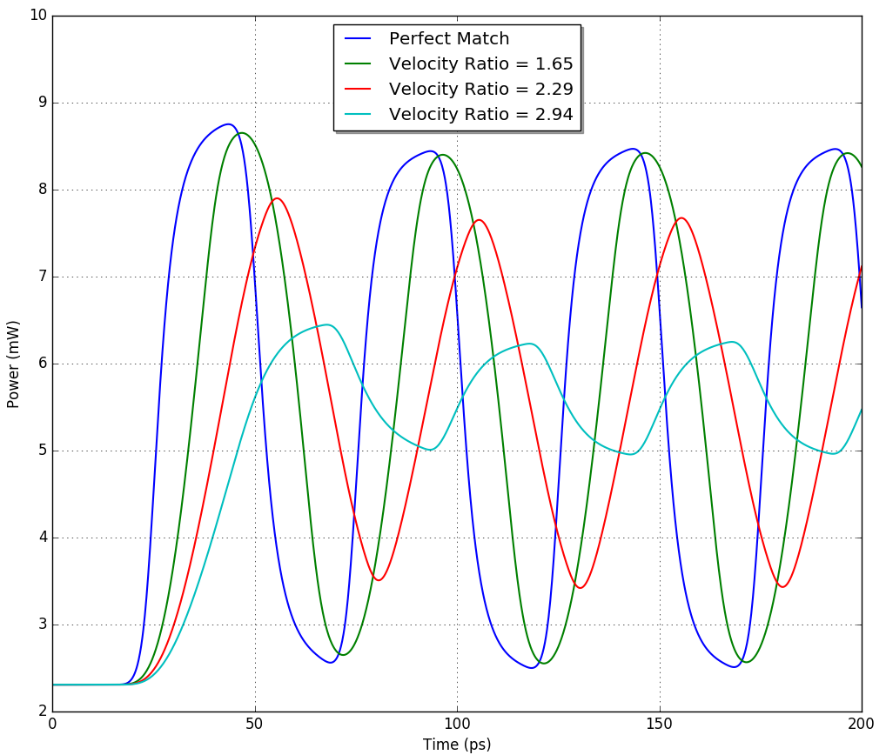
Velocity mismatch simulation
In this simulation the refractive index of the waveguide was increased to reduce the velocity of the electric field
As the velocity mismatch becomes more severe the change in the refractive index and the electric field traveling in the waveguide do not overlap long enough
The reduced overlapping time decreases the total amount of phase shift accumulated by the traveling electric field, therefore the extinction ratio gets smaller
OptiSPICE simulation showing velocity mismatch
in the traveling wave modulator (Ref design: TWMZM_Silicon_VelocityMismatch.osch)

