Slide 1
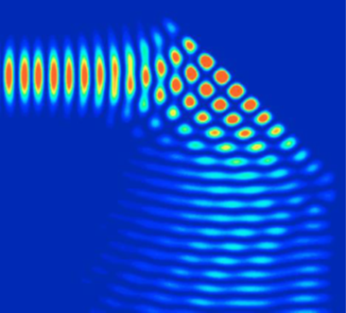

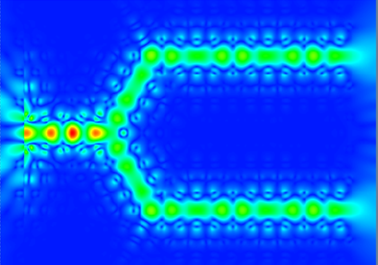

Grating couplers

Slide 2
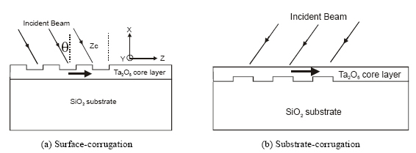
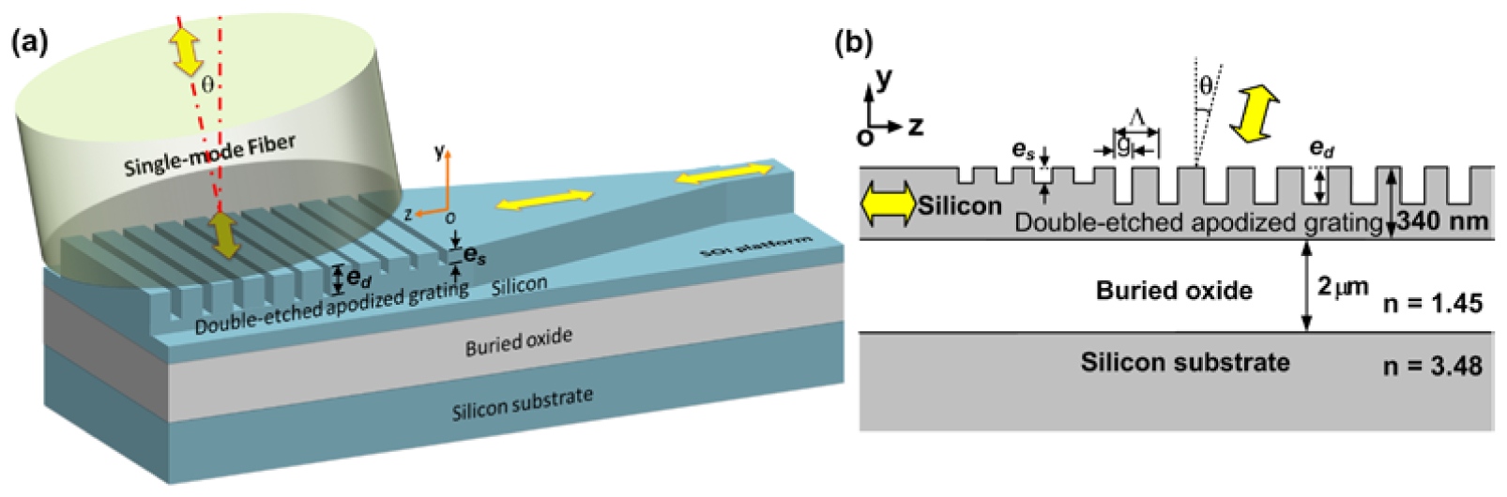
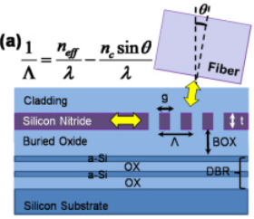
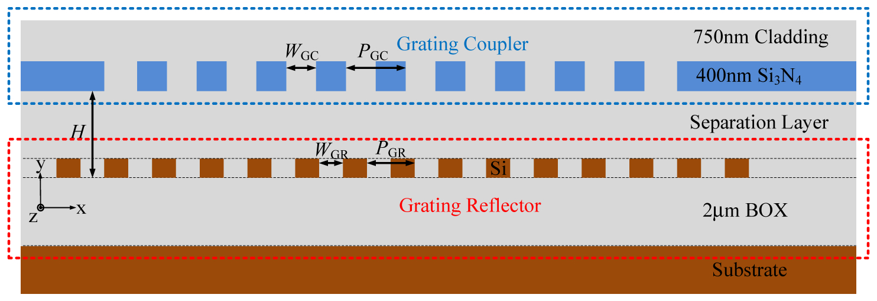
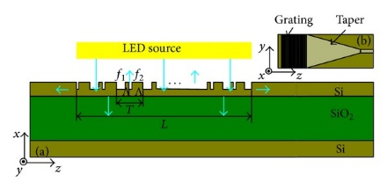


Introduction
Grating coupler (GC) is a widely used I/O device to couple light between fibre (or free-space) and sub-micrometer waveguides.
Two typical applications: grating coupler based on CMOS-compatible Silicon-on-Insulator (SOI) platform [1] and grating coupler for heat assisted magnetic recording (HAMR) [2].
Designs of high coupling-efficiency : grating coupler with distributed Bragg reflectors (DBR) [3] or grating reflectors [4], binary blazed grating coupler [5], double-etched apodized grating coupler [6] et al..
Regular GC on SOI platform
Grating coupler for HAMR application
GC with DBR
GC with grating reflector
Binary blazed GC
Double-etched apodized GC
[1] S. M. Csutak, et al., “CMOS-Compatible Planar Silicon Waveguide-Grating-Coupler Photodetectors Fabricated on Silicon-on-Insulator (SOI) Substrates,” IEEE JQE. VOL. 38, NO. 5, 477-480 (2002)
[2] Chubing Peng, et al., "Input-grating couplers for narrow Gaussian beam: influence of groove depth," Opt. Express 12, 6481-6490 (2004);
[3] Huijuan Zhang, et al., "Efficient silicon nitride grating coupler with distributed Bragg reflectors," Opt. Express 22, 21800-21805 (2014)
[4] Jinghui Zou, et al., "Ultra efficient silicon nitride grating coupler with bottom grating reflector," Opt. Express 23, 26305-26312 (2015)
[5] Li, H., et al. “ Large-area binary blazed grating coupler between nanophotonic waveguide and LED ,” The Scientific World Journal, 1-6 (2014).
[6] Chao Li, et al. "CMOS-compatible high efficiency double-etched apodized waveguide grating coupler," Opt. Express 21, 7868-7874 (2013);

Slide 3
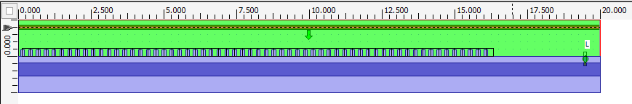
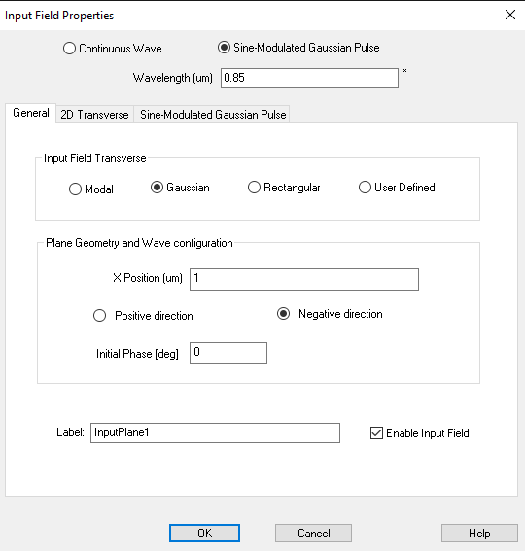
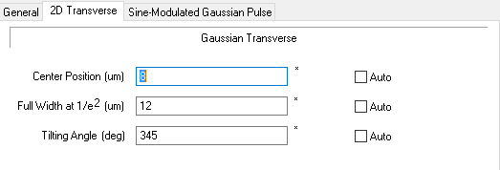
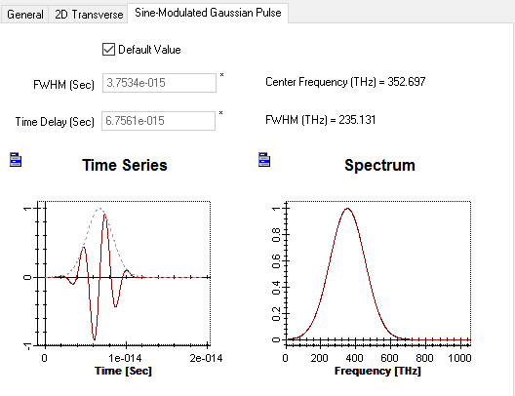
2D FDTD simulation
Design of grating coupler
SMGP with Gaussian transverse and a tilting angle

Slide 4
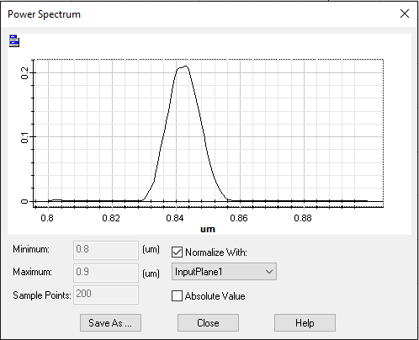
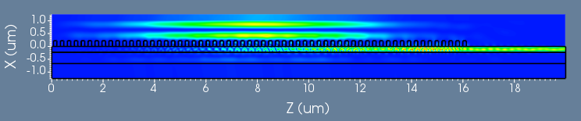
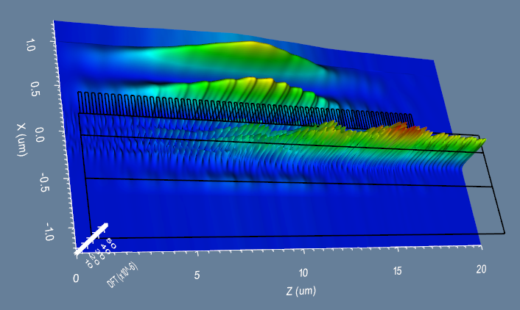
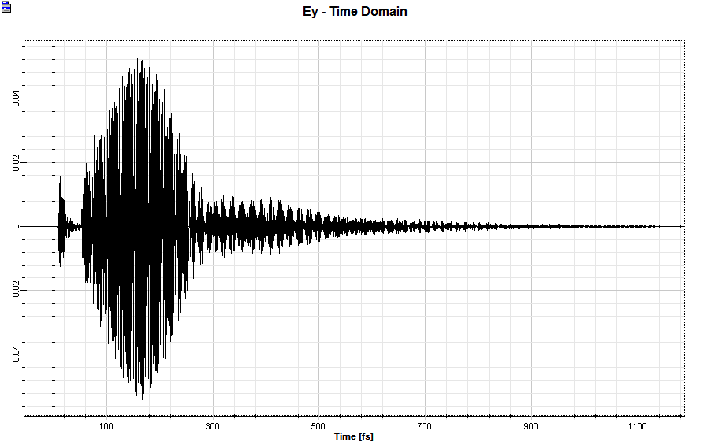

Simulation results
The power spectrum from the line detector.
The intensity image (2D & 3D) of Ey for wavelength 0.843um from the area detector.
The Ey field in time domain from the point detector.
Note: a movie is recorded below during the CW simulation for the wavelength of 0.843 um. (can be played in PPT. file)

