Slide 1
OptiSystem applications: Photodiode sensitivity modelling

Slide 2
Introduction
Photodetector sensitivity modelling
One of the main working parts of any optical receiver is the photodetector (which converts optical power to an electric current). Either a PIN or APD (avalanche photodiode) photodetector can be used depending on the system performance objectives.
The bit error rate (BER) is the primary metric used to specify the reliability of a communication transmission system and is normally linked to a Receiver sensitivity value which defines the minimum average optical power that must reach the photodetector to achieve a desired BER performance. Alternatively the Q of the channel can be calculated from sampled signal statistics and used to estimate the system BER (OptiSystem supports both calculation methods).
The photodetector plays an important role in defining the ultimate sensitivity of a basic communication system as it contributes statistical perturbations in the form of shot (quantum-based) and thermal noise. It also introduces a dark current (which can be viewed as DC noise) and has a defined Responsivity (a measure of how much electrical output is obtained per unit of input power) which depends on the wavelength of the incident light and the sensor’s material properties and physical design. In addition to these effects, photodetectors also exhibit a frequency-dependent transfer function due to the presence of a junction capacitance and the need to connect to a load resistor to measure the received signal (for this analysis the transfer function is assumed to be ideal)
The following four examples demonstrate how to setup and measure (using OptiSystem) the receiver sensitivities of PIN and APD intensity-modulated direct-detection (IM-DD) systems, specifically:
Quantum-limited ideal PIN photodetector
Thermal-noise limited PIN photodetector
Thermal and shot-noise APD performance
PIN photodetector with optical pre-amplification
The reference file for this application note is: PIN and APD Receiver Sensitivity Analysis Version 1_0 24 Jan 17.osd.

Slide 3
Ideal photodetector (PIN)
Photodetector sensitivity modelling
The test configuration is as follows : Bit rate: 10 Gb/s; Wavelength = 1550 nm; PIN responsivity: 1 A/W; Dark current = 0 nA; Sequence length = 1048576.
As the receiver is ideal its only noise source is the PIN shot (quantum) noise - the thermal noise contribution has been disabled. The receiver makes an error when an expected Logic 1 (ON signal) sees no photons (Poisson statistics). The absolute threshold of the Data Recovery component is set to 1E-12 to verify this condition.
The minimum number of photons/bit required to achieve a given BER can be calculated as follows: BER = 1/2 * exp (-2*N) where N is the average number of photons per bit. For the example below the attenuator was set to 58.1 dB (average photons per bit ≈ 6). The resulting expected quantum limit performance is LOG(BER) = -5.51.
For the simulation run below, the BER Test Set shows that three bit errors were detected (LOG(BER) = -5.54)
REF: L. Kazovsky, S. Benedetto, A. Willner, Optical Fiber Communication Systems, Artech House (1996), pp. 199-200
Layout: Ideal optical receiver (PIN)
To model quantum-limited performance the Shot Noise Distribution has been set to the Poisson statistical noise model
A Component script has been set up to calculate the average photons arriving per bit interval (=Sampled Signal Power (Photons)/Bandwidth)
The BER Test Set is the best tool to model quantum-limited performance as we need to count (over a very long sequence) the number of times that no photons are received over a specified bit interval (but expecting a Logic 1 ON state)

Slide 4
Thermal noise limited PIN (1)
Photodetector sensitivity modelling
In this example the receiver sensitivity of a PIN photodiode (for Q=7, BER=1E-12) is determined based on the following configuration: Bit rate: 100 Mb/s; Wavelength = 1550 nm; Load resistance: 100 ohm; Temp = 300K; PIN responsivity: 0.95 A/W
In this case the primary noise source is the PIN thermal noise (Thermal noise current = 91 nA). The required receiver sensitivity is approximately -31.7 dBm.
NOTE: In the reference the load resistance is set to 200 ohm. As an additional amplifier noise figure of 3 dB is included in the REF (to model an electrical post-amplifier), we have reduced the load resistance to 100 to account for this factor of 2 increase in noise.
REF: Keiser, Gerd; “Optical Fiber Communications”, 4th Ed., Tata McGraw Hill, 2008 (pp 261-262)
The PIN Photodiode includes theoretical calculations for thermal and shot noise. You can verify the standard deviation (RMS) levels of these noise sources under Component Results
The Eye Diagram Analyzer can be used to validate the signal statistics and expected error performance (Q factor)
Layout: Thermal noise limited (PIN)
The average received optical power is approx. -31.7 dBm thus confirming the OptiSystem noise model’s alignment to the theoretical calculation for receiver sensitivity

Slide 5
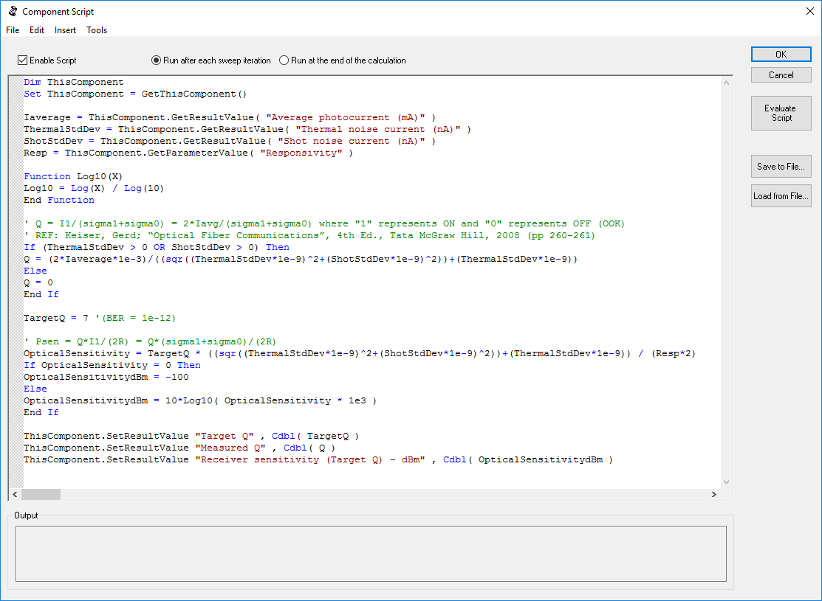
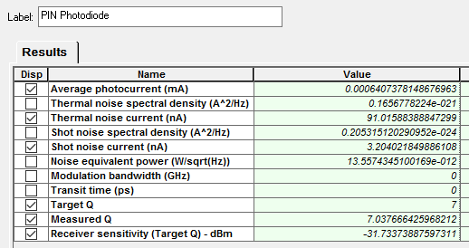
Thermal noise limited PIN (2)
Photodetector sensitivity modelling
The Component script feature can be used to perform custom calculations and results. If needed, parameters or results from any component on the design canvas can be accessed and used as inputs for calculations.
The VBScript below is associated with the PIN Component . The received signal Q is first calculated and then the Receiver sensitivity is calculated based on a target Q (the measured Q can also be used).
To access the Component script, right-click on the component and select Component Script from the pull-down menu
Access Parameters and Calculation results from PIN Component
Calculate Q factor from average received signal photocurrent and RMS levels for Logic 1 (thermal + shot) and Logic 0 (shot noise)
Q = 2*Iavg/(Sigma1 + Sigma0)
Calculate Receiver sensitivity:
RxSen = Q*(Sigma1+Sigma0)/(2*R)
Export results to the Results tab (performed at the end of each simulation run)
Note: These custom results need to be manually added to the Component Results!

Slide 6
Thermal/shot noise APD
Photodetector sensitivity modelling
In this example the receiver sensitivity of an APD photodiode (for Q=7, BER=1e-12) is determined based on the following configuration: Bit rate: 100 Mb/s; Wavelength = 1550 nm; Load resistance: 100 ohm; Temp = 300K; PIN responsivity: 0.95 A/W; Gain(M) = 10; F(M) = 5.
In this case the primary noise source remains the APD thermal noise (Thermal noise current = 100 nA) but the shot noise increases due to the APD gain and excess noise factor (Shot noise current = 21 nA). However, as the signal also undergoes gain the overall performance is improved in comparison to the PIN model (the required receiver sensitivity is approximately -42 dBm).
NOTE: In the reference the load resistance is set to 200 ohm. As an additional amplifier noise figure of 3 dB is included in the REF (to model an electrical post-amplifier), we have reduced the load resistance to 100 to account for this factor of 2 increase in noise.
REF: Keiser, Gerd; “Optical Fiber Communications”, 4th Ed., Tata McGraw Hill, 2008 (pp 261-262)
Layout: Thermal and Shot Noise (APD)
The Eye Diagram Analyzer can be used to validate the signal statistics and expected error performance (Q-factor)
The average received optical power is approx. -41.2 dBm thus confirming the OptiSystem noise model’s alignment to the theoretical calculation for receiver sensitivity

Slide 7
PIN with Optical Pre-Amp (1)
Photodetector sensitivity modelling
In this example the receiver sensitivity of an PIN photodiode with an optical pre-amplifier (for Q=7, BER=1e-12) is modelled based on the following configuration: Bit rate: 100 Mb/s; Wavelength = 1550 nm (193.4145 THz) ; OA Gain=30 dB; OA_NF=4 dB; Optical Filter BW =Bitrate*2; PIN responsivity: 0.95 A/W; Receiver BW = Bit rate
In this case the primary noise source is assumed to be the signal-ASE beat noise (as we are applying a channel filter after the OA, the ASE-ASE beat noise can be neglected).
The thermal noise has also been neglected for this analysis but will generally add a degradation especially when the optical power at the receiver is low (less than 1 mW)
The receiver sensitivity is calculated as follows: RcvrSenPwr = NFLinear*h*Freq*RxBW*(Q^2 + Q(rf-0.5)^0.5
REF: Optical Communication Systems (OPT428), slides 280-282, Govind P. Agrawal, Institute of Optics, University of Rochester, Rochester, NY 14627 (http://www.optics.rochester.edu/users/gpa/opt428c.pdf - Accessed 9 Jan 2017)
Layout: Optical pre-amplifier (PIN)
The electrical receiver bandwidth is set by the parameter Bandwidth(Shot) = Bit rate.
The Eye Diagram Analyzer can be used to validate the signal statistics and expected error performance (Q-factor)
The average received optical power is approx. -57.3 dBm thus confirming the OptiSystem noise model’s alignment to the theoretical calculation for receiver sensitivity
The Optical PreFilter is an ideal rectangular filter with bandwidth = 2*Bit rate (centered at 193.414 THz)

Slide 8
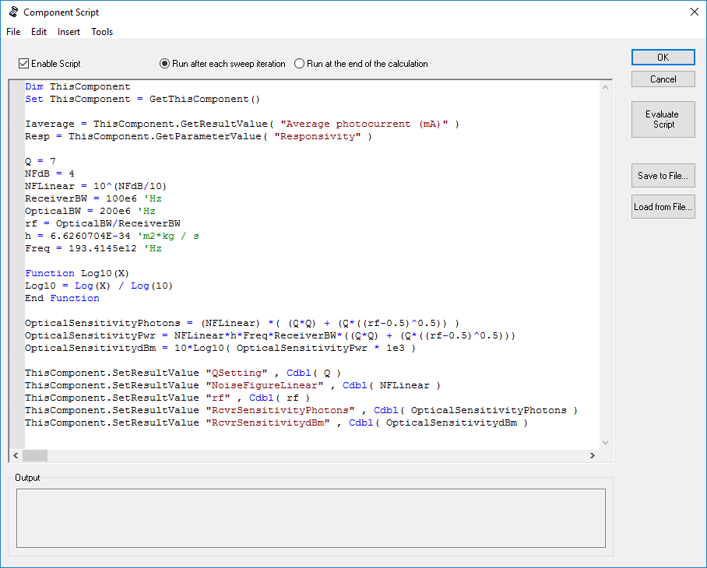
PIN with Optical Pre-Amp (2)
Photodetector sensitivity modelling
The VBScript below is associated with the PIN Component (Layout: Optical pre-amplifier (PIN)). The optical sensitivity is calculated three ways: Photons per bit, Power (W), Power (dBm)
The Bandwidth ratio (rf) defines the ratio of the optical filter bandwidth to that of the electrical receiver bandwidth (keeping this ratio low helps to improve the receiver sensitivity).
Access Parameters and Calculation results from PIN component
Define local variables for calculations. These values can also be accessed from global parameters.
Calculations for receiver sensitivity (Photons/bit, Power (W), Power (dBm)
Export results to the Component Results tab (performed at the end of each simulation run)

