Slide 1
OptiSystem applications: LIDAR systems design

Slide 2
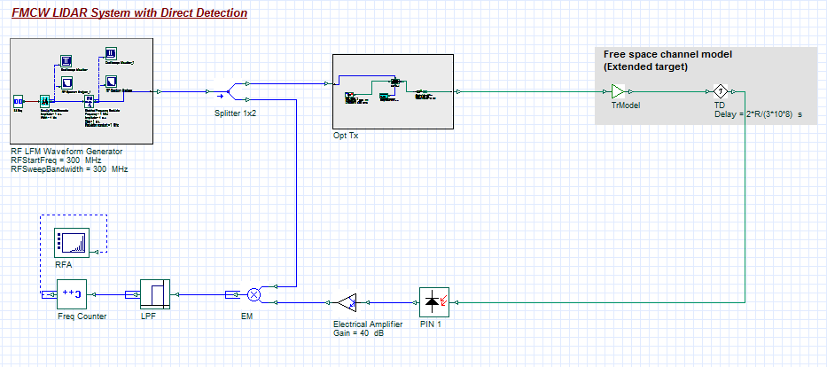
Introduction
Light detection and ranging (LIDAR)
The following four example designs demonstrate how to simulate light detection and ranging systems (LIDAR) using OptiSystem, specifically:
Laser pulse time of flight range measurement
Phase-shift range measurement
Frequency Modulation Continuous Wave (FMCW) range measurement with direct detection
FMCW range measurement with coherent detection
The reference project for this application note is: LIDAR system designs Version 1_0.osd.
Example view of OptiSystem model for FMCW LIDAR using direct detection

Slide 3
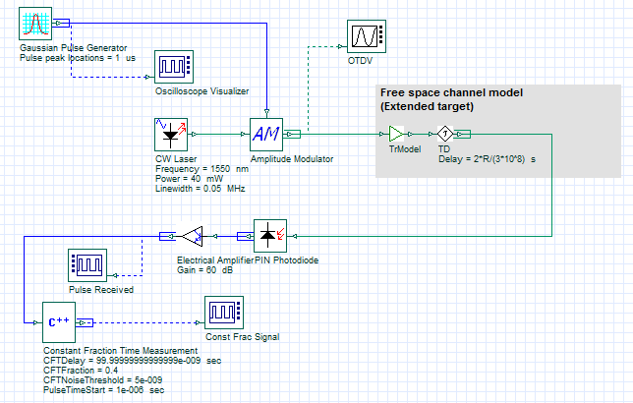
Range measurement (Time of flight) (1)
LIDAR design
Using laser pulses, the time of flight range measurement method measures the time it takes for a transmitted pulse to travel from the transmit device to the target and back to the receiver. The range is then calculated from [1]
$R=\frac{TimeofFlight∙c}{2}$
where c is the speed of light.
The received signal power is determined based on an extended target model and is calculated as follows [2]
$P_{r}=P_{t}\frac{{ρD}^{2}\left(τ_{opt}\right){\left(τ_{atm}\right)}^{2}}{4R^{2}}$
where P_{t} is transmitted optical power, D is the receiver aperture diameter, ρ is the reflectivity of the target, τ_{atm} is the atmospheric loss factor, τ_{opt} is the optical transmission system loss factor and R is the target range
To reliably determine the time trigger for the arriving pulse, the Constant Fraction Time Measurement [3] method is used (implemented with our Cpp Component).
REF 1: Laser ranging: a critical review of usual techniques for distance measurement, Optical Engineering, Vol. 40, No. 1. (2001), pp. 10-19 by Markus C. Amann, Thierry Bosch, Marc Lescure, Risto Myllylä, Marc Rioux
REF 2: Ahmed H. Elghandour; Chen D. Ren; Modeling and comparative study of various detection techniques for FMCW LIDAR using OptiSystem, Proc. SPIE 8905, International Symposium on Photoelectronic Detection and Imaging 2013: Laser Sensing and Imaging and Applications, 890529 (September 19, 2013)
REF 3: Fast-Timing Discriminator Introduction, Ortec Inc., http://www.ortec-online.com/-/media/ametekortec/other/fast-timing-discriminator-introduction.pdf?la=en (accessed 10 Feb 2017)
Layout: Range finder (TofF)

Slide 4
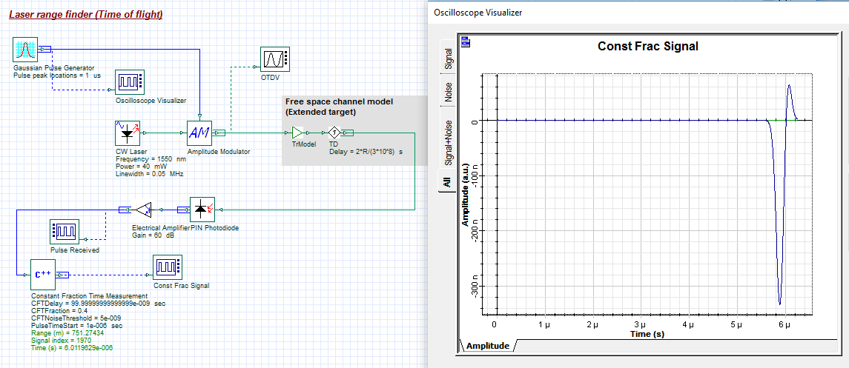
Range measurement (Time of flight) (2)
LIDAR design
In the example below, a Gaussian pulse (Peak pulse time = 1 us) is transmitted optically and reflected from a virtual target (defined by the Free space channel model (Extended target)). After being subjected to attenuation and delay, the received signal is detected and post-processed by the Cpp Component Constant Fraction Time Measurement.
The received pulse is time triggered at the time sample 6.02e-06 sec and in turn the range is found to be 751.27 m (compared to the global parameter range setting of 750 m). The sensitivity of the Constant Fraction Discriminator can be modified by changing the input parameters CFTDelay, CFTFraction, CFTNoiseThreshold.
Global parameter settings for LIDAR system.
The Constant Fraction Discriminator works by first making a copy of the received signal, inverting it, and applying a delay (CFTDelay). The original signal is then reduced in amplitude by the factor CFTFraction and summed with the copied signal waveform. An example of the output waveform is shown here. The zero-crossing point (from negative to positive) is then found and acts as the time trigger to determine the received pulse time.

Slide 5
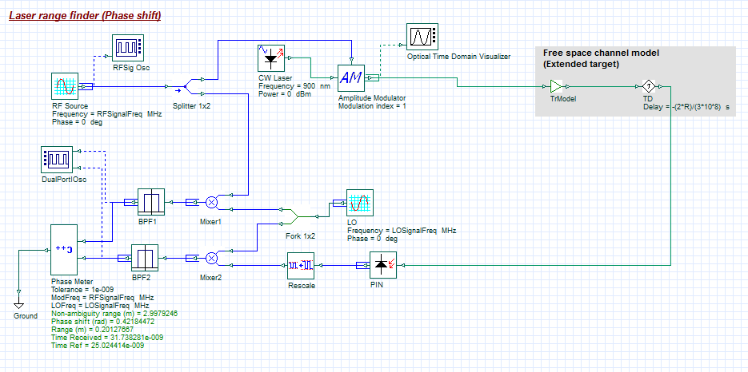
Range measurement (Phase shift)
LIDAR design
Another way to measure the range of an object/target is with a phase-shift range finder. With this method, the optical source is modulated at specific frequency R_{f} and transmitted towards the target. The reflected signal is then detected with a PIN photodiode followed by a heterodyne receiver. The phase shift resulting from the transmission of the optical signal (Δφ), relative to the original reference signal, is then measured and used to calculate the range as follows [1]:
$R=\frac{c∆φR_{f}}{4π}$
To improve the accuracy of this system, the reference and received modulated signals can be mixed with a local oscillator R_{LO} to down-convert the received waveform to a lower frequency (R_{LO} – R_{f} ). These signals are then band-pass filtered (to reduce noise) and processed by a Phase Meter (using our programmable Cpp Component)
REF 1: Laser ranging: a critical review of usual techniques for distance measurement, Optical Engineering, Vol. 40, No. 1. (2001), pp. 10-19 by Markus C. Amann, Thierry Bosch, Marc Lescure, Risto Myllylä, Marc Rioux
Layout: Range finder (Phase Shift)
In this example the range has been calculated as 0.2012 m (compared to the global parameter setting of 0.2 m)

Slide 6
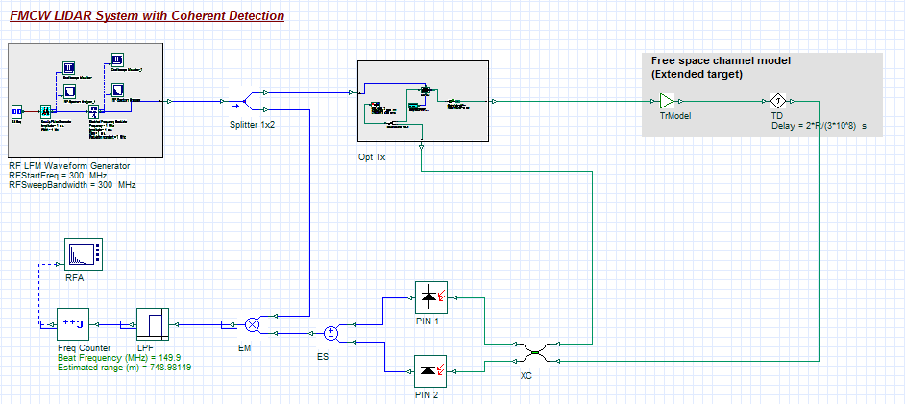
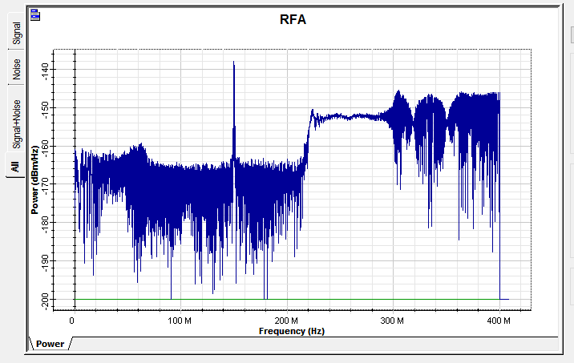
Range measurement (FMCW)
LIDAR design
The last method to be presented is the frequency modulated continuous wave (FMCW) LIDAR. Two models have been developed: FMCW LIDAR with Direct Detection and FMCW LIDAR with Coherent Detection. Both models work on the same principle. A frequency modulated optical transmitter is sent out towards the target and the reflected signal is detected (by a photodetector) and mixed with the original linear frequency modulated (LFM) signal. As the received signal is time-delayed, an intermediate frequency signal is produced. Using a frequency counter (implemented with our Cpp Component) the detected R_{f} signal is measured and then used to calculate the range as follows [1]:
$R=\frac{R_{f}∙c∙RampPeriod}{2∙DeltaFreq}$
where the RampPeriod is equal to the global parameter Time window and the DeltaFreq is equal to the parameter RFSweepBandwidth (set within the component parameters of the Subsystem RF LFM Waveform Generator)
The only difference between both detection systems is that one uses square law detection whereas the other uses a coherent homodyne detector to recover the incoming optical signal before mixing (the latter thus provides a higher sensitivity as the detection process is shot-noise limited)
REF: Ahmed H. Elghandour; Chen D. Ren; Modeling and comparative study of various detection techniques for FMCW LIDAR using OptiSystem, Proc. SPIE 8905, International Symposium on Photoelectronic Detection and Imaging 2013: Laser Sensing and Imaging and Applications, 890529 (September 19, 2013)
Layout: FMCW Coherent Detection
Received electrical spectrum. The peak is the intermediate frequency signal resulting from the mixing between the reference and received FM waveforms
In this example the range has been calculated as 749 m (compared to the global parameter setting of 750 m)

