Slide 1
OptiSystem applications: BER analysis of BPSK with RS encoding

Slide 2
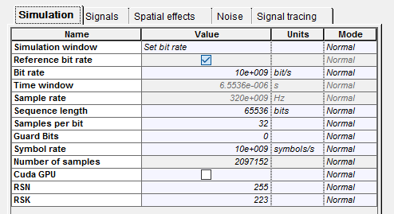
Introduction
BER Analysis of BPSK with Reed Solomon encoding
This application note demonstrates how to perform the BER testing of a BPSK system with Reed Solomon (RS) encoders and decoders.
The typical output of a BER analysis is a set of waterfall curves that map a system’s BER results against gradually increasing background noise levels, defined as Eb/No (the ratio of energy per bit to noise density). When Reed Solomon encoding is applied, the BER performance can be significantly improved as RS encoding can correct multiple errors per symbol block.
An OptiSystem project has been built to allow for the automatic creation of BER waterfall curves for different settings of the RS encoder/decoder. The project folder includes three files:
The OptiSystem project for the BPSK system analysis (BER_Calculation_RS_FEC_BPSK.osd)
The Excel output file where the results are exported and plotted (BER Analysis BPSK FEC - Export Excel.xlsx)
The data tracking file which provides more detailed information on the simulation results (BER_FEC_Analysis_Tracking.txt)
The BER results for three common RS coding schemes (RS4, RS8, RS16) can be seen in the file BER Analysis BPSK FEC - Export Excel.xlsx. Prior to running a simulation these coding schemes can be set from the OptiSystem global parameters RSN and RSK. For example for RS16, RSN = 255 and RSK = 223
These global parameters are linked to the “RS Index N” and “RS Index K” parameters of the FEC Encoder and FEC Decoder

Slide 3
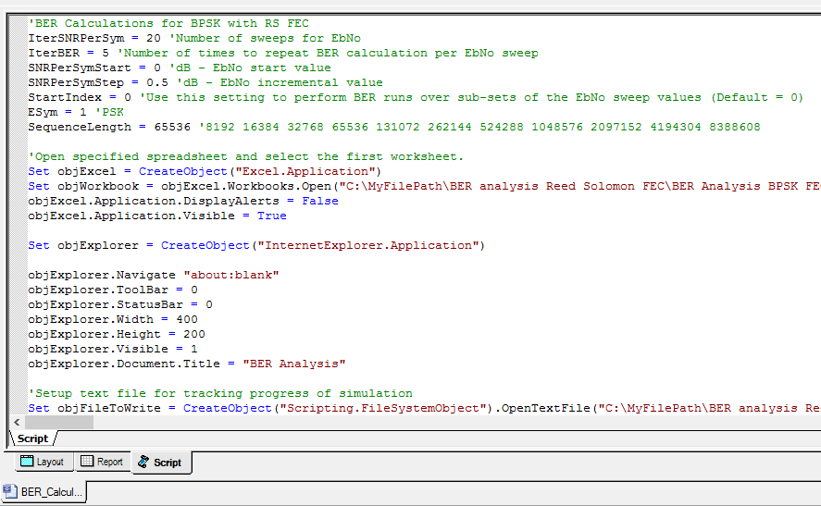
How to run a BER simulation (1)
BER analysis – RS encoding
Open the OptiSystem project BER_Calculation_RS_FEC_BPSK.osd
After determining which RS coding scheme you wish to run (see previous slide for further information), select the tab “Script” (see GREEN box below)
Got to the line “Set objWorkbook = objExcel.Workbooks.Open(…)” (see BLUE box below) and set up the file path information such that it matches the location of the Excel export file on your computer. The format should be as follows: "C:\YourFilepath\BER analysis Reed Solomon\BER Analysis BPSK FEC - Export Excel.xlsx ")
File path for Excel spreadsheet
OptiSystem Script tab

Slide 4
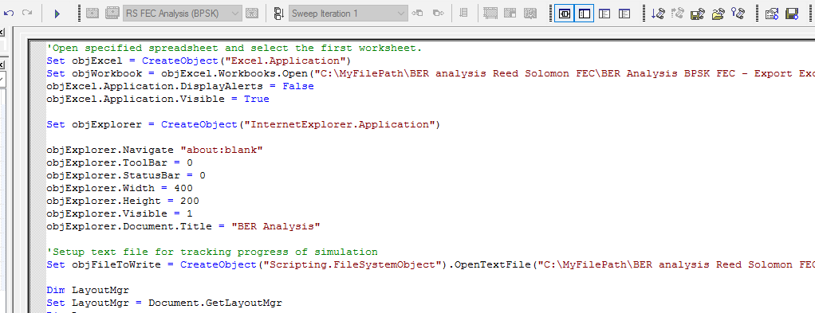
How to run a BER simulation (2)
BER analysis – RS encoding
Go to the line “Set objFileToWrite = CreateObject("Scripting.FileSystemObject").OpenTextFile(…)” (see GREEN box below) and set up the file path information such that it matches the location of the data export file on your computer. The format should be as follows: "C:\YourFilepath\BER analysis Reed Solomon\BER_FEC_Analysis_Tracking.txt",2,true)“
Go to the code section where the BER calculations are exported to Excel (see RED box below). Make sure to set the second number in the brackets (objExcel.Cells (7+i, 8)) to align with the configuration for your simulation (no FEC, RS4, RS8, RS16 or 6, 7, 8 or 9; respectively).
Run script action button
File path for data file
IMPORTANT: On the third line of objExcel.Cells(…) make sure to set the second value to 6, 7, 8 or 9 depending on the FEC configuration. Otherwise the wrong column will be populated with the BER results

Slide 5
How to run a BER simulation (3)
BER analysis – RS encoding
On the upper right menu bar, left-click select the “Run Script” action button (see GREEN box previous slide). The simulation will start.
The Excel spreadsheet will automatically open. At the end of each BER iteration, the simulation data for the BPSK system will be exported to the associated data columns in the spreadsheet (including Eb/No, Eb/No (dB) and one of the BER test configurations: BER (No FEC), BER(RS4), BER(RS8), or BER(RS16) (see RED boxes)
During the simulation a progress box will appear to provide information on the status of the simulation sweeps. Once the message “Simulation complete!” is posted, this dialog box can be closed
BER vs Eb/No simulation results are automatically plotted for the specified RS format. Also the associated BER theoretical limit is calculated (obtained from column BER – Th).
As expected, RS16 provides the most powerful error correction capability as it can correct up to 16 symbols per correcting block. It however requires a larger number of redundant symbols (overhead bits)
The data for each row is updated after a simulation run of the OptiSystem script

Slide 6
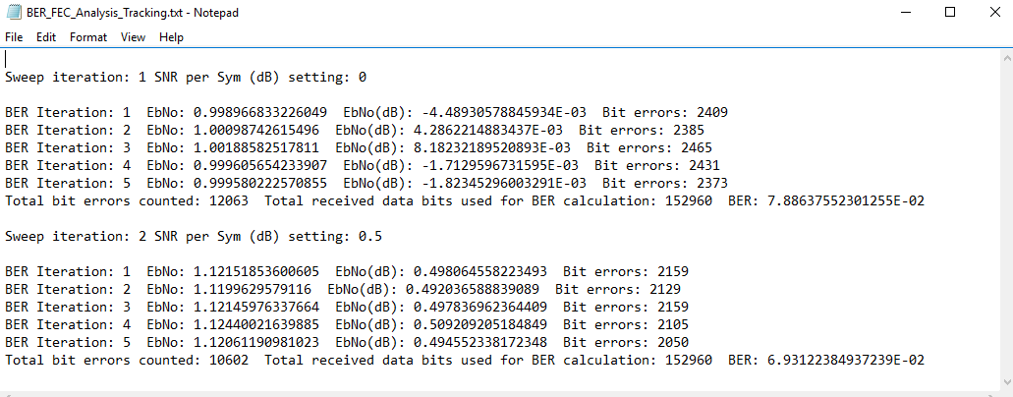
How to run a BER simulation (4)
BER analysis – RS encoding
In addition to the Excel spreadsheet analysis tool kit, a data file is also created during the simulation. An example view of the data file content (from BER_FEC_Analysis_Tracking.txt) is shown below. The content of this file can be modified as required by using the objFileToWrite.WriteLine(“…") command in the simulation script
Sample view of BER_FEC_Analysis_Tracking.txt
In this example, five BER measurement iterations were performed per SNR per Symbol setting.

Slide 7
Notes on BER & FEC analysis (1)
BER analysis – RS encoding
To create a waterfall curve for a specified modulation format, the VBScripting feature of OptiSystem is used to set up the test conditions, create an instance of OptiSystem, run the simulation and retrieve results from the components and visualizers (thus all simulation runs must start from the Scripts tab). If you wish to run a standalone simulation, to verify for example the system setup, start the simulation from the Layout tab (in this case the script will be ignored)
For each simulation run, the parameter Eb/No is configured based on settings in the script and in turn applied to a white noise source in the project layout (specifically the Noise power setting for the AWGN I noise source)
To set the number of iterations in your simulation, the start value for Eb/No, and the level of change of Eb/No per iteration use the parameters IterSNRPerSym, SNRPerSymStart and SNRPerSymStep (see below)
Also if you would like to run a reduced number of iterations over a specific sub-set of the sweep indices, use the parameter StartIndex to define at which index point you would like to start your iterations.
Set the total number of iterations with IterSNRPerSym
When set to a value greater than 1, multiple runs (equal to this value) will be performed for each Eb/No setting and averaged
Set the start value of Eb/No with SNRPerSymStart
NOTE: This value is assumed to be in dB!
Set the incremental value of Eb/No with SNRPerSymStep
NOTE: This value is assumed to be in dB!
Use the parameter StartIndex to fine tune your iterations by performing runs over a specific set of iteration indices
TIP: To improve the accuracy of BER results under low noise conditions (where the symbol/bit error counts may be quite low) or when a strong FEC encoding is used, it is recommended to increase the Sequence length setting. Also you can increase the parameter IterBER to a value greater than 1 (when this is done, the simulation will perform extra runs for each noise level and take the average of the results)

Slide 8
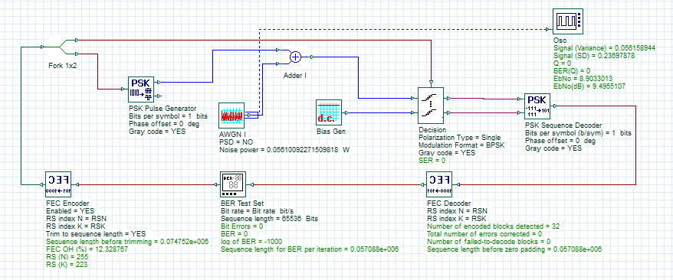
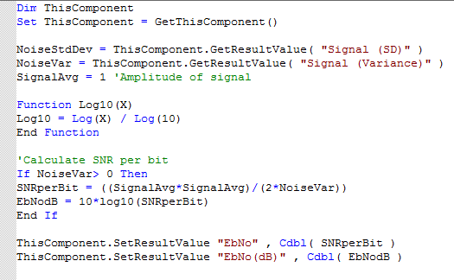
Notes on BER & FEC analysis (2)
BER analysis – RS encoding
To verify that the noise settings are being properly applied to the I channel, the Eb/No parameter is re-calculated in OptiSystem through a Component script procedure written in the Oscilloscope Visualizer (this Visualizer includes a calculation result for Noise (Variance) which is applied to the calculation for Eb/No)
The results Eb/No are in turn exported to the Excel analysis spreadsheet and used for plotting of the BER waterfall curves
The Bit Errors (and the associated Sequence length for BER per iteration) are obtained from the BER Test Set
For each iteration, the Noise power is updated via the simulation script (based on the Eb/No setting)
Component script for Osc Visualizer

Slide 9
Notes on BER & FEC analysis (3)
BER analysis – RS encoding
The FEC Encoder works by adding redundant bits (n-k) to information blocks of length k. The bit sequence at the output of the FEC Encoder will thus be longer than the input. When performing tests on higher order modulation systems, the parameter Trim to sequence length should be enabled. This will ensure that the Decision component correctly recovers all information and redundant (error correcting) symbols that cover the length of the original sequence length.
At the FEC Decoder, the redundant symbols will then be removed and thus the output of the Decoder will have a shorter sequence than the original sequence from the BER Test Set. This is not a problem as the BER Test Set automatically checks for this condition and only applies error counting against the shorter sequence length (this can be confirmed by viewing the result Sequence length for BER per iteration which is equal to 57088; equal in value to the output sequence of the FEC Decoder)
Output sequence has been trimmed to original sequence length (65536)
The FEC overhead (in %) is measured using the OptiSystem Component script. See the component script for further details.
After the removal of error-correction bits, the output sequence length is reduced to 57088.

