Slide 1

Fiber Optic Gyroscope Systems Design

Slide 2
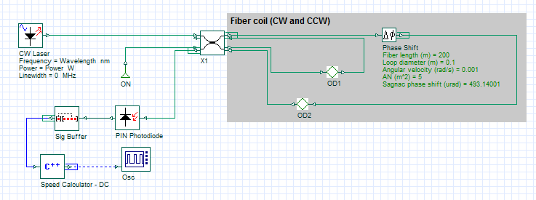
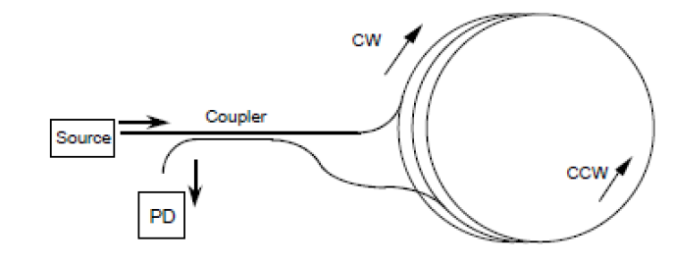

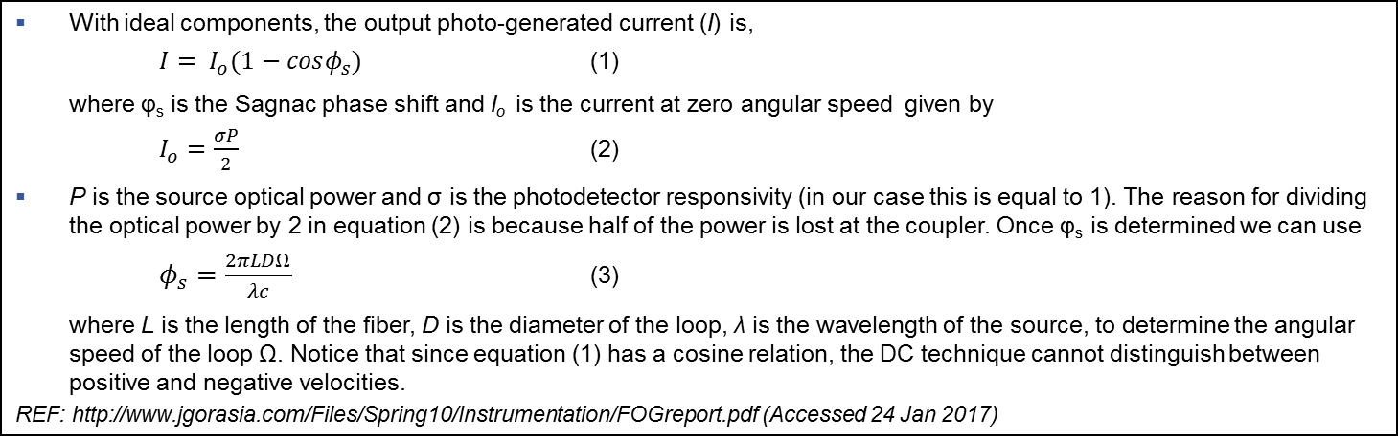
DC detection method
FOG systems design
With ideal components, the output photo-generated current (I) is,
$I= I_{o}(1−cosφ_{s})$ (1)
where φ_{s} is the Sagnac phase shift and I_{o} is the current at zero angular speed given by
$I_{o}=\frac{σP}{2}$ (2)
P is the source optical power and σ is the photodetector responsivity (in our case this is equal to 1). The reason for dividing the optical power by 2 in equation (2) is because half of the power is lost at the coupler. Once φ_{s} is determined we can use
  $φ_{s}=\frac{2πLDΩ}{λc}$ (3)
where L is the length of the fiber, D is the diameter of the loop, λ is the wavelength of the source, to determine the angular speed of the loop Ω. Notice that since equation (1) has a cosine relation, the DC technique cannot distinguish between positive and negative velocities.
REF: http://www.jgorasia.com/Files/Spring10/Instrumentation/FOGreport.pdf (Accessed 24 Jan 2017)
Layout: I-FOG DC Detection
The Sagnac phase shift (resulting from angular rotation) is applied to the CW direction and is calculated as follows:
(8*pi* FiberCoilArea * NumberOfCoils * AngularVelocity )/( ReferenceWavelength* c)

Slide 3

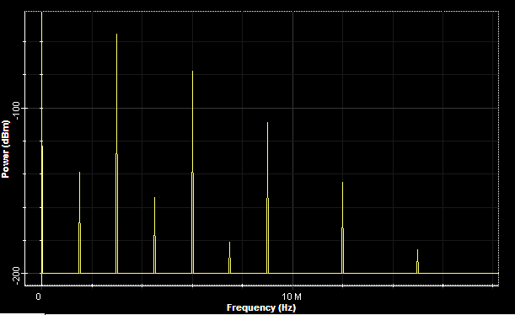
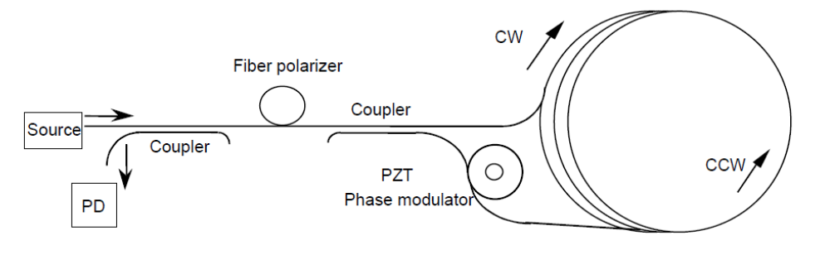
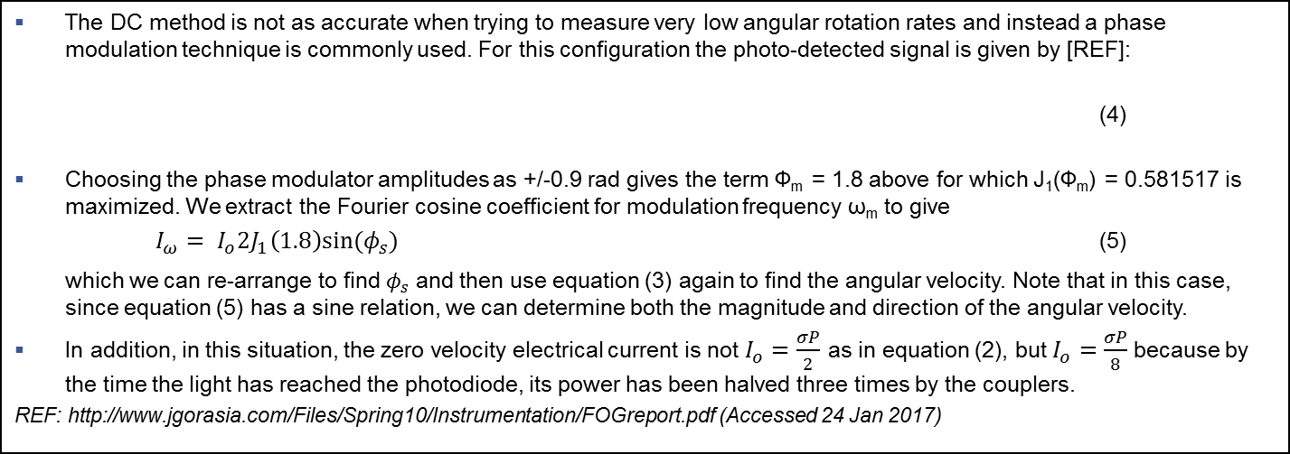
Phase modulation method (1)
FOG systems design
The DC method is not as accurate when trying to measure very low angular rotation rates and instead a phase modulation technique is commonly used. For this configuration the photo-detected signal is given by [REF]:
(4)
Choosing the phase modulator amplitudes as +/-0.9 rad gives the term Φ_{m} = 1.8 above for which J₁(Φ_{m}) = 0.581517 is maximized. We extract the Fourier cosine coefficient for modulation frequency ω_{m} to give
$I_{ω}= I_{o}2J_{1}\left(1.8\right)sin(φ_{s})$ (5)
which we can re-arrange to find $φ_{s}$ and then use equation (3) again to find the angular velocity. Note that in this case, since equation (5) has a sine relation, we can determine both the magnitude and direction of the angular velocity.
In addition, in this situation, the zero velocity electrical current is not $I_{o}=\frac{σP}{2}$ as in equation (2), but$I_{o}=\frac{σP}{8}$ because by the time the light has reached the photodiode, its power has been halved three times by the couplers.
REF: http://www.jgorasia.com/Files/Spring10/Instrumentation/FOGreport.pdf (Accessed 24 Jan 2017)
The photo-detected signal includes the DC term and all harmonics resulting from the phase shift and modulated signal. The harmonic of interest (to be measured) is at the signal modulation frequency
Schematic of modulation technique (Source: REF) upon which the OptiSystem design was built (Note: the Fiber polarizer was not included in the design)

Slide 4
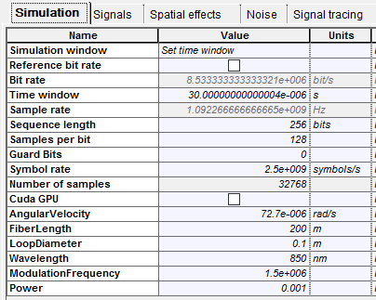
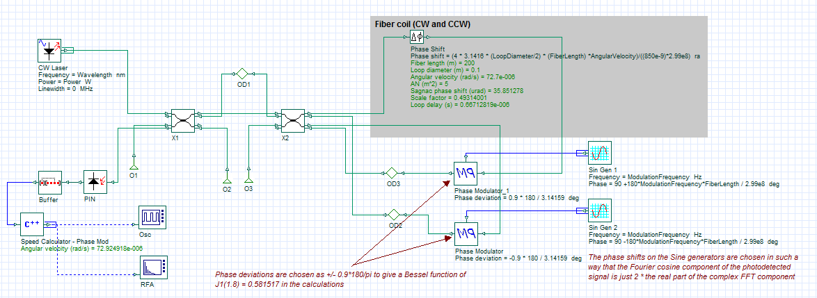
Phase modulation method (2)
FOG systems design
For the OptiSystem design below the angular velocity has been set to 7.27e-5 rad/s (rotation rate of the earth). The settings for the I-FOG are shown in the red box (under Global parameters). The Sagnac phase shift is applied by using the Phase Shift Component and is calculated as follows:
4π (LoopDiameter/2)FiberLengthAngularVelocity/(λ c)
Here we have used our C++ Component to calculate the angular velocity based on the equations from the previous slide. The measured angular velocity (shown as a result below the C++ Component) is 7.29e-5 rad/s
Layout: I-FOG Phase Modulation
The OptiSystem C++ Component can be used to access any OptiSystem signals and perform customized calculations.

